Slide 1
EEA and Norway Grants
Reporting on results and evaluating health programmes
Alex Stimpson
Head of Results and Evaluation
Programme Operators Meeting
Prague, 2 December 2015

Slide 2
Structure
Part 1
Results reporting in the APR
Measuring and reporting on bilateral
Part 2
Evaluation

Slide 3
Where are we now?
Health sector results
395,737 people benefiting from
improved health services
7,050 trained professionals
Source: preliminary data provided by POs, November 2015.

Slide 4
The reporting cycle is based on the Annual Programme Report
November
Donors reports to EFTA
February 15
Annual Prog. Report
October
NMFA Annual Report to Parliament
YEAR
March 31
NFP Strategic Report
31 March
(except CY, MT & SI)
Sector Report to Donors
FMC Status report to EFTA
June
Donors’ Annual Report

Slide 5

What are we looking for from the APRS?
Structure of the Annual Programme Report
And key results sections
1. Executive summary
2. Programme area specific developments
Reporting on Outputs
Reporting on Programme Outcomes
Project selection
Progress of bilateral relations
Monitoring
Need for adjustments
Risk management
Information and publicity
Cross cutting issues
Reporting on sustainability
WHAT ARE WE LOOKING FOR?
REPORTS THAT DEMONSTRATE RESULTS AND PROGRESS TOWARDS OBJECTIVES
SHORT, ANLAYTICAL
SEE ANNOTATED APR TEMPLATE

Slide 6
2. Programme area specific developments
Important developments in the Programme area
(including policy, financial or administrative changes).
Refer to justification in programme proposal and provide updates, including potential synergies with EU programmes, that may have an effect on the planned programme results.
Include statistics and analyse trends in the sector and/or the programme area where possible.
If conditions have changed since the programme proposal, do the changes present risks? How might these might be handled?

Slide 7
Context data
Example: Suicide rates are important context data for programmes with a strong mental health component.
Where does your country stand and what are the trends?

Slide 8
3. Reporting on Programme outcomes
Analyse how the projects’ and Programme’s outputs contribute to the expected outcome(s) defined in the Programme proposal.
Use the programme indicators. Refer to baseline studies/provide a situation analysis.
Use a project example for each outcome to demonstrate results. Use another project example to demonstrate bilateral results.
Brief summary of main risks and mitigating actions.
Relevant horizontal concerns
What worked, what didn’t work, and what could be done better?

Slide 9




A Basic Results Chain
With Key Prompt Questions
Program (Results) Chain of Events
(Theory of Action)
Key Questions
Indirect Influence
7. End results
7. What is our impact on ‘ends’?
WHY?
We want to be around here!
6. Practice/behaviour change
6. Do we influence change?
5. Knowledge, attitude, skill and / or aspirations changes
5. What do people learn? Do we address their needs?
WHAT?
Direct Influence
4. Reactions
4. How do people learn about us?
We are usually around here with our indicators
WHO?
3. Engagement / involvement
3. Who do we reach? Who participates?
Control
2. Activities and outputs
2. What do we offer? How do we deliver?
HOW?
1. Inputs
1. How much does our program cost? (€€s, HR etc)

Slide 10
Analysing progress and results
Key sources of information for your Annual Programme Report
These Reports, together with monitoring and evaluation findings, show progress towards results
Report 44
Aggregated results
Report 15
Individual programme summaries
Report 41
Project
information
Annual Programme Reports:
create the ‘story’ of progress towards results and follow it through each level of analysis
Report 35
Bilateral engagement report

Slide 11
Results example: Mental health
Grants level objective
Improved public
health and reduced inequalities
Programme outcome
Improved mental health services
Project(s)
e.g. centres, access, rehabilitation systems, screening, services
Annual Programme Reports
Describe progress, challenges and opportunities in improving mental health services, contribution of bilateral partners and resulting achievements
Bilateral engagement
DPP/dpp

Slide 12
Context: financials

Slide 13
Aggregate indicators show significant results
395,737 people benefiting from improved health services
7,050 trained professionals
Source: preliminary data provided by POs, November 2015.

Slide 14
Improved mental health is one of the main priorities

Slide 15
Programme outcome/outputs…
in improved mental health services show:
Concentration in the mental health area
Selected results:
  82% satisfaction of users of integrated mental health services
  9,237 youth who have benefited from improved mental health services
  3,000 children and youth get counselling in mental and reproductive health
Add project examples that contribute to this story.

Slide 16

‘Ära tee!’ (Don’t do it!) app with self-help functionalities, based on Norwegian app ‘Stop self-harm’
Source: http://eeagrants.org/News/2015/Web-based-mental-health-services-for-young-people

Slide 17
Progress of bilateral relations
Progress towards strengthening bilateral relations: most important achievements and highlights.
Use of bilateral fund to foster/strengthen bilateral relations, including # of partnerships established, events organised, etc.
Tips
Follow the 4 bilateral outcome areas.
Assess progress in relation to bilateral ambitions.
Use the bilateral indicators in DoRIS.
Using specific examples to assess achievements from any events.
Bilateral results are not always captured by indicators, e.g. networks established, contacts established etc.
What worked, what didn’t work, and what could be done better?
Complementary action: brief summary of results coming from cooperation and exchange of experience with others, if used.
Bilateral thinking (Outcomes)
Extent of cooperation
Shared results
Improved knowledge and mutual understanding
Wider effects

Slide 18
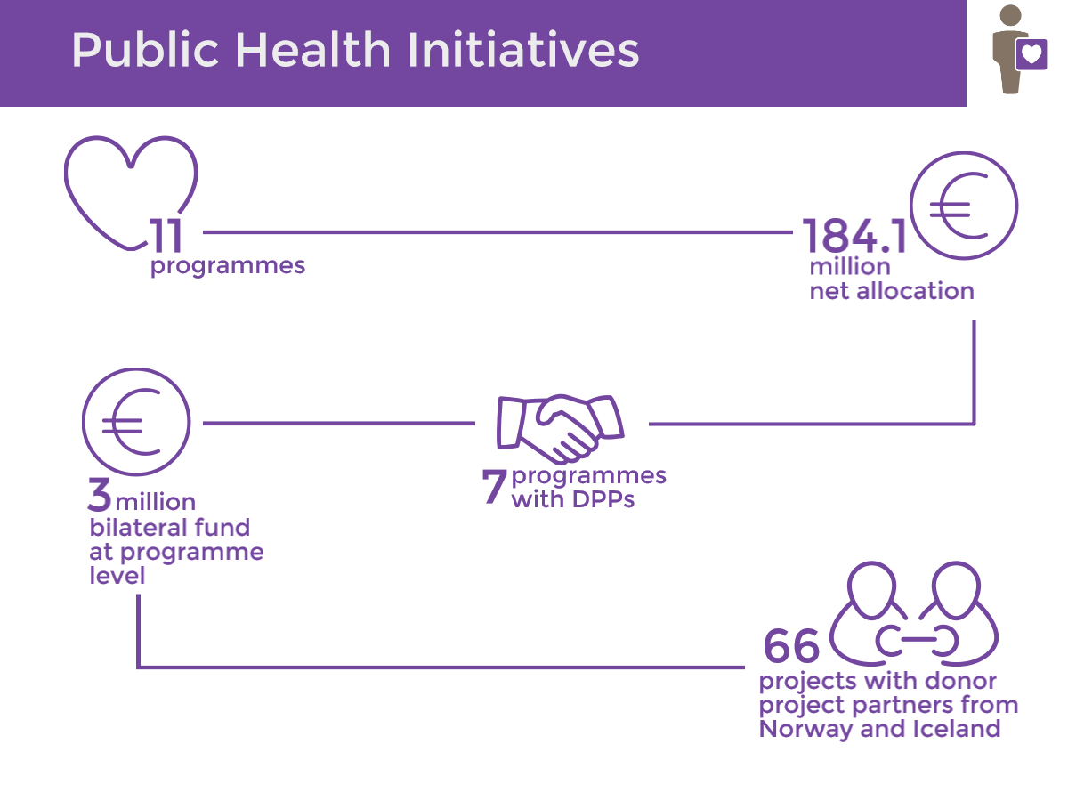

Slide 19
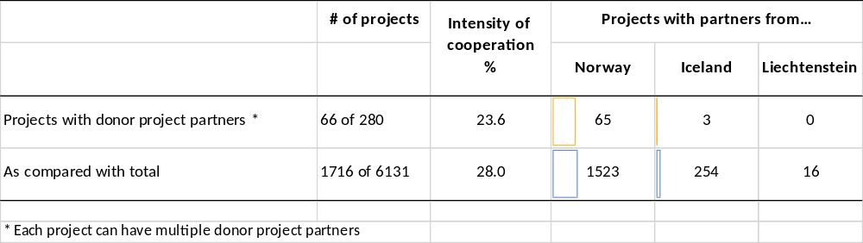
Bilateral fund and intensity of project cooperation
Bilateral fund: 9.5% incurred.
Intensity of cooperation

Slide 20
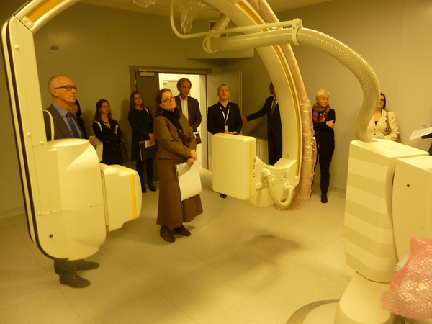
Norwegian health experts visit projects and find out about Poland's health system
Oncology of Wielkopolska - improving and adapting the diagnosis and treatment of cancer
Source: http://eeagrants.org/News/2015/Norwegian-health-authorities-study-visit-to-Poland

Slide 21
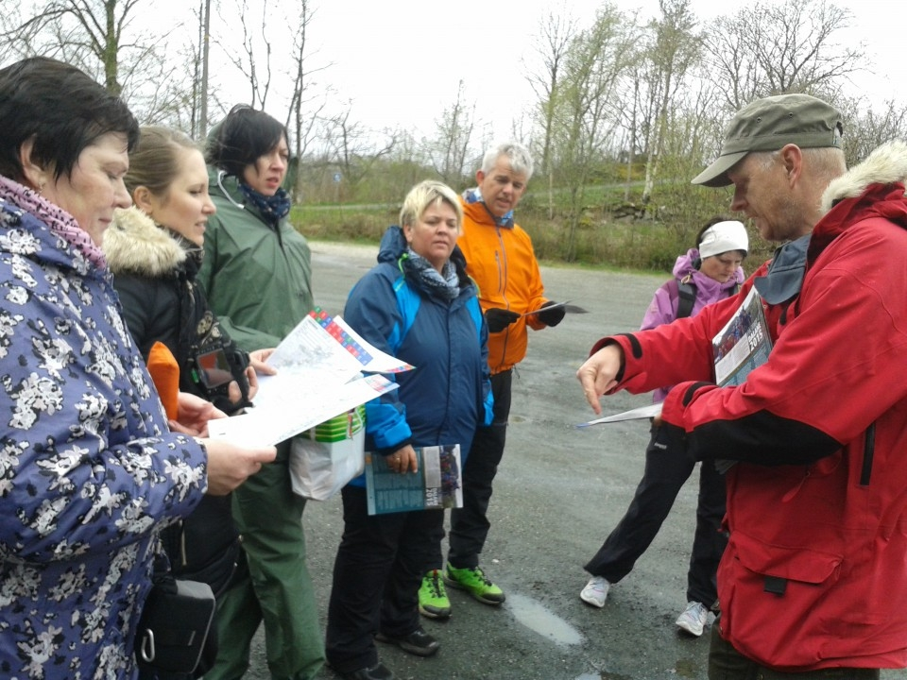
Improving health services for young people in Lithuania
Following the bilateral fund study visit, Plungė and Bjerkreim have continued their cooperation. The two municipalities have now successfully submitted a project application under the Lithuanian ‘Public Health Initiatives’ programme for improving both the accessibility and quality of youth-friendly health care services in Plungė.
Source: http://eeagrants.org/News/2015/Improving-health-services-for-young-people-in-Lithuania
Teaming up for better health
“We are both learning about different approaches in collecting health information, as well as making useful international contacts,”
Source: http://eeagrants.org/News/2015/Teaming-up-for-better-health

Slide 22
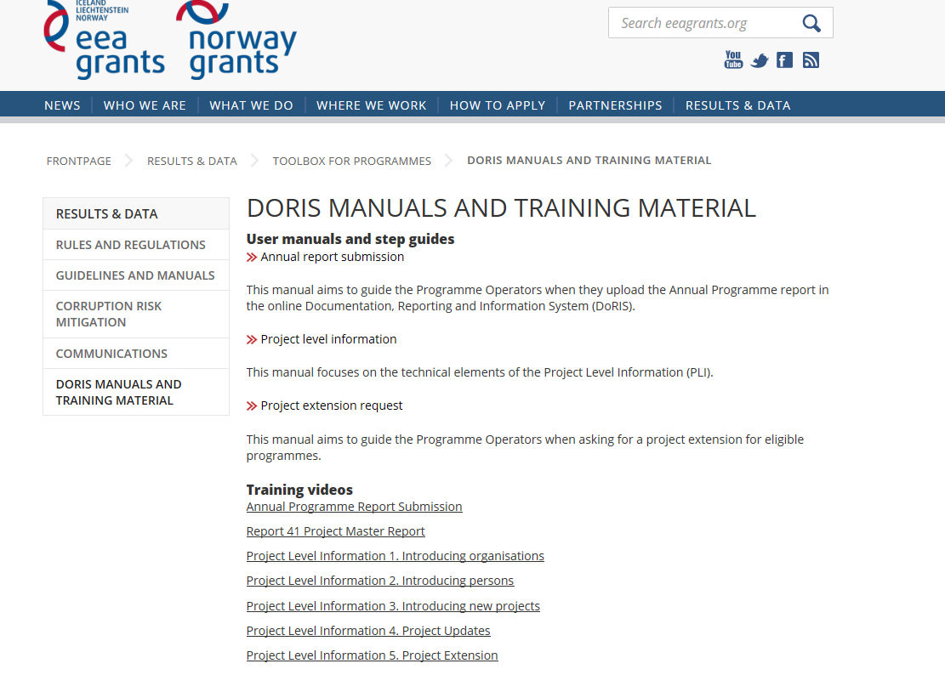

Want to know more?
Uploading the APR and good quality indicators
http://eeagrants.org/Results-data/Toolbox-for-programmes/DoRIS-manuals-and-training-material

Slide 23
In summary…
1. BE CONCISE
2. ANALYSE AND REPORT ON RESULTS RATHER THAN
PROVIDE A DETAILED RECORD
3. ASK THE RIGHT QUESTIONS
ACHIEVEMENTS? FOR WHOM? EVIDENCE?
(USE DATA AND SPECIFIC EXAMPLES)
4. INCLUDE RISKS AND MITIGATING ACTIONS
5. IT’S ABOUT RESULTS:
COHESION, BILATERAL, HORIZONTAL CONCERNS

Slide 24
Structure
Part 1
Results reporting in the APR
Measuring and reporting on bilateral
Part 2
Evaluation

Slide 25
Capturing results
1. Gold standard = programme evaluation
Find out what was achieved, who benefitted, how this linked to the programme’s activities
2. Monitoring e.g. find results and effects after projects have finished
eg: follow-up survey after 6 months
3. Qualitative results = to capture programme effects that are not included in the programme indicators eg APR, FPR

Slide 26
Ongoing donor evaluations / reviews
Bilateral mid-term evaluation (by March-April ’16)
  EE, LV, PL, RO, SK
  Mainly: Research, Scholarship, Cultural exchange,
  (Institutional) Capacity building
  Survey to all POs in the 5 countries
Mid-term review of the Grants (by April-May ’16)
  CY, CZ, EE, LT, PL, PT, RO
  Mainly: Environment, Green Industry Innovation, Justice & Home Affairs, Asylum and Migration, Human and Social development, Health
  Survey to all … forthcoming
Communications review (by May ’16)
  BG, LT, PL, PT, SK
  Mainly: environment, climate change, green industry, civil society, research and scholarships, justice and home affairs
  Survey to NFPs now, POs/PPs for case studies in Jan-Feb

Slide 27
More on the mid-term review
Conducted by The Centre for Strategy and Evaluation Services (CSES)
Purpose: assess efficiency and effectiveness of Grants, in particular programme model/implementation and progress towards overall programme objectives.
Methods: desk review, on-line survey and in-depth case studies.
Today: Stephan Kreutzer, Consultant, CSES, here to meet you and learn more about the programmes.

Slide 28
Evaluation (Regulations)
The regulations outline responsibilities in terms of evaluation…
Article 9.1 Responsibilities of Beneficiary States
1. The Beneficiary State shall carry out evaluations of programmes to assess actual and/or expected effects at the outcome level. It shall present its evaluation plan in the Strategic Report.
2. Evaluation shall be carried out by experts or entities independent of the National Focal Point, the Certifying Authority and the Programme Operator in accordance with the Evaluation Guidelines.

Slide 29

Your evaluation plans?
What are your plans for evaluation?
In which areas would POs like
further support?

Slide 30


Thank you!
www.eeagrants.org
www.facebook.com/eeanorwaygrants
Further questions? Alex Stimpson: ast@efta.int

