Slide 1
Public Health Initiatives, PT06
Portugal
Isabel Oliveira and Joana Almeida, ACSS, IP
Overview of the programmes, EEA Grants 2009-2014

Slide 2
Selection procedure
The PT06 first call took place between the 21st February 2014 and the 30th of April 2014 (until 11 am, Lisbon time). There were 104 applications submitted electronically.
The extension for the period of submission took place between the 3rd and 21st of november 2014 with 67 applications. Submitted in paper.
The applicants were incentivated to establish partnerships with public or private entities, proit or non profit, non governenmetnal or governmental, headed in Portugal or in the beneficiary states and the donor countries.

Slide 3
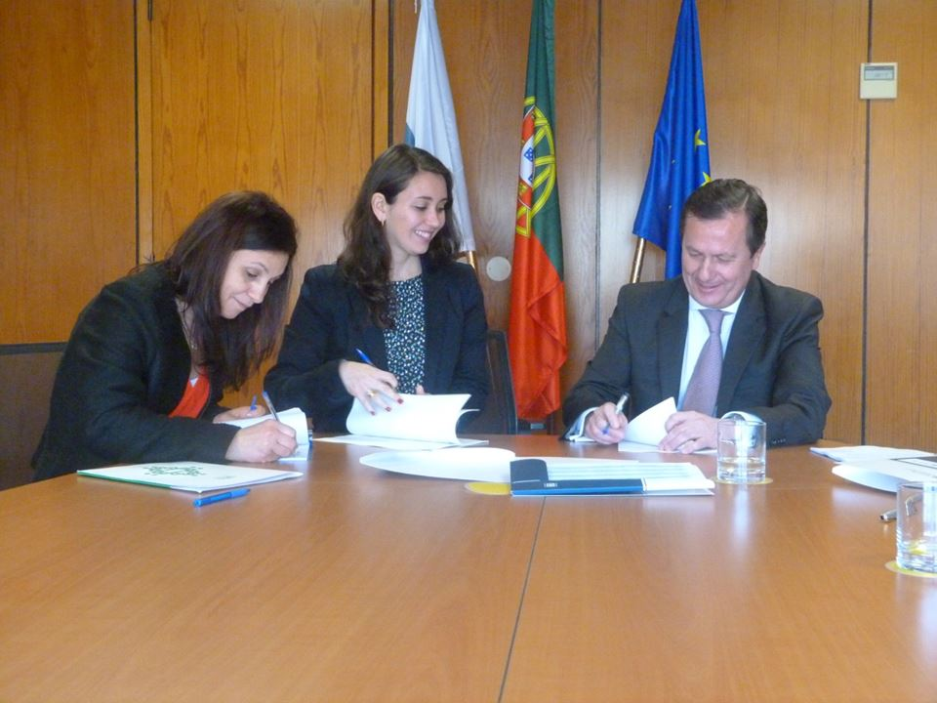
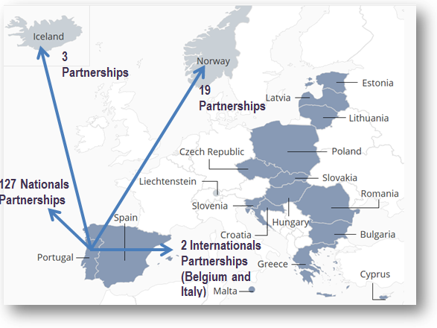
Selection procedure
            171 applications submitted
  101 applications made it to the Selection Committe:
            54 in Mental Health
            28 in Nutrition
            12 in Communicable Diseases
            7 in the Health Information Systems
  1 Pre-Defined Project in Health Information Systems
26 Projects financed:
  10 in Mental Health
  7 in Nutrition
  6 in Communicable Diseases
  3 in Health Information Systems

Slide 4
Specific selection criteria
(in the area of public health
initiatives)
FUNDS FOR BILATERAL RELATIONS
Available Fund: €176.471, to be allocated in the 2015-2016 period.
Timeline for Submission of Proposals - 1st Call: 9 - 22 June 2015.
The Funds for Bilateral Relations (FBR) granted 9 projects (from 9 applicants)
EXTENSION PERIOD FOR ELEGIBILITY
The extension period for eligibility of funds had 18 applications
6 projects selected with both, FBR and the extension Period request.

Slide 5
Projects funded
+ FBR
+ Extension period
Area | Entity | Extension Period For Eligibility | Funds for Bilateral Relations | FBR + Extension Period
HIS | Instituto Nacional de Saúde Doutor Ricardo Jorge | X | X | X
NU | Faculdade de Ciências da Nutrição e Alimentação – U. Porto | X
NU | Centro Hospitalar São João – Unidade de Nutrição e Dietética | X
CD | Instituto Nacional de Saúde Doutor Ricardo Jorge | X
MH | Faculdade Psicologia e Ciências da Educação – U. Coimbra | X
CD | Faculdade de Farmácia – U. Porto | X | X | X
MH | Escola Nacional de Saúde Pública | X
NU | Faculdade de Ciências da Nutrição e Alimentação – U. Porto | X
MH | EUTIMIA |  | X
NU | Faculdade de Letras – U. Porto | X
HIS | Faculdade de Medicina – U. Porto | X | X | X
MH | EUTIMIA |  | X
HIS | Sociedade Portuguesa de Reumatologia | X | X | X
HIS | Faculdade de Medicina da Universidade de Lisboa | X | X | X
CD | Instituto de Saúde Pública da Universidade do Porto | X
MH | Faculdade de Medicina – U. Coimbra | X
NU | Administração Regional de Saúde de Lisboa e Vale do Tejo IP | X
CD | Instituto de Higiene e Medicina Tropical | X
MH | Faculdade de Ciências Médicas- UNL | X
NU | Liga Portuguesa de Profilaxia Social |  | X
MH | Faculdade de Medicina – U. de Lisboa | X | X | X
MH – Mental Health
NU – Nutrition
CD – Communicable Diseases
HIS – Health Information Systems

Slide 6
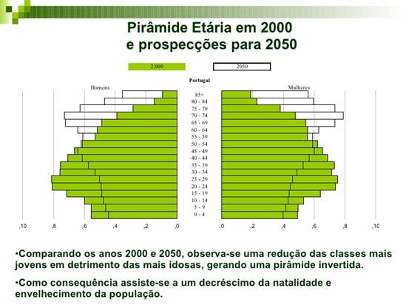
Supported activities
As it is the common knowledge Portugal
is now faced with a economic crisis and is also one with the highest level of older population.
Consequently the investment in public
health policies decreased.
The areas with more need for policies
were the areas focused in mental health
and nutrition, and it comes as no surprise
that the ones that had the majority of
applications.
Source: INE – Instituto Nacional de Estatística

Slide 7
Results
Overall progress of the projects:
Financially :
The first advance payments totalled: 1.602.874,03 €
The second payments to the Promoter totalled: 2.162.342,95 €
The Pre Defined Project totalled: 634.647,17 €

Slide 8
Results
Area | Entity | Scientific Area | 1st Advance Payment | 2nd Advance Payment | 3nd Advance Payment | 4nd Advance Payment
PDP | Instituto Nacional de Saúde Doutor Ricardo Jorge IP | Information Systems | 243.432,00€ | 333.626,00€ | 172.125,00€ | 170.403.29€
NU | Faculdade de Ciências da Nutrição e Alimentação - U. Porto | Nutrition | 79.546,00€ | 116.665,75€
NU | Centro Hospitalar de S. João, EPE | Nutrition | 86.746,00€ | 90.605,83€
DT | Instituto Nacional de Saúde Doutor Ricardo Jorge IP | Communicable Diseases | 100.208,00€ | 246.878,81€
SM | Faculdade Psicologia e Ciências da Educação – U. Coimbra | Mental Health | 53.183,00€ | 74.024,45€
DT | Faculdade de Farmácia - U. Porto | Communicable Diseases | 27.251,00€ | 29.236,74€
SM | Escola Nacional de Saúde Pública - UNL | Mental Health | 32.829,00€ | 0,00 €
NU | Faculdade de Ciências da Nutrição e Alimentação - U. Porto | Nutrition | 60.514,00€ | 70.789,63€
SM | EUTIMIA, ONG | Mental Health | 89.579,00€ | 191.471,13€
NU | Faculdade de Letras - U. Porto | Nutrition | 61.583,00€ | 25.750,09 €
SI | Faculdade de Medicina - U. Porto | Mental Health | 127.810,00€ | 177.604,42 €
SM | Maiêutica, Cooperativa de Ensino Superior, CRL | Mental Health | 92.464,00€ | 124.997,47€
SM | EUTIMIA, ONG | Mental Health | 41.899,00€ | 111.112,18€
SM | Hospital Fernando da Fonseca, EPE | Mental Health | 31.050,00€ | 50.428,41€
SM | Aventura Social, Associação | Mental Health | 33.627,81€
SI | Sociedade Portuguesa de Reumatologia | Information Systems | 128.791,00€ | 173.367,86€
SI | Faculdade de Medicina da U. de Lisboa | Information Systems | 76.415,00€ | 101.046,94€
DT | Instituto de Saúde Pública da U. Porto | Communicable Diseases | 40.417,00€ | 20.904,21€
DT | Associação para o Desenvolvimento da Faculdade Medicina | Communicable Diseases | 39.155,00€ | 38.288,27€
NU | Faculdade de Medicina da U. Porto | Nutrition | 66.536,00€ | 98.754,64€
SM | Faculdade de Medicina –U. Coimbra | Mental Health | 36.983,01€ | 28.470,28€
NU | Administração Regional de Saúde de Lisboa e Vale do Tejo | Nutrition | 76.676,00€ | 97.180,57 €
DT | Instituto de Higiene e Medicina Tropical - UNL | Communicable Diseases | 32.923,00€ | 44.115,99 €
DT | GAT | Communicable Diseases | 49.944,00€ | 10.066,48€
SM | Faculdade de Ciências Médicas - UNL | Mental Health | 54.435,16€ | 27.914,00€
NU | Liga Portuguesa de Profilaxia Social | Nutrition | 33.461,00€ | 36.372,81€
SM | Faculdade de Medicina - U de Lisboa | Mental Health | 82.475,00€ | 142.668,18€
 | TOTALS |  | 4.399.864,15 €

Slide 9
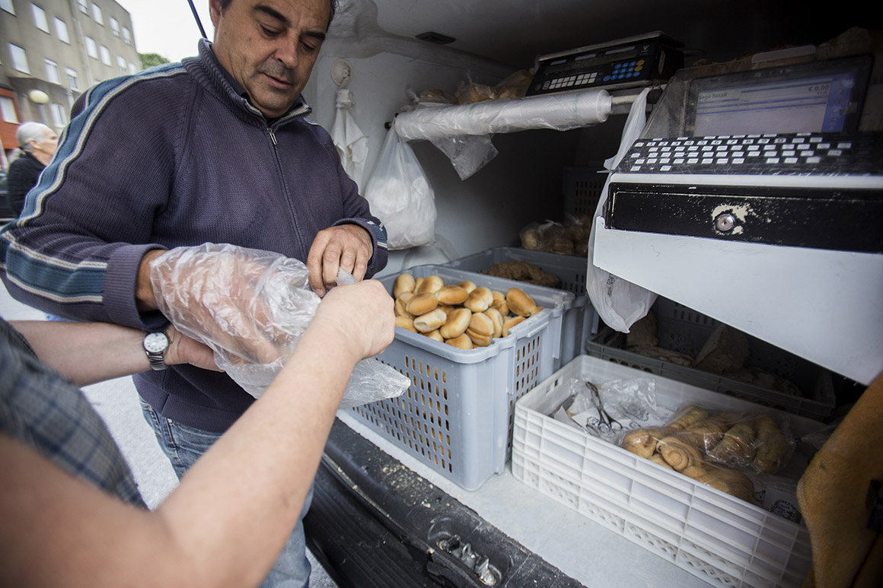
EEA Grants: Public Health Initiatives and the project
Promoting Food Security in Portugal, to evaluate
and improve the nutritional status of the elderly
Portuguese population.
The Programme, supported with grants from the donor countries Norway, Iceland and Liechtenstein aims to support the intervention and research of 26 selected projects in four priority areas of intervention “Nutrition”, “Mental health”, “Communicable Diseases” and “Information Systems”. The 12 million euros of the Programme is more than the total investment in these areas in the last 8 years.
Among the selected projects is Promoting Food Security in Portugal.
Due to the economic crisis one of the major problems facing the
Portuguese population, particularly the older population and also the
more vulnerable due economic reasons is food security.
9 AM and the baker arrives, by van, to one of the social projects with
159 small houses, in Vila Nova de Gaia, where the average income is 300 Eur. per month, to sell bread. People start to arrive. This is also an opportunity for a small chat among the old and aged neighbours with increasing difficulties.

Slide 10
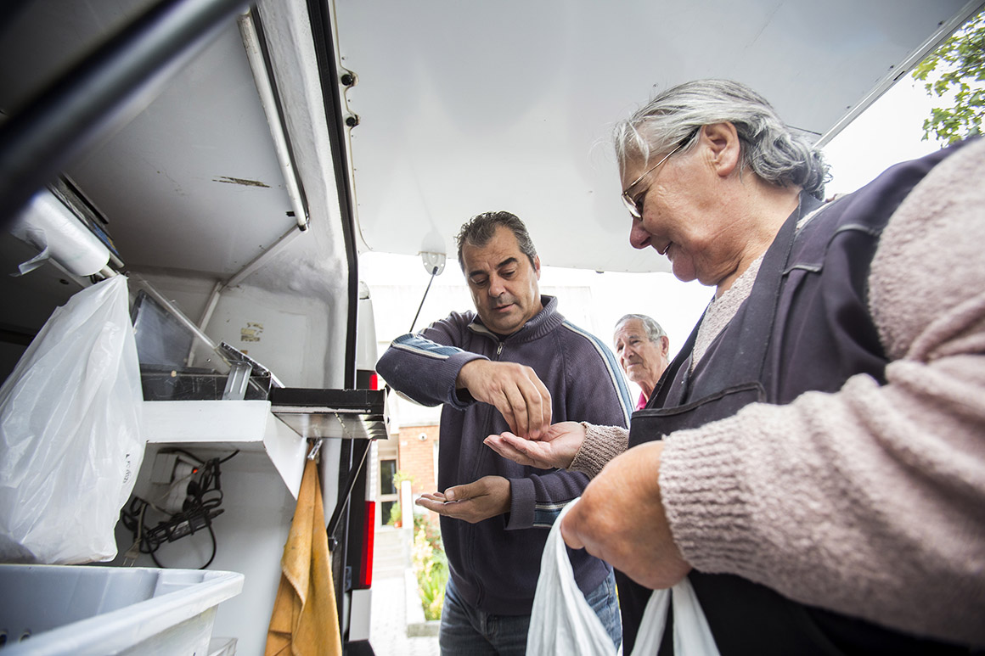
EEA Grants: Programme Public Health Initiatives
and the project Promoting Food Security in
Portugal, to evaluate and improve the nutritional
status of the elderly Portuguese population.
Manuel Lourenço is 78 and lives in this neighbourhood with his 274 Euros monthly pension. Bread is the one thing that he is still able to buy and like him, many others in a strong economic struggle. “We may not have anything else, but bread and a soup…” he says with tears in eyes.
This is one case to exemplify what the researchers are saying: Bread, but which bread? In the global market of today, the type of bread that these populations are buying are the cheapest ones, made from the flours with the lowest nutritional value. This project is relevant to bring awareness to these facts and help improve the nutritional intake with very low income. The bread is cheap and satiates. Buying 2 kilos of vegetables for the week is good for the health, but it will not “kill” the hunger. So the there is much to be done to change this situation, he states.

Slide 11
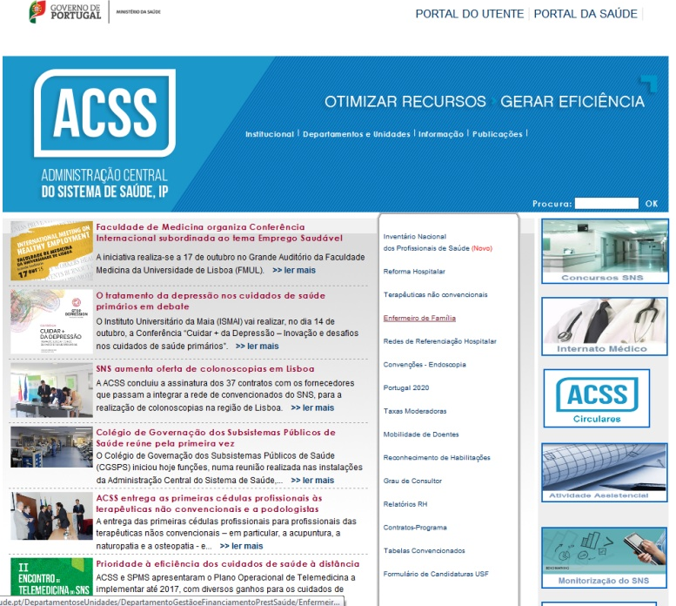
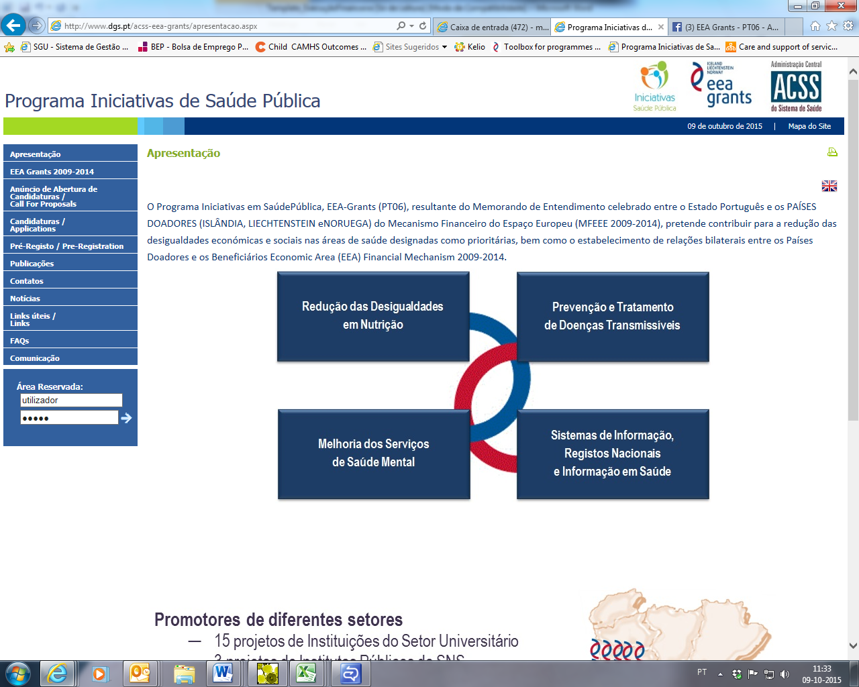

Web pages and links
The ACSS IP webpage____________________________ http://www.acss.min-saude.pt/
_____________ Webpage of the PT06
http://bit.ly/1Ioy9fV
Facebook page of the PT06________________________
http://on.fb.me/1MkGXH2

