Slide 1

Norwegian Financial Mechanism
2009–2014 Programme LT11
“Public Health Initiatives”
Lithuania
Gytė Sirgedienė, Ministry of Health of the Republic of Lithuania

Slide 2
Supported activities (1)
Key focus areas | Eligible activities
Child health monitoring | Development and implementation of information system
Health care in schools / pre-school institutions | Health offices repaired / equipped (open call)
Youth friendly health care services (YFHCS) | Development and implementation of YFHCS model (2 open calls)
Identifying and reducing health inequalities | Preparation of methodological recommendations / trainning programmes on identifying and reducing health inequalities Organization of capacity building training

Slide 3
Supported activities (2)
Eligible activities | Evaluation of applicants interest in activities
Development and implementation of information system | Applicants interest for certain kind of activities → high 1. Active participation in Programme events (questions, participation in discussions) 2. Current situation analysis provided in projects applications shows the demand 3. Number of projects applications received
Health offices repaired / equipped (open call)
Development and implementation of YFHCS model (2 open calls)
Preparation of methodological recommendations / trainning programmes on identifying and reducing health inequalities Organization of capacity building training

Slide 4
Specific selection criteria (1)
Development and implementation of YFHCS model (main specific selection criteria):
Development of bilateral cooperation – project partner from Norway
Involvement of youth organisations or youth in the development of the model
Involvement of the public health bureau of the municipality / youth organisations or non-governmental organisations in the implementation of the model
Minimum percentage (at least 15% of the total population) of young people aged between 14 and 29 of the applicant’s municipality in 2014 (model implementation)
Requirements related to the ensuring the continuity of the YFHCS model developed and implemented in municipalities

Slide 5
Specific selection criteria (2)
Health offices repaired / equipped (main specific selection criteria):
Project implemented in a municipality, which has been designated as problem area according to the decision of the Government (unemployment rate, FDI and others)
Number of health officies included in the project application (more officies → wider effect)
Detailed justification of the project demand provided
Requirements related to the ensuring the continuity of the projects results

Slide 6
Selection procedure (1)
Open call | Publication start /end dates | Interest in the call (number of projects applications received) | Number of projects contracts signed
Development of YFHCS model | 2014-02 – 2014-04 | 2 | 1
Health offices repaired / equipped | 2014-06 – 2014-08 | 27 | 10
Implementation of YFHCS model | 2015-04 – 2015-06 | 17 | 11

Slide 7
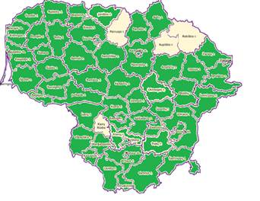
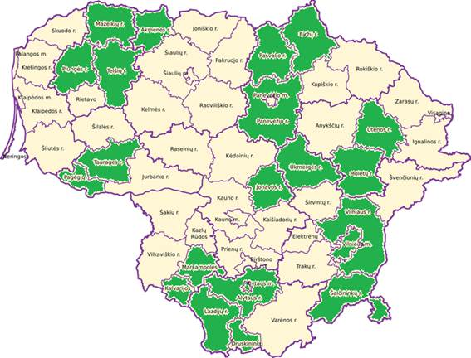
Selection procedure (2)
Example showing the high interest in the call (Health offices repaired / equipped)
27 projects applications received (demand of repaired / equipped health offices in 56 municipalities)
10 projects contracts were signed (health offices in 22 municipalities will be repaired / equipped)

Slide 8
Results (1)
Pre-defined projects / Open calls | Projects implementation dates | Absorption of funds(%)
Development and implementation of Child health monitoring information system | 2014-06 – 2016-09 | 29,21
Identifying and reducing health inequalities | 2014-06 – 2017-01 | 73,44
Health offices repaired / equipped | 2015-02/06 – 2016-12 | 39,92
Development of YFHCS model | 2014-08 – 2016-12 | 34,00
Implementation of YFHCS model | 2015-09 – 2016-12 | 30,00

Slide 9

Results (2)
Strengthening bilateral relations between Norway and Lithuania
5 study visits to Norway of projects applicants / projects promoters were organized:
experience exchanged,
acquired knowledge will be applied while implementing the projects,
bilateral contacts were established,
partnership opportunities were discussed.
Use of Bilateral cooperation fund till 31 March of 2017
4 projects with official partners from Norway (measure of YFHCS model implementation in municipalities)
At least 3 planned common activities with Norwegian institutions (unofficial partners)

Slide 10

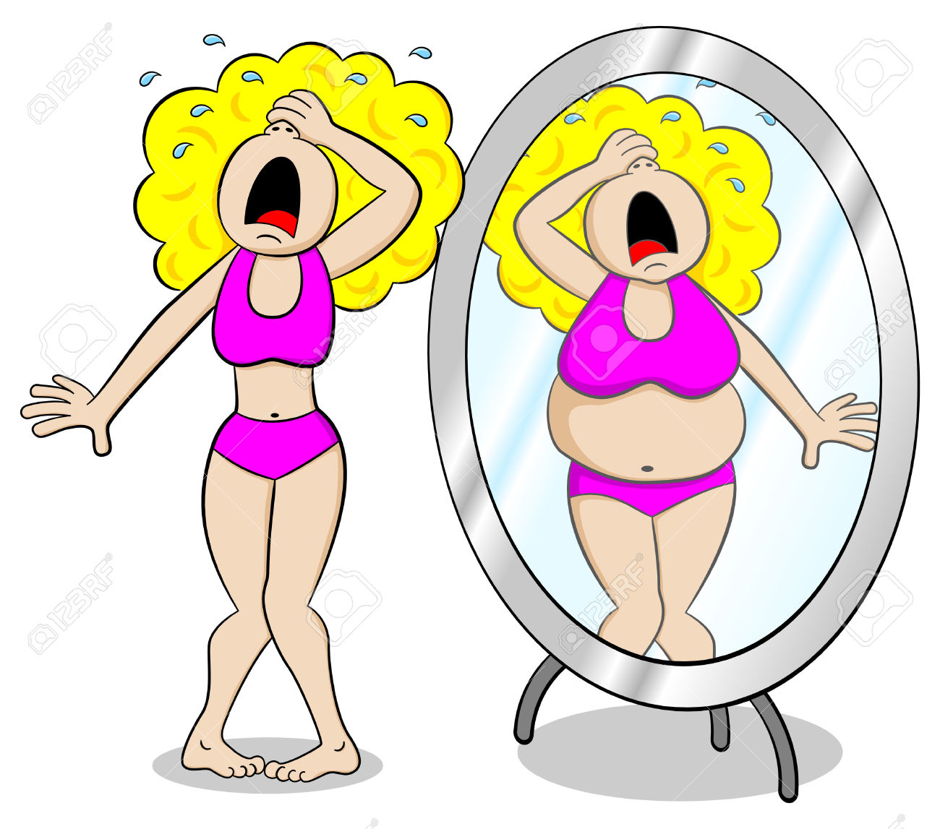
Story:
Norwegian support helps
to improve youth health
This is Inga. She is 15.
Since her classmate told
her that she is fat she
started suffering from terrible
thoughts thinking about it..

Slide 11
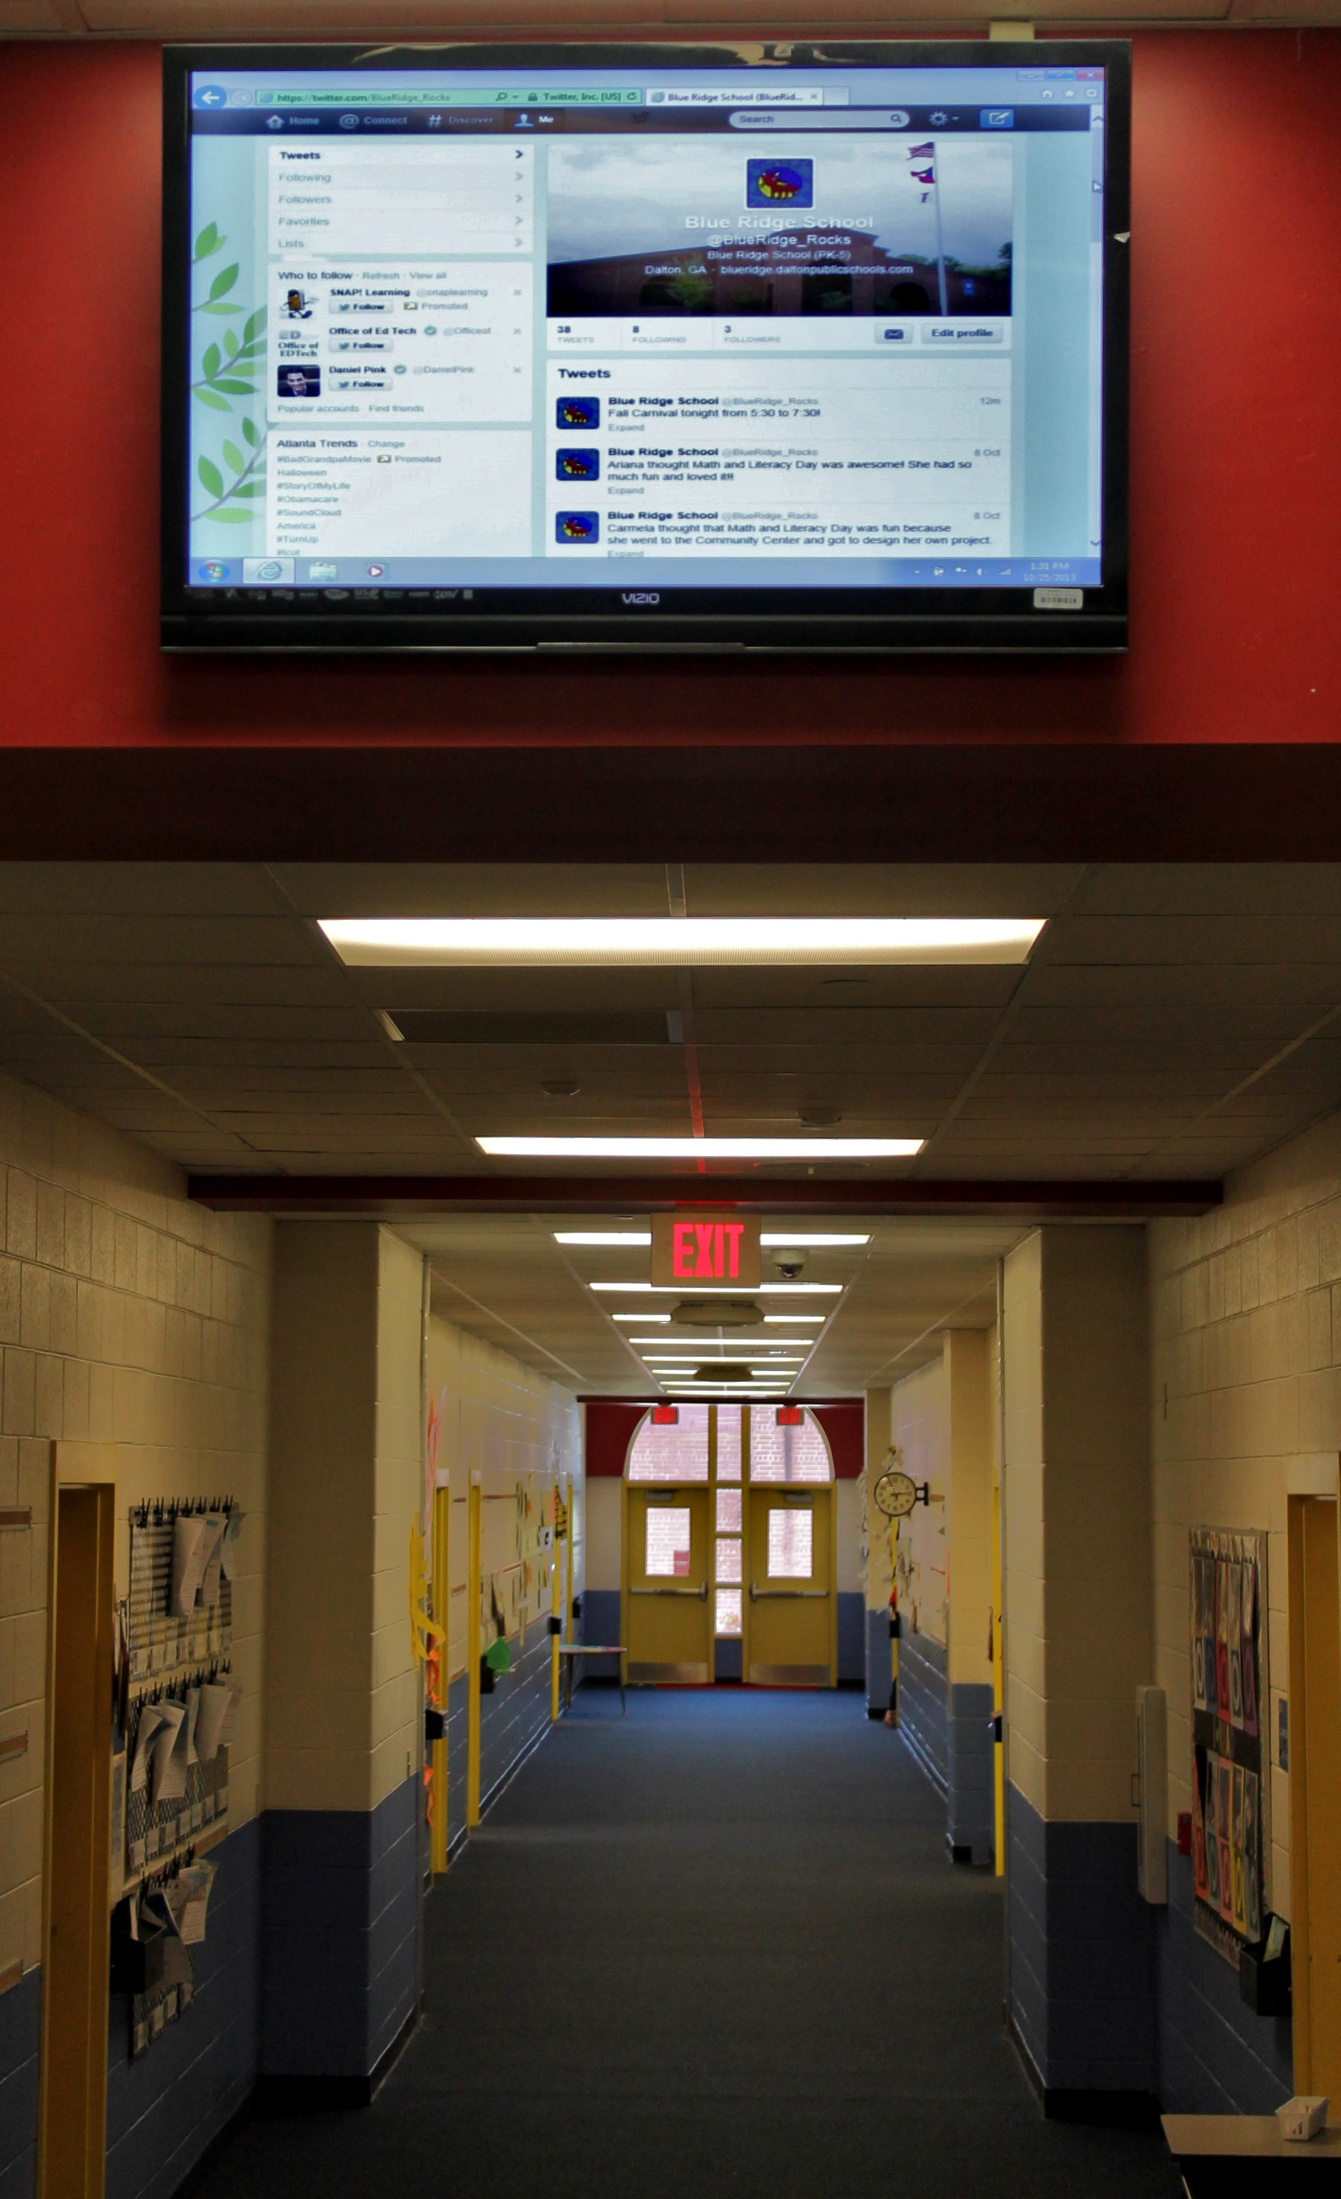


Story
After reading some short articles in the portal, reading questions-answers in forums, watching some videos, Inga understood that she is not alone feeling like this.
She wanted to talk about her feelings with someone she could trust but keeping everything in confidentiality at the same time…
One day Inga saw information about Youth Health portal in flat screen.

Slide 12


Story
In the portal she saw contacts of YFHCS coordinator, wrote her an e-mail… Coordinator wrote her back asking her to come to the YFHCS coordination center and promised to help finding a solution.
Same day Inga came to the YFHCS coordination center and told all her biggest fears to the coordinator.

Slide 13

Story
Coordinator listened to the Inga‘s story and (using algorithms as a tool) find out that Inga needs urgent consultation of psychologist. Coordinator registered Inga for the next day psychologist consultation (according to the cooperation agreement signed with primary health care institution (polyclinics)
After few months of psychologist consultations Inga felt better. During all that time coordinator was in contact with Inga (like case manager). Inga decided to become health training volunteer (after participating in special training).
http://www.sveikatostinklas.lt/

Slide 14
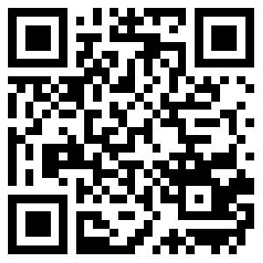
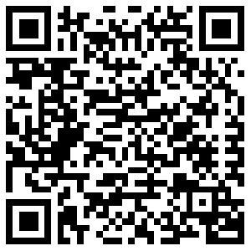
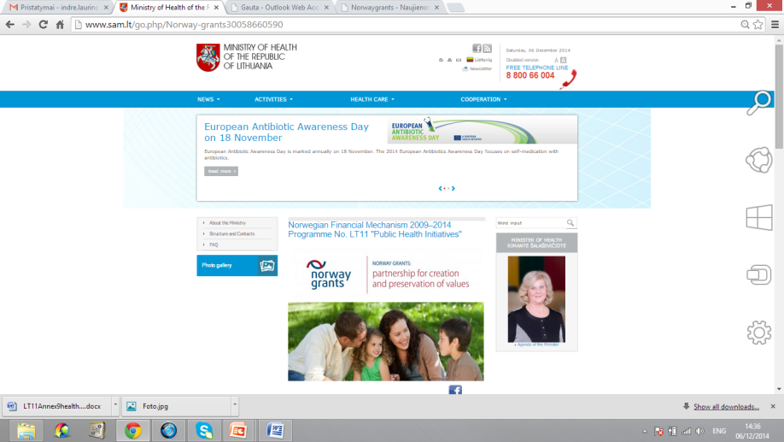
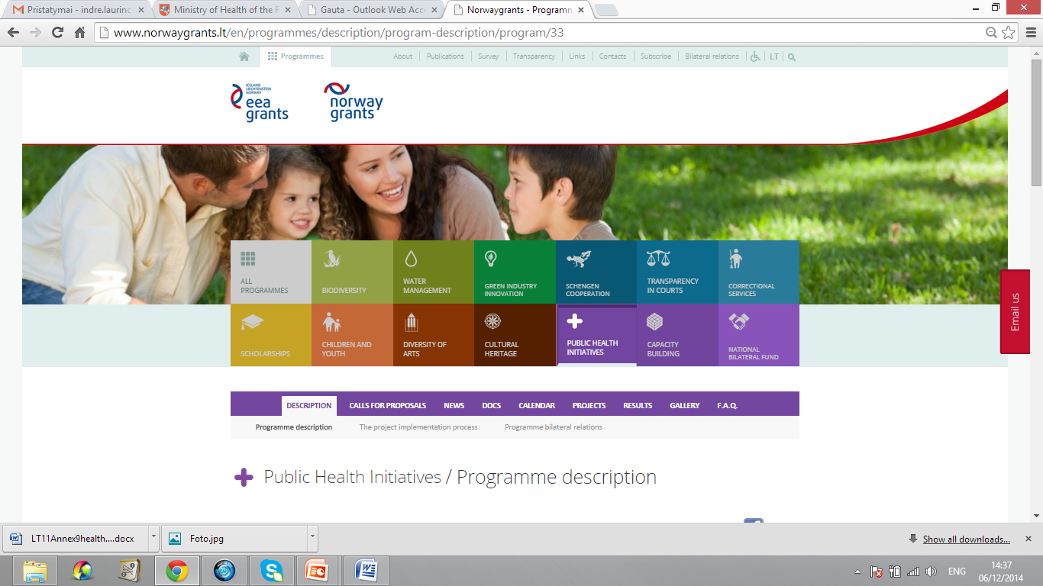
More information
http://www.norwaygrants.lt/en/programmes/description/program-description/program/33
http://sam.lrv.lt/en/cooperation/norway-grants
norwaygrants@sam.lt

Slide 15

Next time see you in Vilnius ☺

