Slide 1

Role of the Council of Europe - International Partner Organisation
Justice Programme
Prague, 20 March 2019
Criminal Law Cooperation Unit
Action against Crime Department, DG I - Human Rights and Rule of Law

Slide 2
International Partner Organisation (IPO) role:
Advisory role based on the Council of Europe recognised experience in the area of human rights, democracy and rule of law
Prior to the implementation of the programme:
  participate in stakeholders consultations meetings, in additional planning meetings necessary in the development of the concept notes and programme agreements,
  provide written assessment and input on the concept notes and programme agreements,
  advise the Programme Operator on the risk management and communication plans.
During the implementation of the programme:
  participate in Cooperation Committee meetings,
  contribute to the development of, and take part in, any specific and relevant activities organized at programme level,
  contribute to the exchange of experience and capacity building, facilitate study visits to the Council of Europe,
  participate in the follow-up communication plan of the programmes,
  facilitate the project implementation by providing advice to relevant partners.

Slide 3
Standards
Monitoring
Co-operation and technical assistance

Slide 4
What do we do ? Theory of change
The CoE’s capacity development interventions (revision of the institutional framework, training, workshops, seminars etc.) :
short-term effectiveness(e.g. enhance understanding of prison standards)
medium-term (e.g. enhance practices by authorities)
long-term (e.g. safe return of prisoners into society)

Slide 5
What do we do ? Methodology of work
Policy documents and promotion of a strategic approach to reform of prison / probation / police systems Europe-wide
Assist the legislative processes by offering advice and legal expertise/opinion, as well as facilitating discussions and drafting
Capacity-building, ensuring sustainable training provision and enhanced professionalism of the prison and police staff to ensure a better human rights protection for detained persons
Institution-building measures and awareness-raising activities

Slide 6
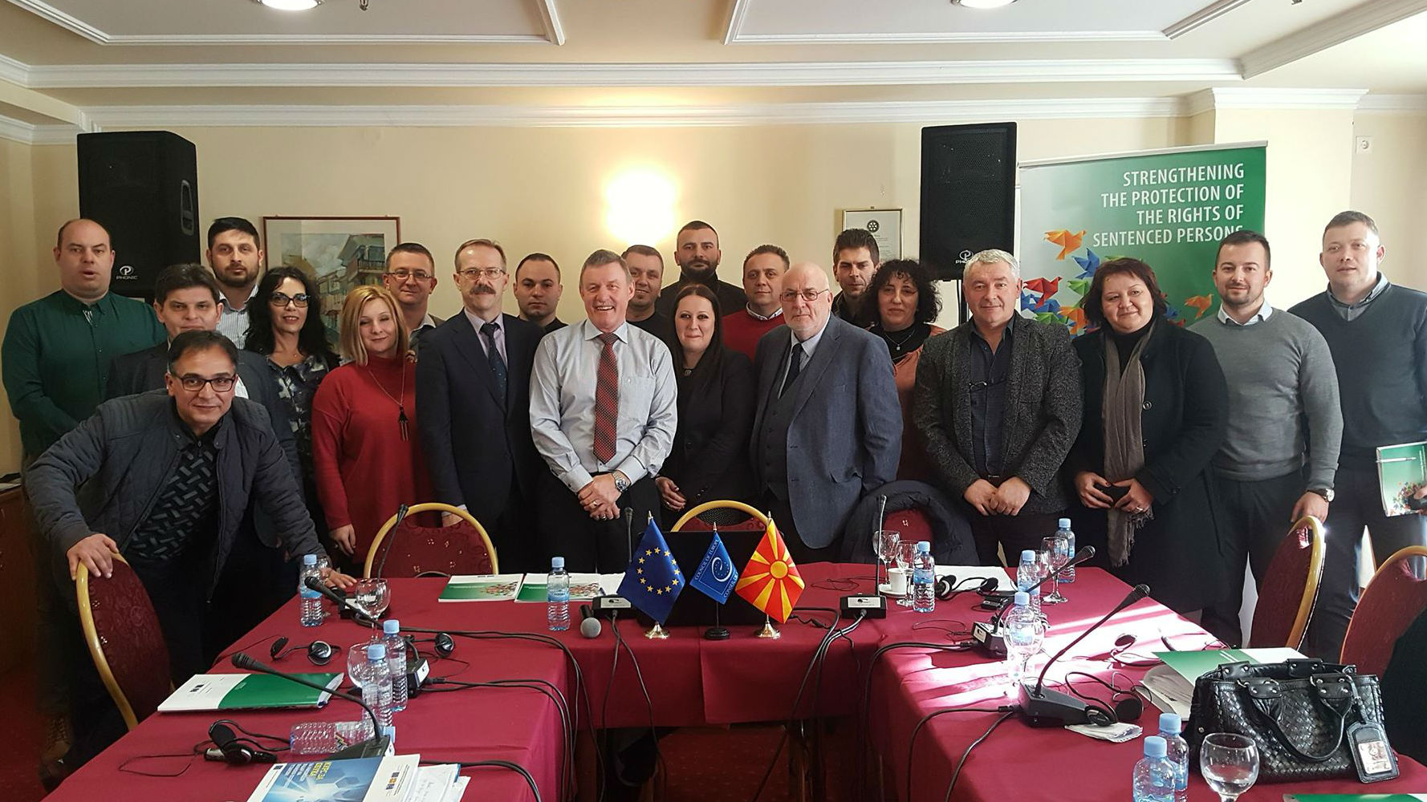
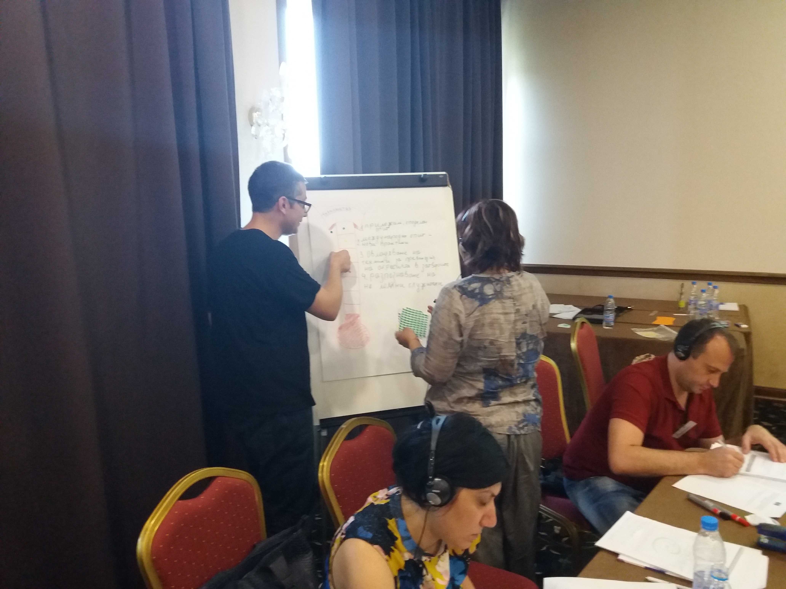
Criminal Law Co-operation Unit: What do we do? An example
    Train prison staff - promoting dynamic security and ensure better use of prison staff skills and knowledge
      Developing core prison competences, from the suicide prevention programmes through the basic elements of the provision of health care in prisons and offenders behaviour and treatment programmes, all the way up to prison management.

Slide 7

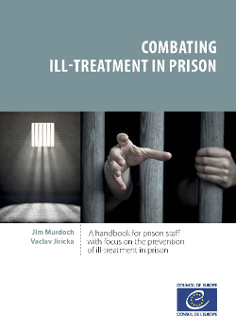

Criminal Law Co-operation Unit: Publications
Manuals, guidelines and booklets are developed under technical assistance projects
https://www.coe.int/en/web/criminal-law-coop/publications

Slide 8
Programmes/Projects (envelops)
Norway Grants – International Partner Organisation Correctional Services - Bulgaria, Croatia, Czech Republic, Latvia, Lithuania, Romania
Horizontal Facility for the Western Balkans and Turkey Albania, Bosnia and Herzegovina, Kosovo*, Montenegro, Serbia, North Macedonia
Partnership for Good Governance, Armenia, Azerbaijan, Georgia, Republic of Moldova, Ukraine and Belarus - the EU’s Eastern Partnership countries

Slide 9
Projects (individual)
Joint Programmes EU/CoE (JP)
Voluntary Contributions (VC)
Examples:
  Promoting a human rights compliant criminal justice system in the Republic of Moldova (VC) - 1 March 2018 – 28 February 2020 (36 months)
  Structured sentence management for violent and extremist prisoners in Bosnia and Herzegovina (VC) - 1 November 2018 – 30 October 2020 (24 months)

Slide 10
Multilateral meetings
Thematic Multilateral Meetings
- prisons
- community sanctions and measures
Regional Multilateral Meetings/Projects
- dealing with radicalisation

Slide 11
Projects in numbers

Slide 12
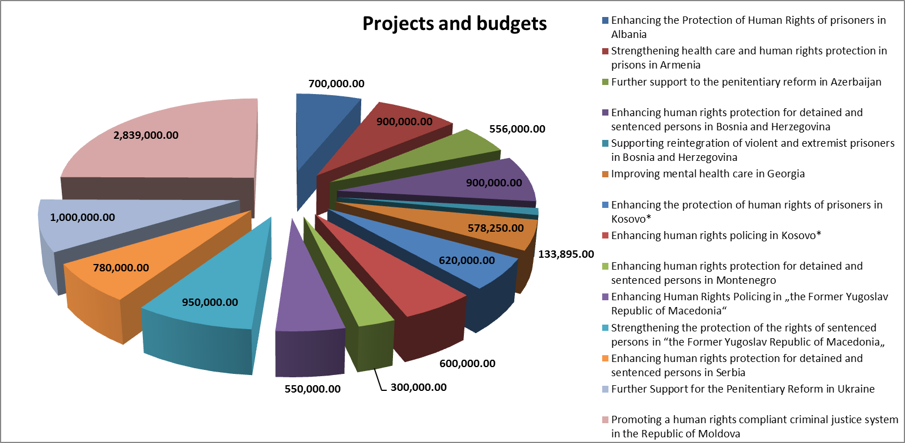
Projects and Budgets

Slide 13
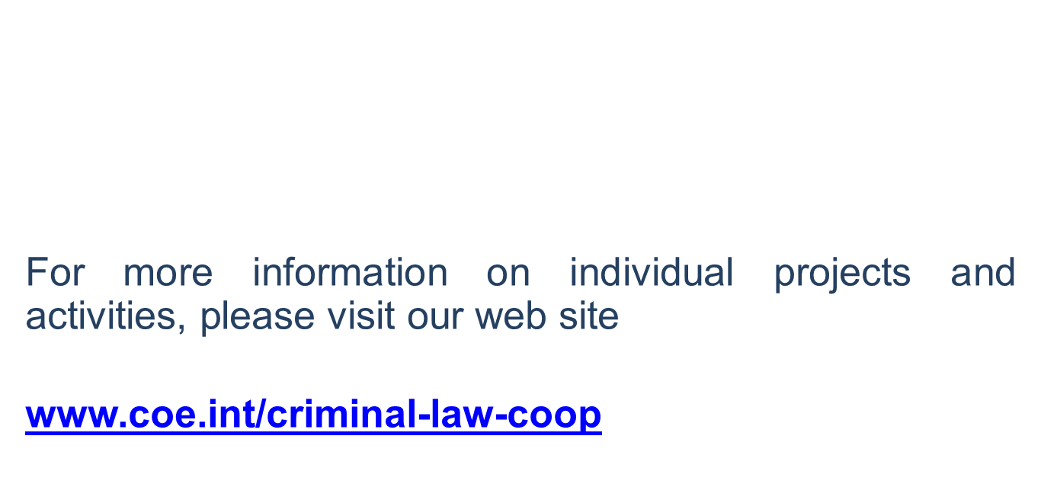


Slide 14
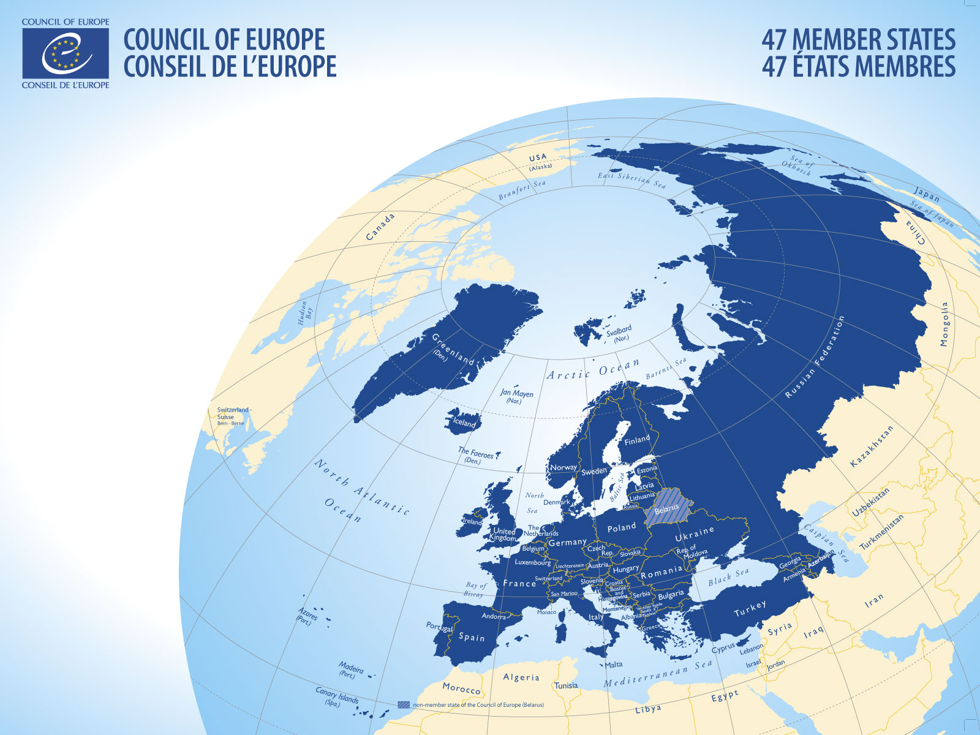
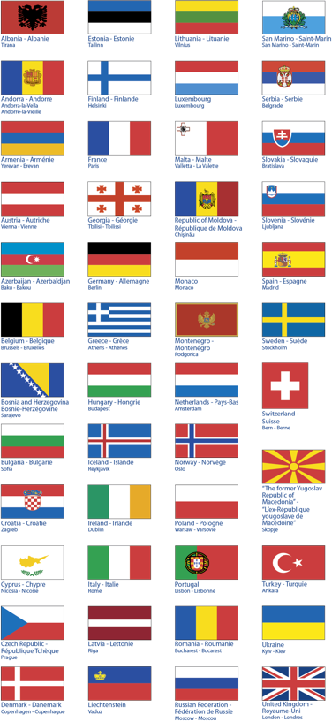
      Thank you for your attention

