Slide 1

MINISTRY OF HEALTH
Programme BG07 „Public Health Initiatives” - Republic of Bulgaria
Recent Challenges and Progress
Dr. Elvira Foteva
Deputy Head of PO
Director International Activities, Projects and Programmes Directorate Ministry of Health

Slide 2
Programme BG07 at a glance (1)
Programme Operator: Ministry of Health
Supporting Unit: Good Governance Directorate,
Council of Ministers Administration
Objective:
Improved public health and reduced health inequalities
Budget: € 15 782 353
(NFM € 7 765 000; EEA € 5 650 000;
€ 2 367 353 national contribution)
Expected outcomes:
Improved governance in health care
Improved access to and quality of health services including reproductive and preventive child health care
Improved mental health services
Reduced inequalities between user groups

Slide 3
Programme BG07 at a glance (2)
Programme BG07 “Public Health Initiatives” is implemented through:
4 Pre-defined Projects
4 Measures
Small Grant Scheme: Scholarship Programme for Roma students of health professions

Slide 4
Specific criteria for selection of proposals under Measures
As part of the evaluation PO envisaged additional selection criteria:
Under 4 Measures additional points to be granted from the evaluation of the project proposals for partnership with organizations for Donor States
Under Measures 2 and 6 the activities with the participation of target groups, 50 % of which must be representatives of Roma population

Slide 5
Resent Challenges in
Programme Implementation
Need to catch up with delays in the development of the guidelines for applicants under the calls for proposals (Measures 1, 2, 5 and 6) and announcement.
New PO team when the project proposals were submitted.
Short time for contracting the projects in order to be proposed for extension.
PO strengthened communication with FMO and NFP, selected good independent evaluators, assigned professional selection committee.

Slide 6
Results (1)
Submitted proposals under all Measures - 98.
89 - after the evaluation for compliance with the administrative and eligibility criteria
Measure 1:
26 applications; 4 projects included donor partners
3 applications not eligible
10 proposals selected for funding
(total amount EUR 2 150 758)
Measure 2:
28 applications
4 applications not eligible
3 proposals selected for funding
(total amount EUR 650 313)

Slide 7
Results (2)
Measure 5:
28 applications; 4 projects included donor partners
1 application not eligible
9 proposals selected for funding
(8 projects contracted - total amount EUR 2 162 634)
Measure 6:
16 applications; 2 projects included donor partners
1 application not eligible
3 proposals selected for funding
(total amount EUR 592 381)

Slide 8
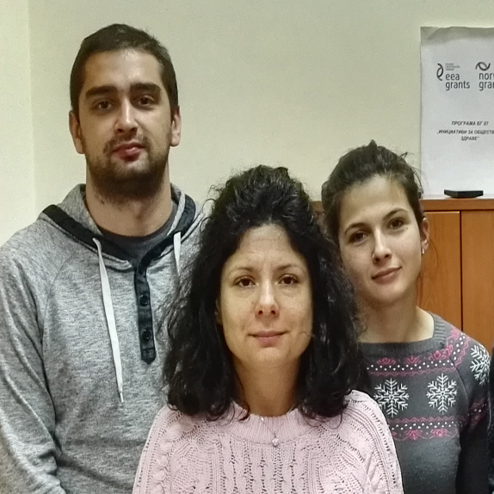
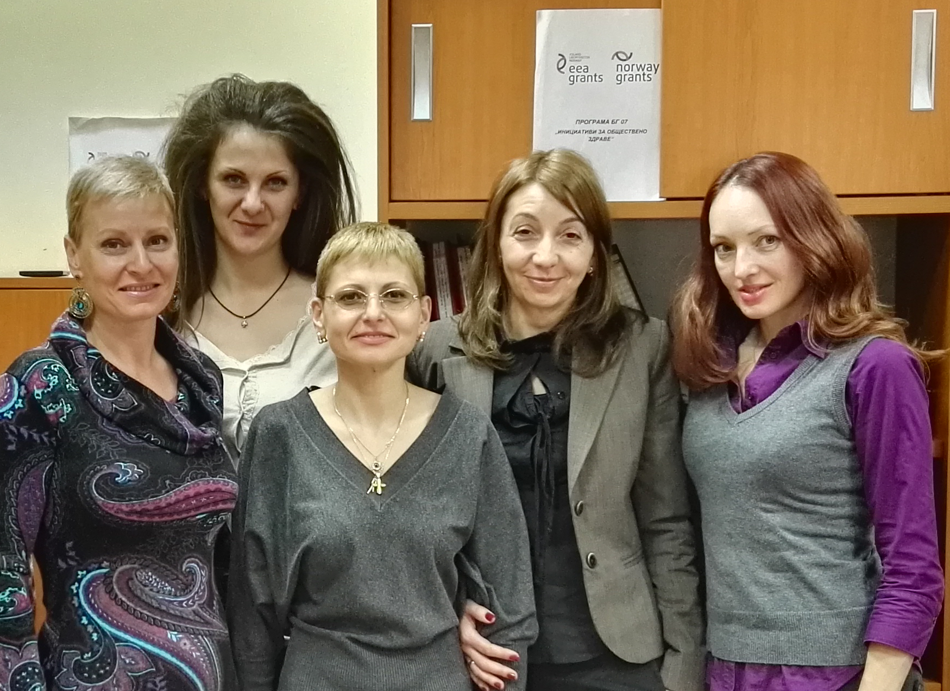
Thank you for your attention!
www.bg07eeagrants.com
e-mail: bg07@mh.government.bg

Slide 9

Good start of the projects – one project under Measure 5
Fresh Start for Young People with Anorexia and Bulimia

Slide 10
Fresh Start for Young People with Anorexia and Bulimia
Project promoter: Foundation “Center INSIGHT”, Bulgaria
Partner: Counselling for eating disorders - ROS - Rådgivning om spiseforstyrrelser, Norway
Project objective: To improve the access to quality treatment services for psychic health and to improve the quality of care for young people with eating disorders (anorexia, bulimia and others) in Bulgaria
Total project cost: 202 000 EUR; grant: 181 800 EUR.
After the project start on 14.09.2015: Training by ROS for the team who will conduct prevention campaign in secondary schools; Training of the professional therapeutic team; Film for both trainings; Project presentation at National meeting of psychologists; Web site and Web based Questionnaire; Telephone line and Anonymous web based chat; Initiated equipment of Day Centre for intensive treatment of the disorders

