Slide 1


A -very- brief introduction to the Czech music scene.

Slide 2
Czech Republic
General information:
EU member since 2004 / Part of Schengen Area
Population and residents of Country by Ethnicity:
  10,58 million:
    64% Czech,
    5% Moravian,
    1.4% Slovak,
    0.4% Poles, 0.2% German
    At the last census in 2011, “nationality” was optional and about 26% left this blank. It’s estimated that the Czech Republic is home to 250,000 Romani people, as well as 440,000 foreigners…. now its apx 700.000-
Currency value against EUR : 1 EUR - 25.8 CZK
GDP Per Capita : 36,784 USD

Slide 3
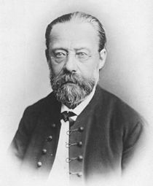
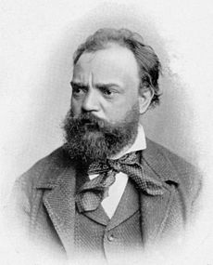
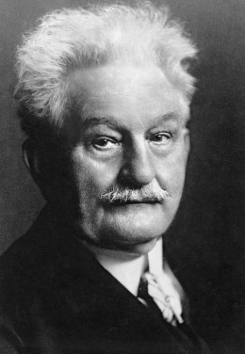

Bedřich Smetana
1824 - 1884
Antonín Dvořák
1841 - 1904
Leoš Janáček
1854 - 1928
Bohuslav Martinů
1890 - 1959

Slide 4
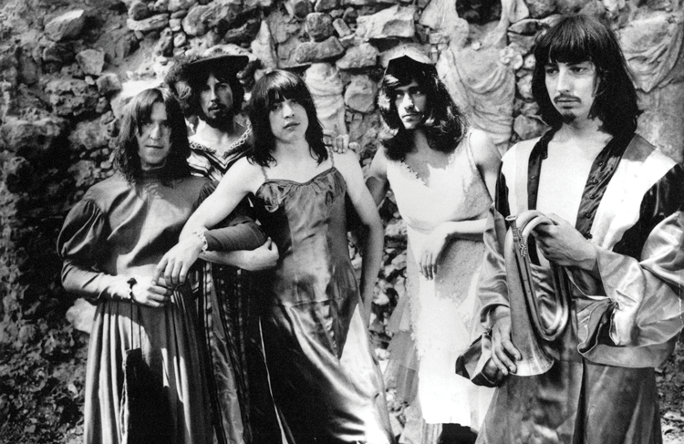
“Long-haired, neurotic drug addicts and mental cases who take delight in the grossest of perversions and deliberately sing vulgar, anti-social songs.”– Review of the Plastic People of the Universe in Czechoslovakian paper Rude Pravo ( a state sponsored news paper in the 70’ies).

Slide 5
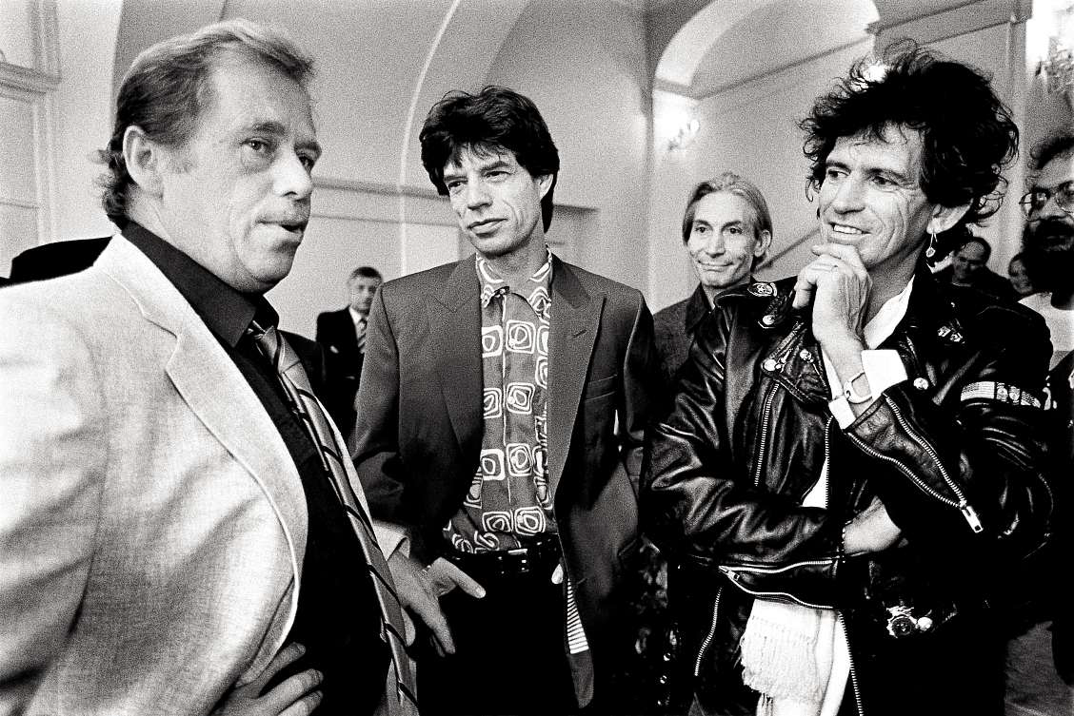

Slide 6
Music festivals
BEATS FOR LOVE 3.-6. 7. 2019 (Ostrava) b4l.cz - pop, electronic
BRUTAL ASSAULT 7.-10-8 2019 (Jaroméř) brutalassault.cz - metal, heavy
COLOURS OF OSTRAVA 17.-20. 7. 2019 (Ostrava) colours.cz - world music, fusion, pop, rock
FOLKOVÉ PRÁZDNINY 27. 7. – 3. 8. 2019 (Náměšť nad Oslavou)- folk
HIP HOP KEMP 15.–17. 8. 2019 (Hradec Králové) hiphopkemp.cz - hiphop
JAZZFEST BRNO (a concert series during spring) - jazz
LET IT ROLL 1.–4. 8. 2019 (Milovice) letitroll.eu - electronic, drum’n’bass - EU’s major d’n’b gathering
METRONOME FESTIVAL PRAGUE 21.–22. 6. 2019 (Prague) metronomefestival.cz - pop rock
MIGHTY SOUNDS 12.–14. 7. 2019 (Tábor) mightysounds.cz - ska, reggae, punk,
MLADÍ LADÍ JAZZ 30. 3.–30. 4. 2019 (Prague) mladiladijazz.cz - jazz fusion
RESPECT FESTIVAL 15.-16.6 2019 (Prague) - world music, folk
ROCK FOR PEOPLE 4.–6. 7. 2019 ( Hradec Králové) rockforpeople.cz - rock, fusion
STRUNY PODZIMU (Strings of Autumn) October-November concert series (Prague)- classical, contemporary, experimental
FESTAS: Czech Festival Association - Funded in 2017 ( represents ariund 30 Cz Festivals)

Slide 7
Showcases
Czech Music Crossroads 15.16.7 www.crossroadsmusic.cz - with focus on the V4 region
Nouvelle Prague ( 8-9.11. 2019) www.nouvelleprague.cz regional music sector meeting point linking CEE to intl music, and creative industry
Czeching www.rozhlas.cz/radiowave (september) CŘ -Radio Wave station’s talent contest/mentoring session/ showcase

Slide 8
Main Venues
The live music scene is utterly vivid in Czech Republic so out of the 400 optional clubs, find a shortlist below. (alphabetical order)
Cafe V Lese, Praha (capacity 250)
Fleda, Brno (800)
Forum Karlín, Praha (3000)
Futurum Music Bar, Praha (400)
Kabinet Múz, Brno (250)
Lucerna Music Bar, Praha (1 000)
MeetFactory, Praha (1000)
O2 Arena, Praha (18 000)
Palac Akropolis, Praha (900)
Radost FX, Praha (800)
Rock Café, Praha (600)
Roxy, Praha (1 000)
Cross Club, Praha (300 plus 100)
Sono, Brno (2000)
Tip sport Arena, Praha (13 238).....
AVERAGE TICKET PRICE FOR: local acts performing: 150 CZK (apx 6 EUR)international acts performing: 350 CZK (apx 14EUR)
MOST POPULAR LOCAL MUSIC GENRES: metal, rock, pop, folk, jazz, drum and bass, techno and electronic.

Slide 9


Music Awards
Anděl Award - since 1997, main and genre awards
(world music, jazz & blues etc.)
Vinyla Award - founded 2011, annually highlights important artists and achievements in contemporary Czech popular music
Apollo Award - Czech Critics award, founded 2011

Slide 10
Labels
(besides majors, the loudest independents in alphabetical order)
Animal Music,
Big Boss,
Červený kůň,
GenotCentre,
Indies Scope,
Minority Records,
Polí5,
Pushteek,
Stoned to Death,
Supraphon,
Tranzistor….
….(Platform of independent labels (Platforma) gathers most of the active Czech labels)

Slide 11

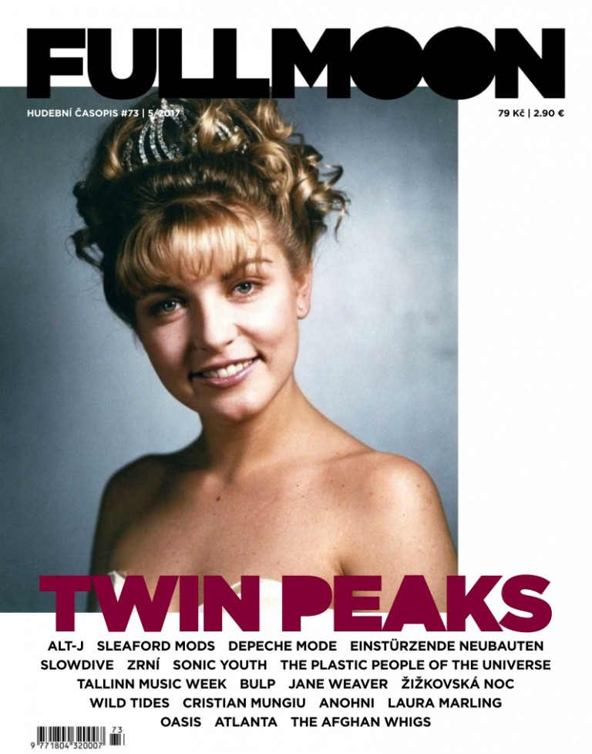
Media
Full Moon Magazine & Full Moon Zine
www.fullmoonmagazine.cz
www.fullmoonzine.cz

Slide 12

Fakker
www.fakker.cz

Slide 13
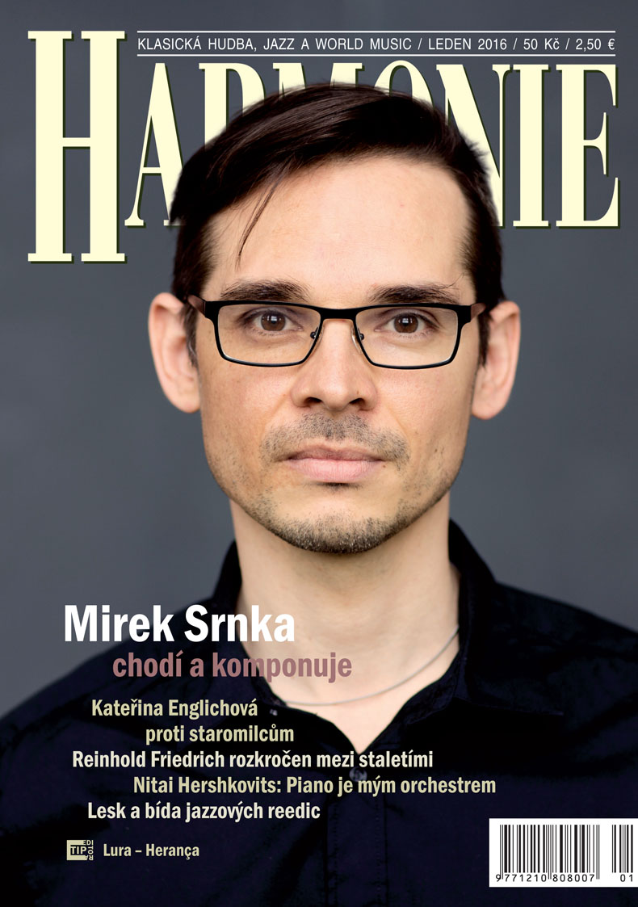
Harmonie
www.casopisharmonie.cz

Slide 14

Headliner
www.headliner.cz

Slide 15

Muzikus
www.muzikus.cz

Slide 16

Rock & All
www.rockandall.cz

Slide 17

Rock & Pop
www.rockandpop.cz

Slide 18
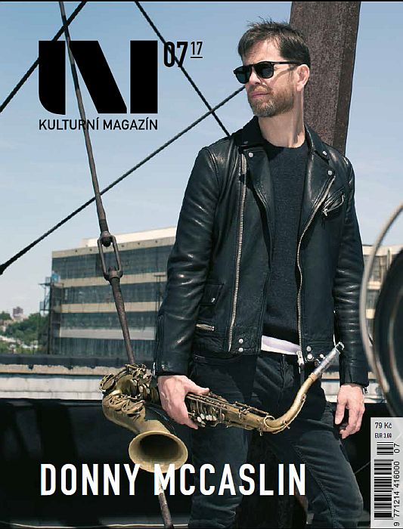
Uni
www.magazinuni.cz

Slide 19

Czech Music Office - SoundCzech
The mission of SoundCzech is to facilitate the development of the Czech music industry in a wide range of genres such as world music, rock, pop, electronic music, hip-hop, jazz, alternative music and other under genres and fusions.
April 2017 marked a turning point in the history of the Czech music industry. Based on the demands from the representatives of the music sector and an initiative of the Arts and Theatre Institute, an export agency, SoundCzech/Czech Music Office, was founded with the aim of supporting the Czech music sector in all varieties of music genres.
SoundCzech is financed by the Cultural Ministry of Czech Republic, and works as a sub-office of the Arts and Theatre Institute
www.soundczech.cz

Slide 20
Czech Music Office - SoundCzech
Organizing Czech presence at professional music events, showcase festivals, conferences (supporting Czech music professionals to attend, and creating networking opportunities)
  Eurosonic- Noorderslag ( country focus in 2019 with Slovakia)
  Reeperbahn, WOMEX, Jazzahead, Mama Paris, Spring Break, MENT, Vienna Waves...
Raising the exposure, and circulation of Czech music
Helping Czech artists mobility through different tour support schemes, and programs
Working on the professionalisation of the music sector, by organizing VET actions, meetings, mentoring events.
Lobbying for the better representation of Czech republic,and the CEE region on an EU level, as member of different EU networks EMEE, ETEP...
Locally SoundCzech works on creating a Czech music platform that can translate the voice and needs of the sector towards stakeholders. www.soundczech.cz

