Slide 1


Slide 2

Czechs are ready to perform
Jana Návratová
14. 2. 2019
www.idu.cz

Slide 3
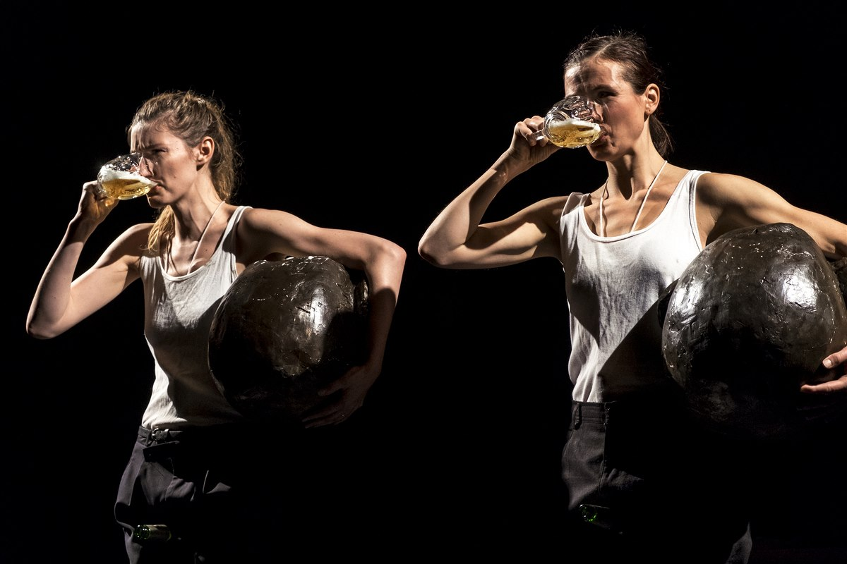

Slide 4

Specifics
Název kapitoly
After 1989 theatre environment in Czech Republic completely changed from state regulation and censorship into (still developing) the concept public support and freedom for artistic voice.
Next to the theatres which are supported by state, local governments and the cities, works also private, commercial, artistic subjects (This shouldn´t be forgotten)
Historically, Czech Republic has a very dense network of theatres with permanent ensembles (nine opera houses included) and bigger towns see the existence of their own theatre as prestigious.
Speaking about prestige it´s good to mention that in our small country which is nationally coherent operates 3 national theatres
Regarding the specifics we have long and rich tradition of the puppet theatre and still this genre is strong and internationally acclaimed – Theatre Drak, Naive theatre Liberec
Another specific is strong and well-organized amateur theatre movement, which is the important part of the system.
Theatre played significant role in our history – it was tool of self-determination, national liberation and constituting of Czech identity (in 19 century) ; in 20 century theatre, especially small scales theatres, was medium and platform of resistance against totalitarian regimes.
www.idu.cz

Slide 5
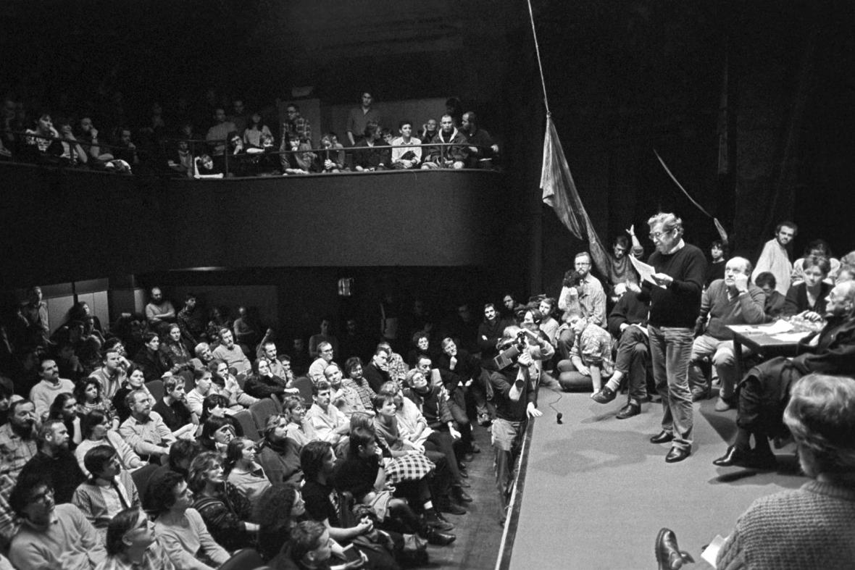

Slide 6
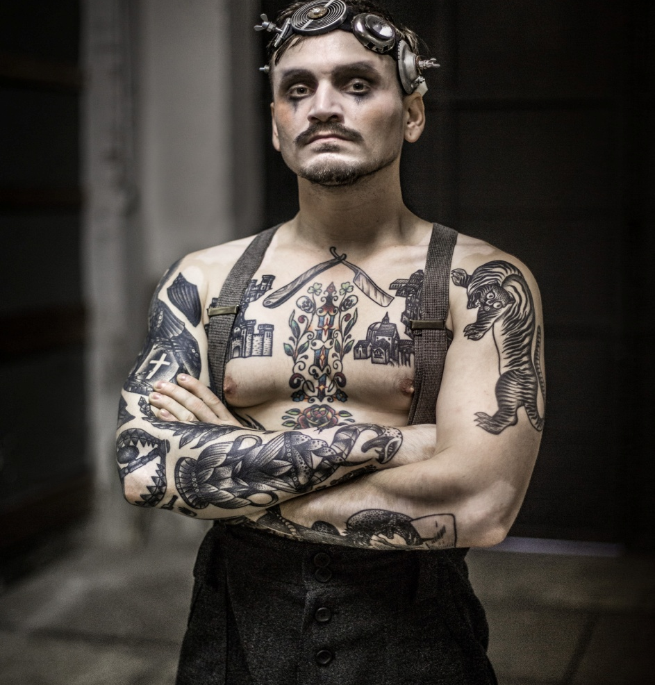

New genres, new opportunities
New atmosphere and opportunities, especially international collaboration, brought new dynamic and new artistic styles and genre shas emerged – for instance contemporary dance and later on also contemporary circus has been developing after 1989
This movement brought needs of new infrastructure – schools, venues, festivals, organizations... everything is still work in progress because most of the infrastructure elements is operating in the capital city and very slowly penetrates the regions.
Czech independent theatre fully adapt and very active in international collaboration
www.idu.cz

Slide 7
Performczech.cz
What can you find on the portal?
Up-to-date information on the Czech performing arts scene
Profiles of theatres, festivals, schools, and other organizations
Profiles of Czech personalities of performing arts – from playwrights to choreographers
The selection of recommended productions available for international touring
Curator selections with a specific focus – e.g. for contemporary art fairs or curated theatre tours in the Czech Republic
The offer of workshops in various fields of performing arts
Essays and papers on theatre, dance and contemporary circus in the Czech Republic, including statistical data as well as cultural and political topics
Information and links to publications and theoretical outputs
Our goal is to inform on subjects, artists, current events in theatre, dance, and contemporary circus in the Czech Republic.
We believe you find the information you have been looking for, and if you have not looked for it, we are happy you have it!
http://performczech.cz/en
www.idu.cz

Slide 8
Comme and see, come and meet
Venues – in Prague, in regions
Festivals
Good to know subjects

Slide 9
VENUES in PRAGUE
PONEC (2001) – contemporary dance venue, residences, productions
ALTA (2007) – dance venue with studios and co-working space
ARCHA THEATRE (1994) – contemporary theatre, music and dance
ALFRED VE DVOŘE (1997) – venue for new theatre, movement and dance theatre
TEATRO NoD (2004) - centre for performing arts and gallery
JATKA 78 (2014) – new circus and contemporary performing arts
LA FABRIKA (2007) – contemporary performing arts
PALACE AKROPOLIS - independent culture – theatre, music, dance
MEETFACTORY – new theatre, dance, music, gallery, film, community centre
VENUŠE VE ŠVEHLOVCE – new and movement theatre
THE BROTHER FOMAN’S BOAT– summer venue on the river

Slide 10
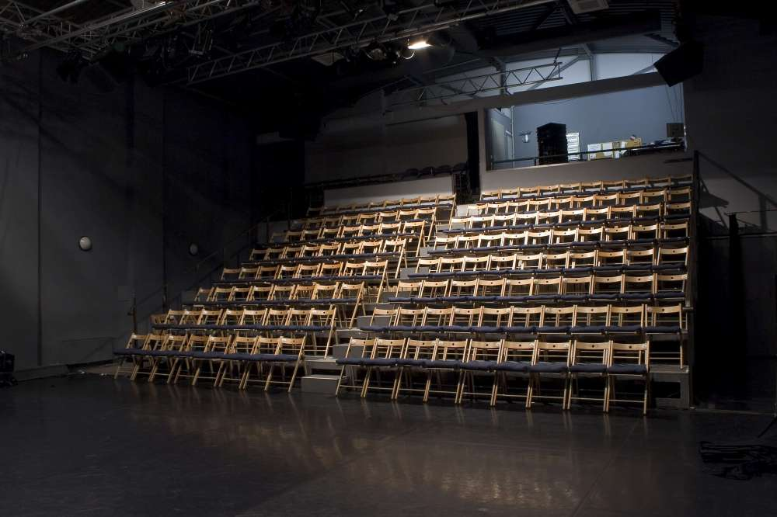
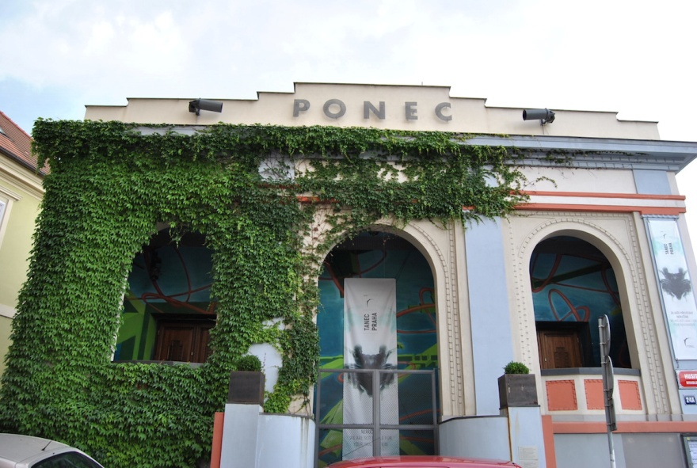
PONEC THEATRE
Tanec Praha dance venue since 2001 – 18th season
Presenter
International cooperation
Producer of the creations
co-producer
residential place
Ponec for children
Networking – i.e. EDN, Aerowaves, Creative Europe, Dance transit
www.divadloponec.cz

Slide 11
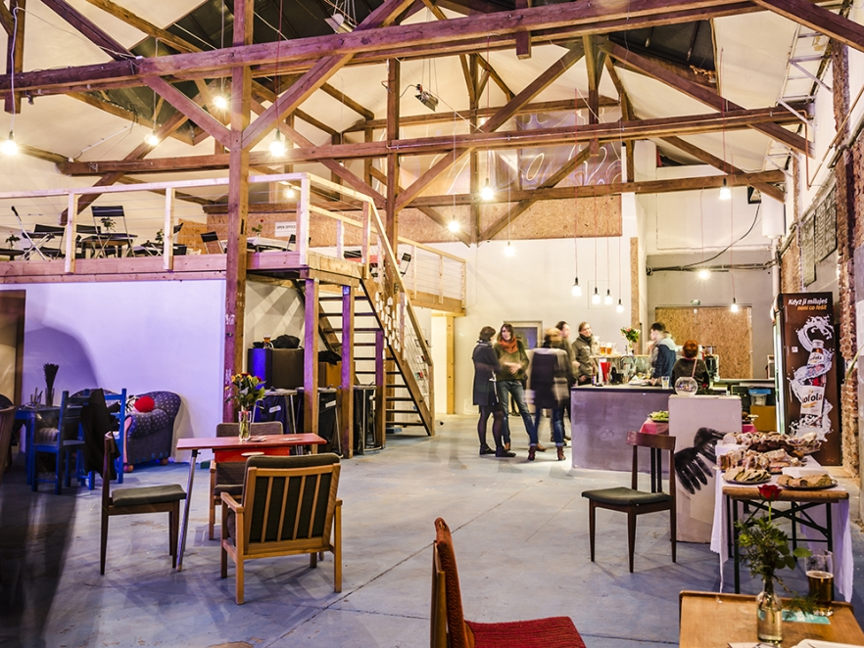
STUDIO ALTA
Performing space, studios, co-working
Creations / Research / Education /Community work / Leisure
www.altart.cz

Slide 12
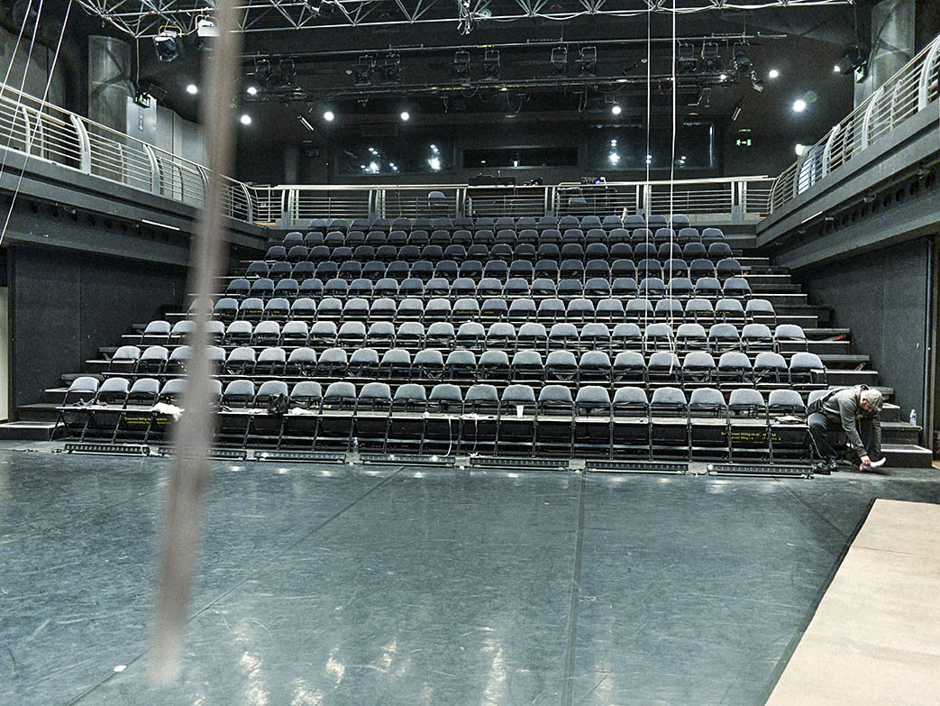
Archa Theatre production house and a venue for contemporary performing arts
Focused on socially specific and documentary theatre
Presenter
Producer
www.archatheatre.cz

Slide 13
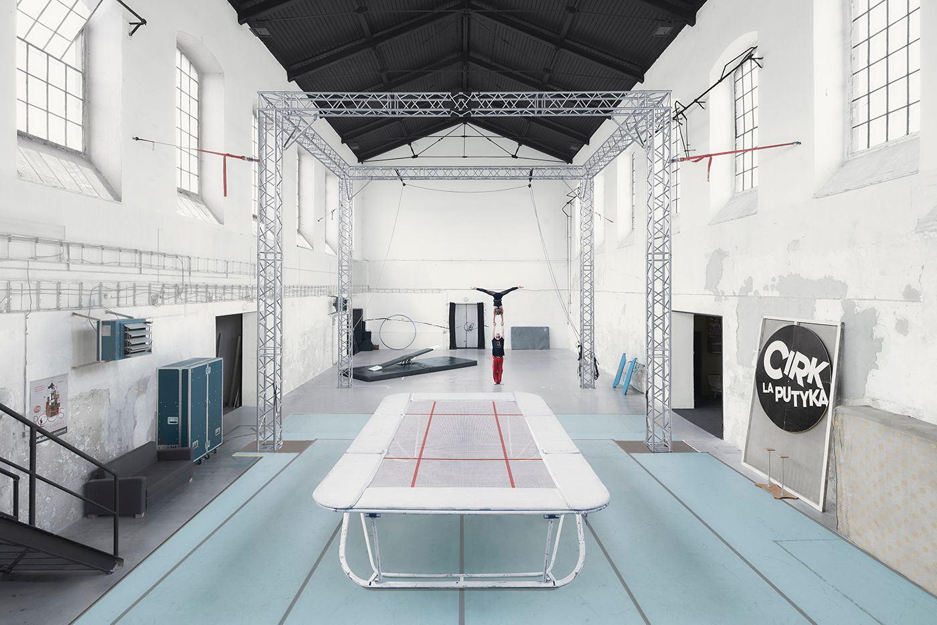
JATKA 78
Venue for new circus, perfoming
^{arts and contemporary dance}
Presenter
Producer
Residency for new circus, dance or drama
Education for new circus
Home of La Putyka comp.
www.jatka78.cz

Slide 14
Venues in regions
  MOVING STATION – Pilsen
  DEPO – Pilsen
  PAPIRNA – Pilsen
  CASTEL ŽDÁR – Cultural Center Ždár nad Sázavou
  DIOD – Jihlava,
  COOL TOUR – Ostrava
  UFFO – Trutnov

Slide 15
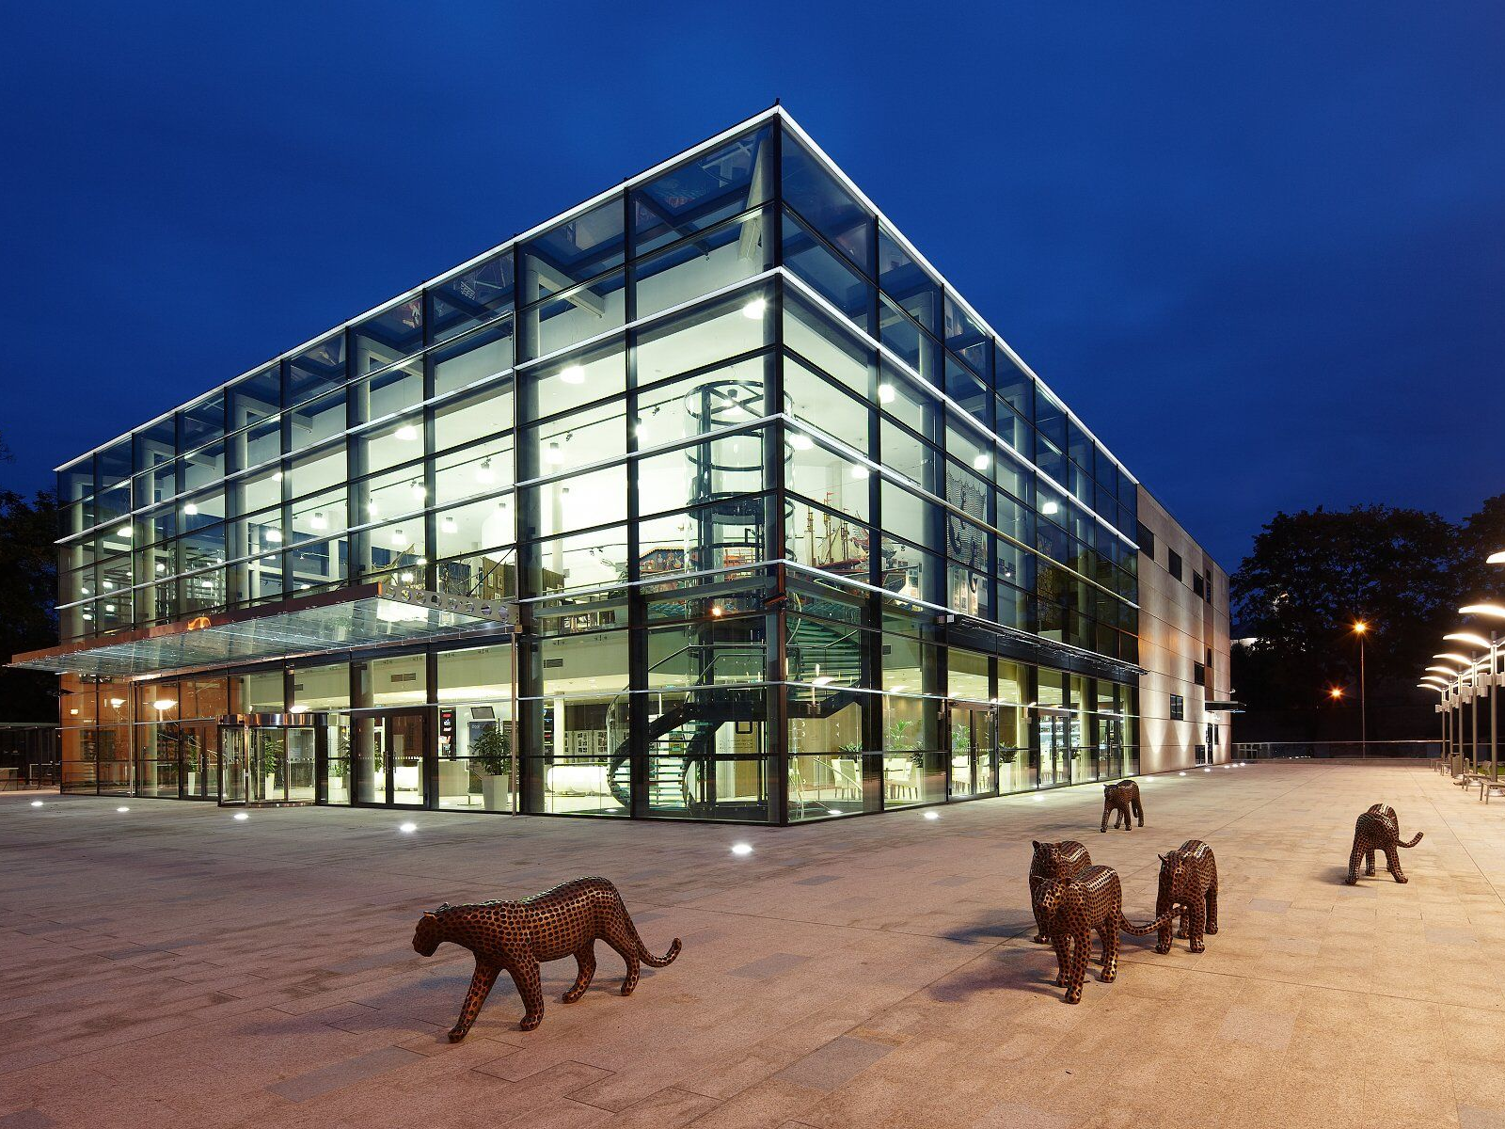
Uffo Trutnov - http://uffo.cz/ cultural center
Social heart of the region
Residential place
Organizer of Cirk-uff festival – new circus

Slide 16
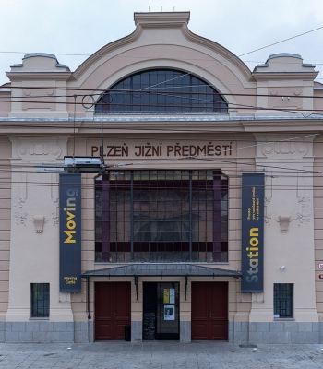
Moving Station centre for cultural and social projects in Pilsen
artistic projects (festivals, theatre and paratheatre projects, production, consulting)
social work (street work, contact and information centre for problematic youth, primary prevention of pathological phenomenon, resocialization projects and work with volunteers)
educational projects (concerned with methods based on educating by art, aesthetic education, drama education and personal and social development)
www.johancentrum.cz

Slide 17
FESTIVALS
WWW.PERFORMCZECH.CZ

Slide 18
In Prague
  The International Festival of Contemporary Dance and Movement Theatre TANEC PRAHA (1989)
  4+4 Days in Motion – International Festival of Contemporary Art (1996)
  Czech Dance Platform (2000)
  Small Inventory – selection of the “new theatre” outstanding performances
  Letní Letná – new cricus festival (2004)
  Zero Point – new forms of physical and street theatre and modern clownery (2008)
  Dance Film Festival (2009)

Slide 19
Festivals in the regions
Flora Theatre Festival – Olomouc (1996)
ProART Festival – (2004)
Tanec Valmez – (2005)
Small and Big Inventory – new theatre ( 2002)
KoresponDance – Žďár nad Sázavou (2009)
Cirk-Uff – Trutnov (2011)
Festival Theatre – Pilsen (1993)
Theatre World Brno – Brno (2010)

Slide 20
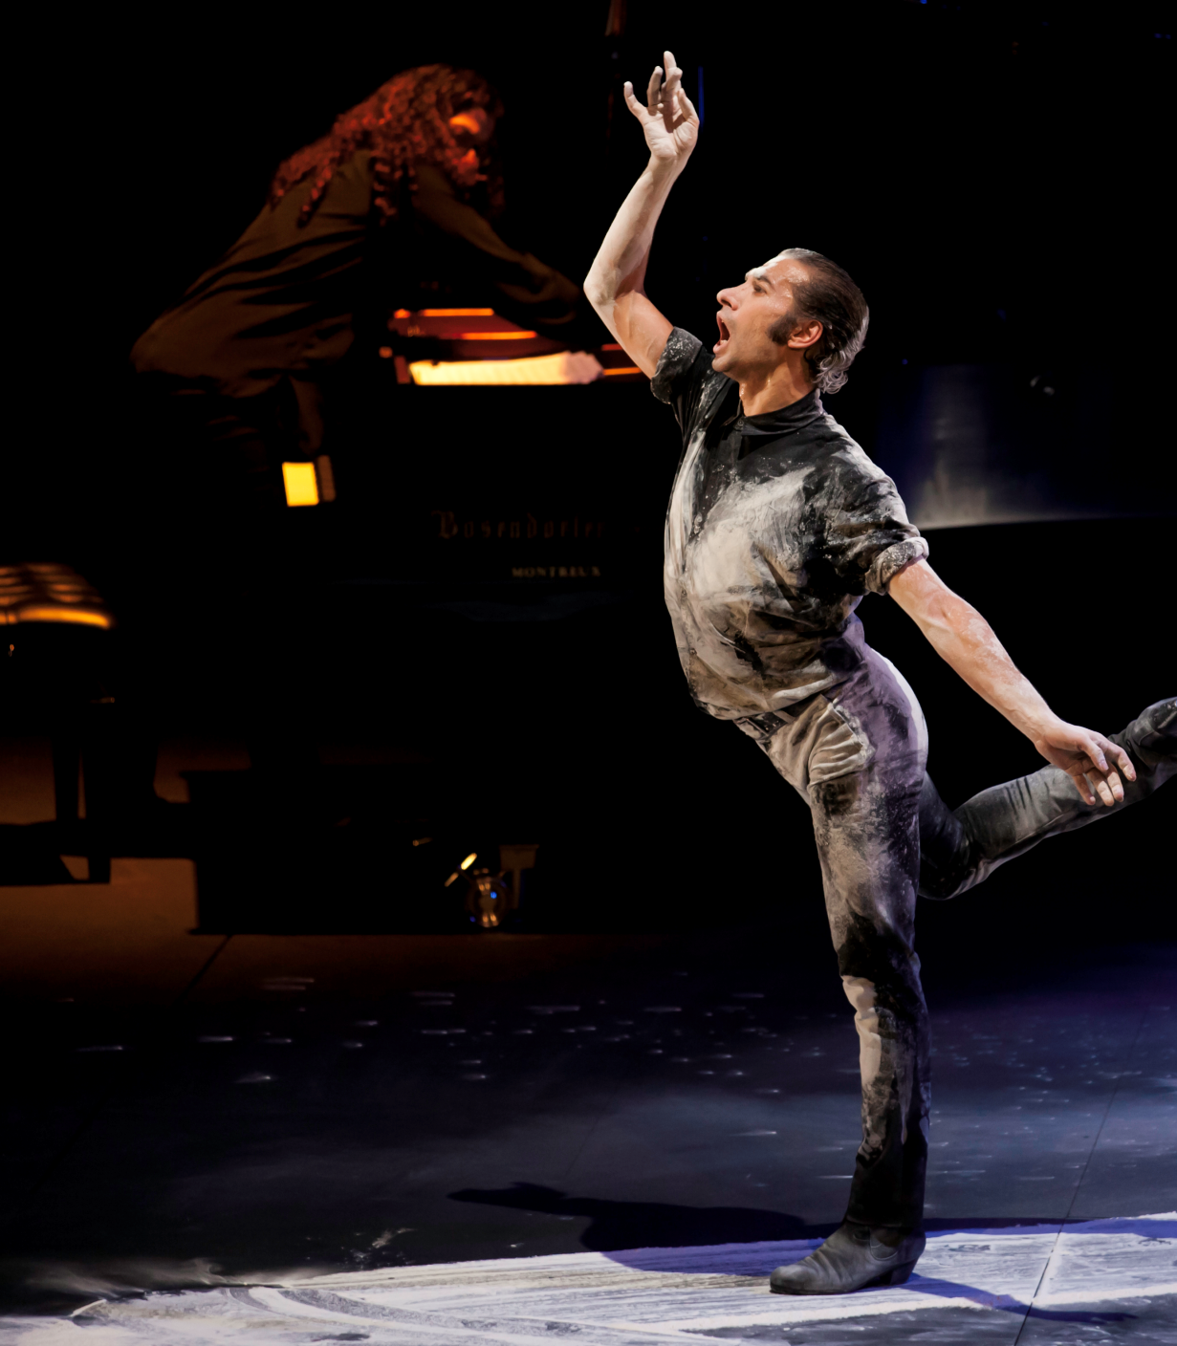
Tanec Praha
The International Festival of Contemporary Dance and Movement Theatre
Held annual in May / June
Founded in 1989
Presentation of the international dance project and CZ creations
Program for professionals
Discussion
Tanec Praha in the regions
Tanec Praha for Children festival
www.tanecpraha.org

Slide 21
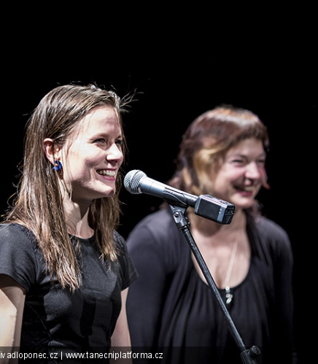
Czech Dance Platform presentation and competition of the best CZ dance projects
Held in April
Based in 2000
Preliminary jury
Festival international jury
Awards:
  Best piece
  Dancer of the year
  Public award
  Best lighting design
  Best dance manager of the year
www.tanecniplatforma.cz

Slide 22
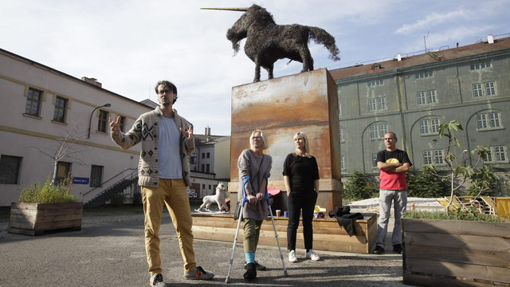
4+4 Days in Motion
International Festival of Contemporary Art
Held annual in October
Based in 1996
Presentation of dance and movement theatre and the artist of visual and kinetic art
Specific aspect: focus on un-traditional spaces
Organizer of number international site specific projects, co-production projects with other European organisations, seminars, membership in international associations and organisations, and consultation activities in the field of cultural management
www.ctyridny.cz

Slide 23
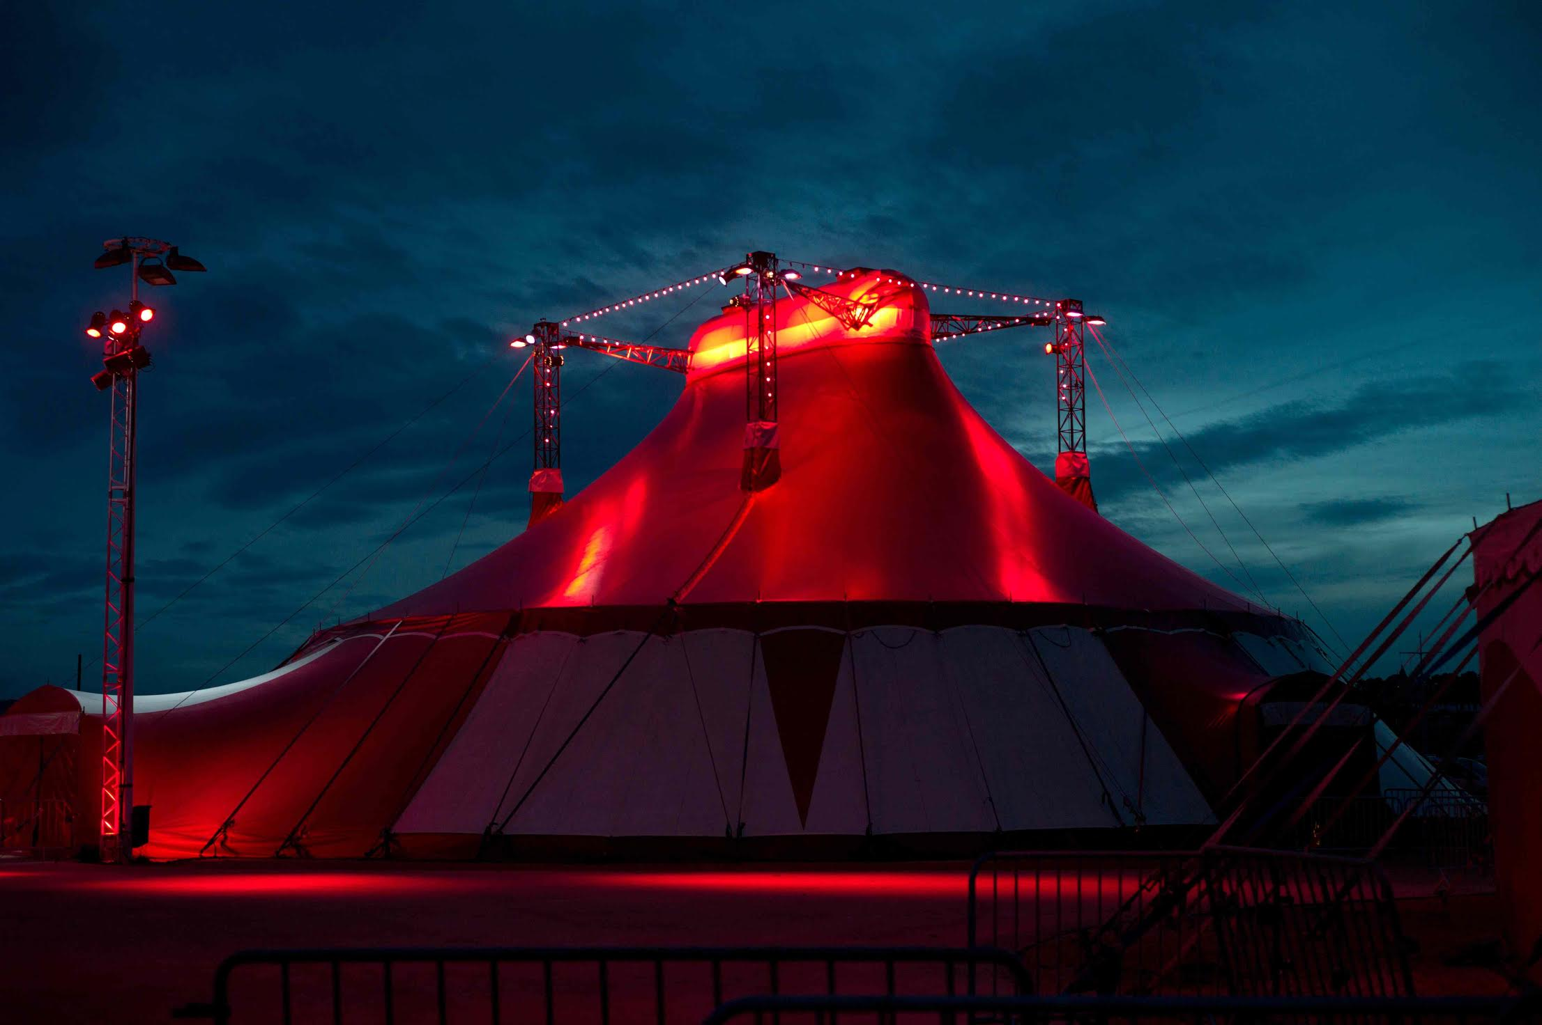
Letní Letná
Held annual August / September
Founded in 2004
takes place in the romantic area of Prague park Letná – out and in the tents
Presentation of the best of international contemporary circus
cultural and leisure activities to children and their families
solid platform presenting the work of Czech contemporary circus
co-producer of European projects
www.letniletna.cz

Slide 24
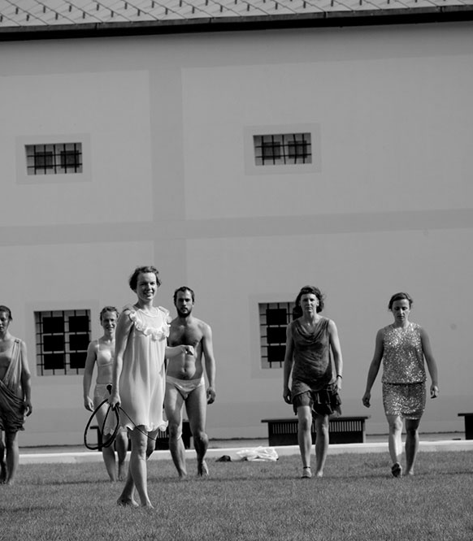
KoresponDance
International festival of modern dance and physical theatre
Held in July
Founded in 2009
Castle Žďár nad Sázavou – romantic historical area
Interdisciplinary program – dance, music, visual arts
Open air projects
Program for professionals – workshops, discussions, presentations
Program getting together international artists and local people
Walks and guided tour across historical building and new museum
www.korespondance.cz
www.se-s-ta.cz

Slide 25
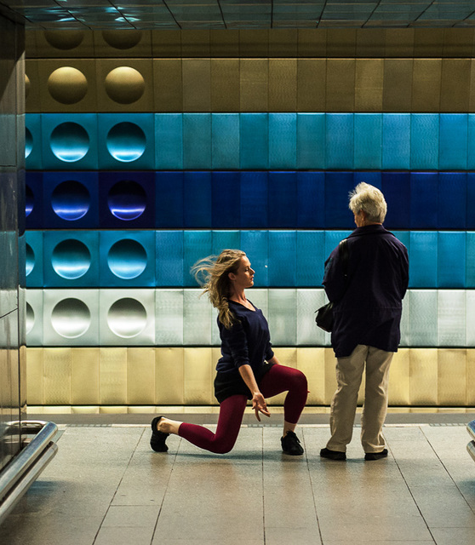
Dance Film Festival
Biennial
Founded in 2009
Presentation dance for camera films, documentaries and best stage recording
Workshop Dance and camera – develop CZ dance cinematography
Production of dance for camera films
www.tanecnifilmy.cz

Slide 26
Other important subjects
Association of the Professional Theatres - http://www.asociacedivadel.cz/
Association of the Independent Theatres - http://andcr.cz/
Theatre Faculty of the Academy of Performing Arts in Prague // www.damu.cz
Theatre Faculty of the Janáček Academy in Brno // www.jamu.cz
Se.S.Ta – Centre of choreographic development // http://www.se-s-ta.cz/uvod.php
Dance career endowment fund // http://tanecnikariera.cz
New web // http://www.novasit.cz

Slide 27
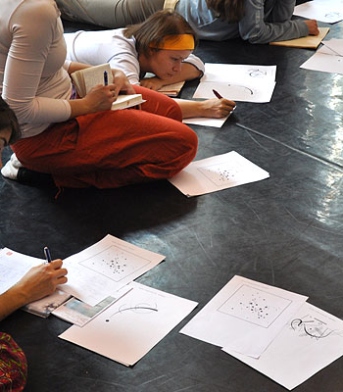
SE.S.TA centre of choreographic development
Founded 1999
The mission: foster the development of professional contemporary dance in the Czech Republic in international context.
Further education for dance professionals (choreographers, dancers, pedagogues, critics and theoreticians) in international context, in the form of creative workshops, seminars, residencies in the Czech Republic and abroad, research workshops, etc.
Production and coproduction of new contemporary dance pieces in cooperation with Czech and foreign artists and institutions.
Distribution of productions of contemporary dance in the Czech Republic and abroad.
Cultivating audiences – activities that allow artists and audiences to interact more intimately (lectures, exhibitions, commented presentations, discussions with artists an many more).
www.se.s.ta.cz

Slide 28
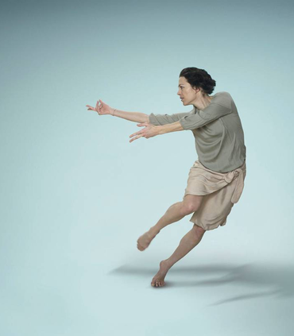
Dance career endowment fund
Founded in 2015
Mission:
The Fund helps professional performing artists (dancers, mimes, performers, acrobats etc.) cope with personal and professional changes that follow the end of active career in the respective field
up-to-date information on the job market situation
individual coaching
career and personnel consulting
individual psychological consulting
legal counselling
informative thematic seminars and workshops
Lobbying
www.tanecnikariera.cz

Slide 29
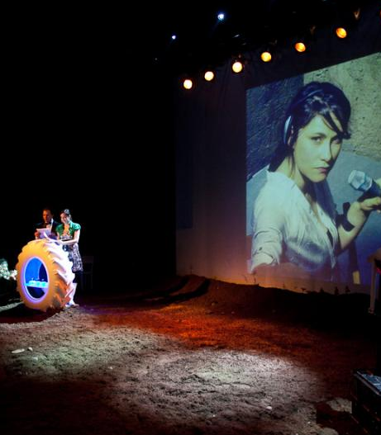
NEW WEB
Founded 2004
helping to develop contemporary art and civic society in the Czech republic and abroad
Organizer of Small and Big Inventory – new theatre, and dance festival
Focus on circulation of the projects across the country
Production of theatre projects
Residences
Education
Arts advocacy
Networking
www.novasit.cz

Slide 30
Thank you for your attention
Jana Návratová
T 224 809103
E jana.navratova@idu.cz
Celetná 17, 110 00 Praha 1 | T 224 809 134 | F 222 326 121 | www.idu.cz

