Slide 1

Information seminar Oslo 14. february 2019

Slide 2
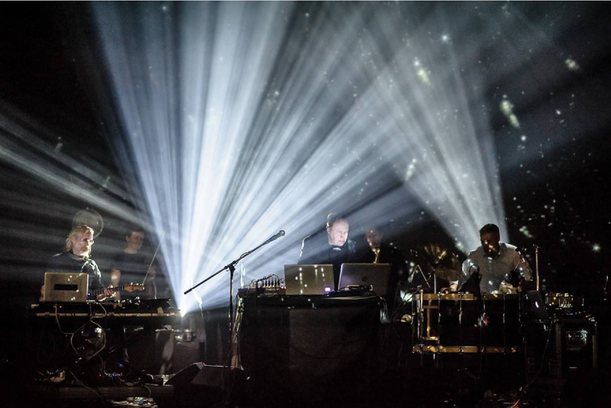
EEA Grants
- We strengthen bilateral relations with 15 EU countries and reduce economic and social disparities in the European Economic Area
Knowledge
Network
Inspiration
The picture is from PUNKT festival, a project between Norwegian and Czech musicians.
Notes:
Desiré

Slide 3


Slide 4
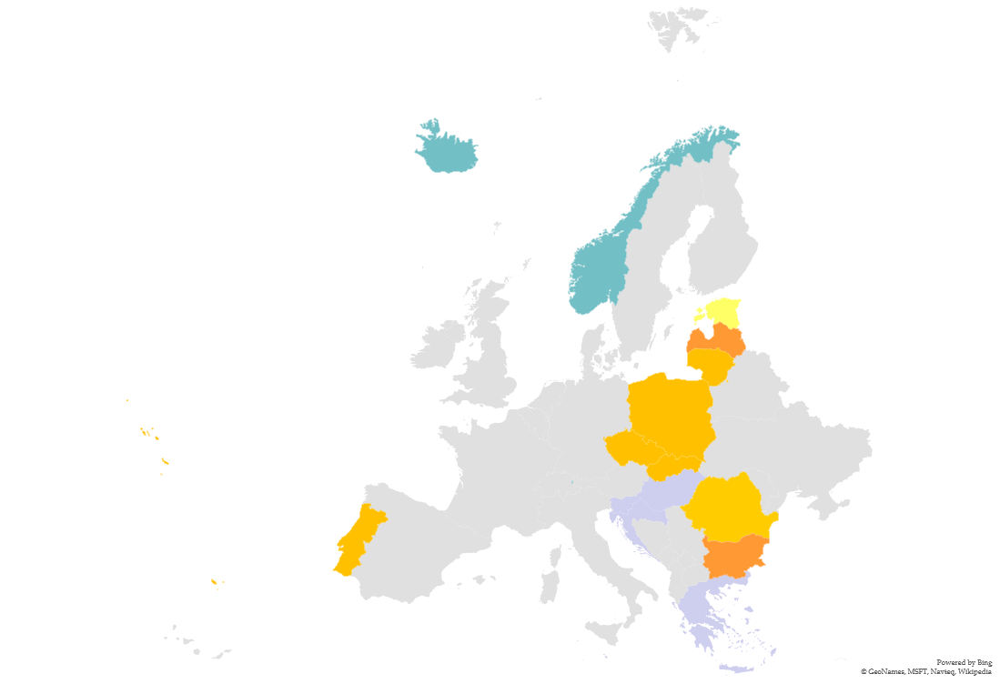
Countries of cooperation
Czech republic
Bulgaria
Latvia
Lithuania
Poland
Portugal
Romania
Slovakia
Notes:
Desiré

Slide 5
Arts Council Norway – EEA Grants
Arts Council Norway cooperates with Programme Operators as a Donor Programme Partner.
We provide advice on our area of expertise, cultural cooperation and contemporary arts.
Assist in facilitating bilateral partnerships.
EEA grants opens possibilities for dialogue and cooperation in a range of areas.

Slide 6
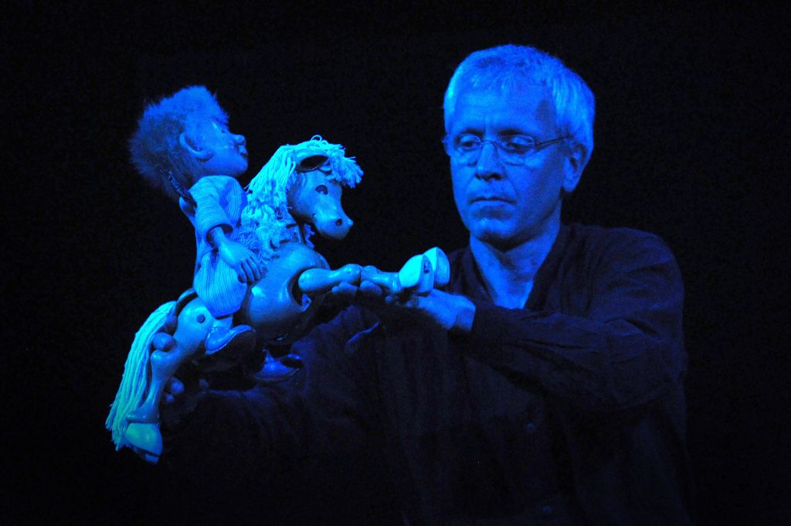
Cultural cooperation – examples of projects
ONLY IN CZECH R: Arts Critisism
Co-production of contemporary arts
Mobility of arts and culture initiatives
Audience development
Arts and culture as creative placemaking
Cultural entrepreneurship
Networks
Competence building
Documentation of culture and arts
Bringing arts and culture to new groups
The picture is from the theatre project Folk Tale with Teater Innlandet and the czech companies Divadlo ANPU and Buchty a loutky.
Notes:
Anna – prosjekteksempel

Slide 7
Travel
Grants/seed money
From Norway to the Czech rep. or the other way round
Match-making seminar
Usually in beneficiary country
Calls
Open ca 3 months
Project-
application and cooperation
High ambitions
Activities
Both countries
Notes:
Kristine – 2 min
Rediger den himla fargen…

Slide 8
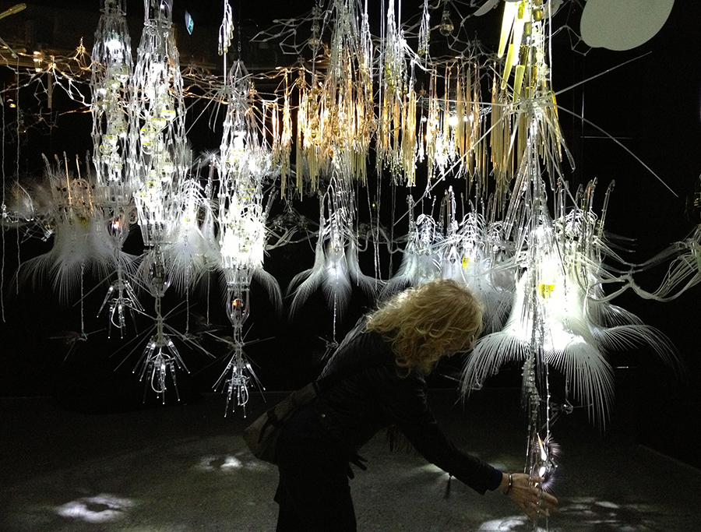
TRANS(e)MISSION was a cooperation between CIANT in Prague and TEKS in Trondheim.
Notes:
Anna- prosjekteksempel

Slide 9
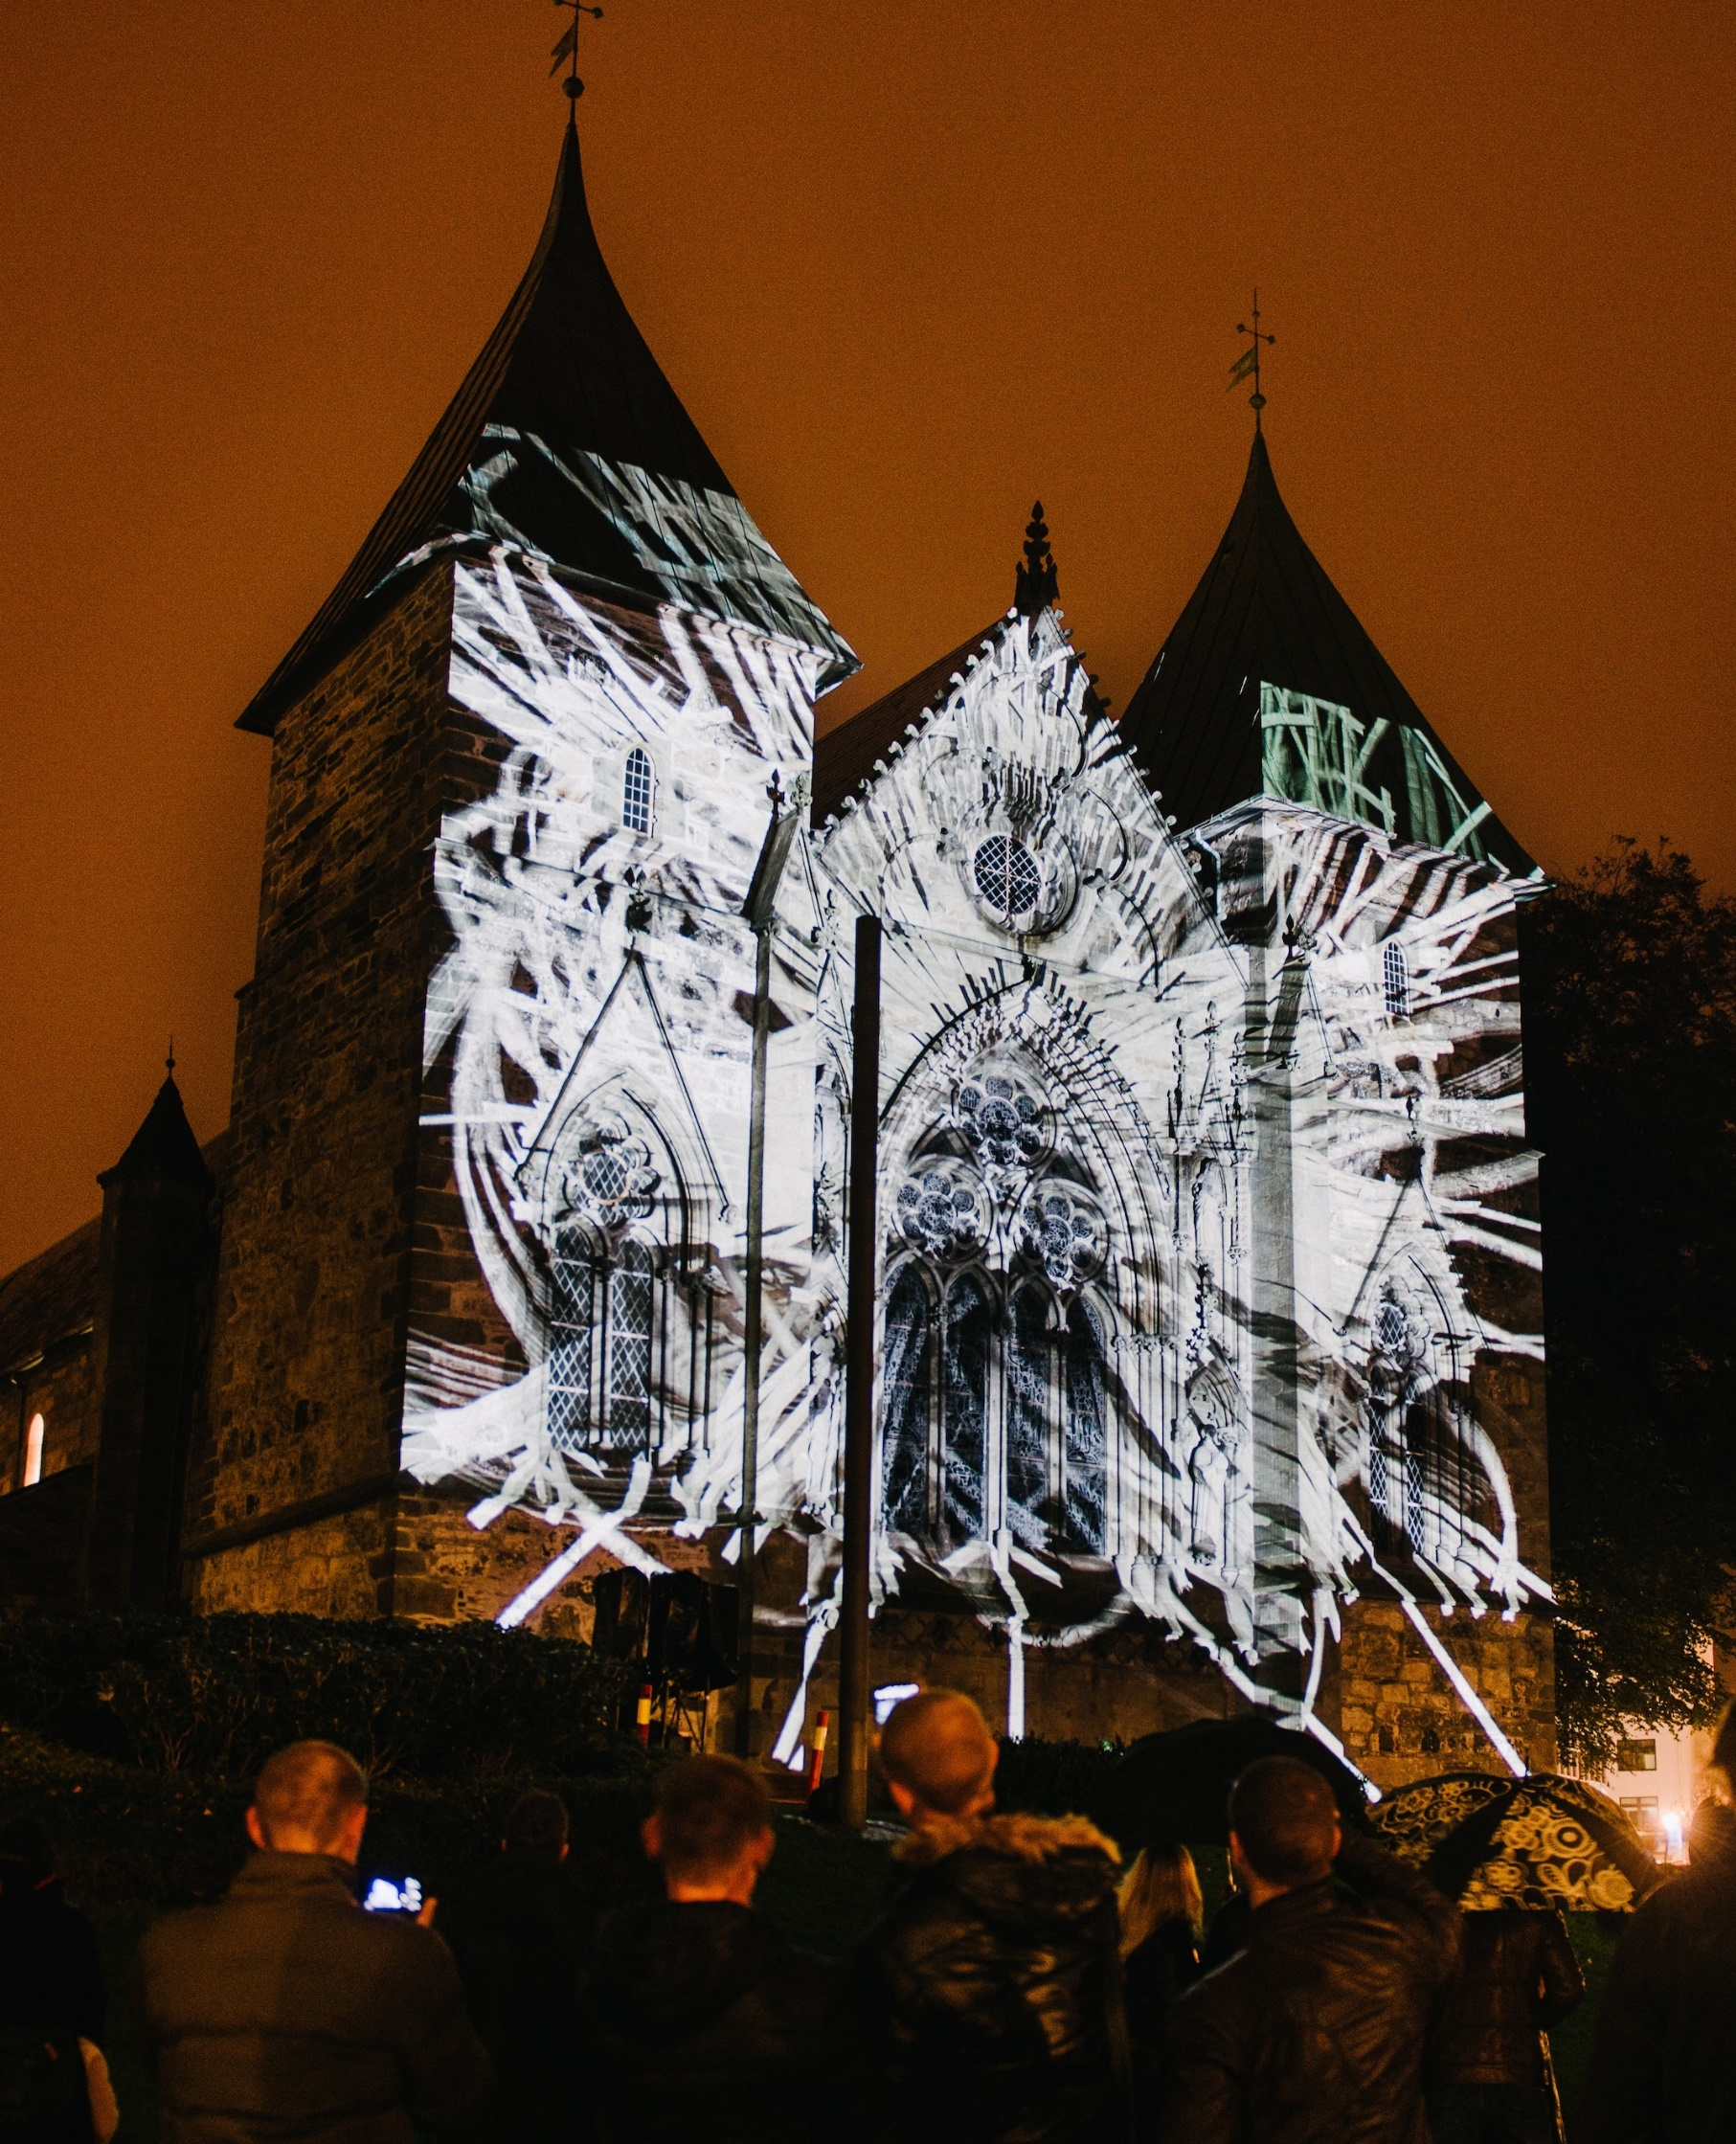
Norwegian project partners
Close to 300 Norwegian partners involved in the EEA and Norway Grants (2009-14)
60% are registered outside of Oslo
Spread across different sectors, size and type of organisation
The Norwegian-Czech project Screen City presenting moving images in public spaces.

Slide 10
Contact information: EOS-kultursamarbeid@kulturradet.no
Arts Council Norway: www.kulturradet.no
Anna Benedicte Stigen: abs@kulturradet.no

