Slide 1
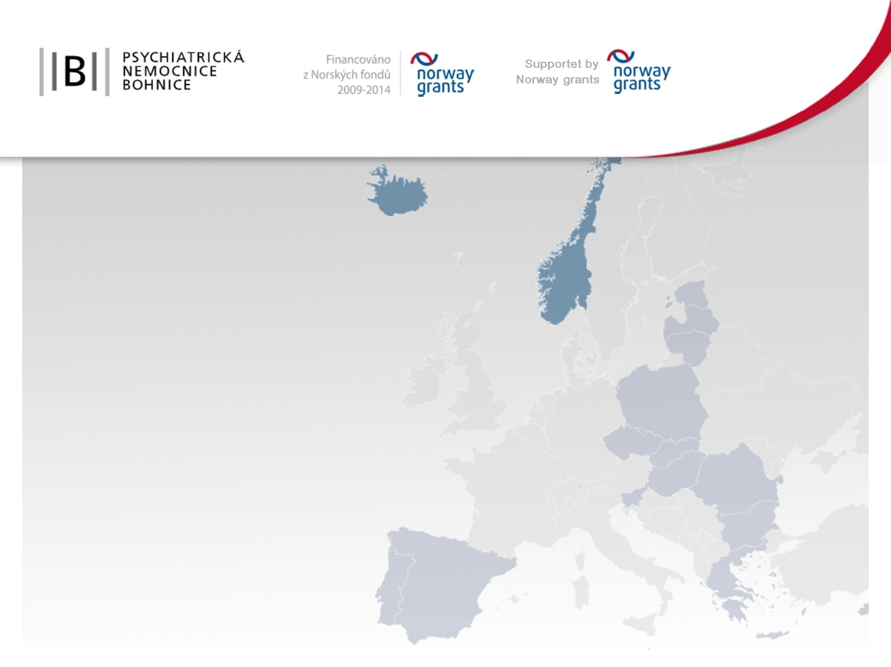
Project SOMA
Vojtěch Malina
Presentation on projects implemented by Mental Hospital Bohnice within Norway Grants – examples of bilateral cooperation

Slide 2

Programme number: PROGRAM CZ11 approved within EEA Financial Mechanisms / Norwegian Financial Mechanisms
Project title: “SOMA: Psychical health care for mentally ill patients and independent life skills training”
Project number: NF-CZ11-OV-2-030-2015
Grant applier: Psychiatry hospital Bohnice, Ústavní 97/7, 181 00 Praha 8
Imtermediary: Ministry of Finance - Czech Republic

Slide 3
S. O. M. A.
Systém Ovlivnění Metabolismu a Aktivity
S. I. M. A.
System of Influence of Metabolism and Activity

Slide 4
PHB – project SOMA – grant 19 690 497,- CZK (80 %)
Total project costs – 24 613 122,- CZK (100 %)
Realization: 1st January 2015 – 30th April 2016
Prolongation: till 31st August

Slide 5


Project Partners:
Czech technical University in Prague, Faculty of Bioemedical Engeneering in Kladno
Universitetssykehuset Nord-Norge (UNN) in Tromso, NST

Slide 6
Budget according to partners (100 %):
Grant applier PHB 21 607 619 CZK
Partner FBME CTU 1 190 670 CZK
Partner NST 1 597 200 CZK
Equal:
Grant applier PHB 7 202 563 NOK
Partner FBME CTU 366 134 NOK
Partner NST 491 144 NOK

Slide 7

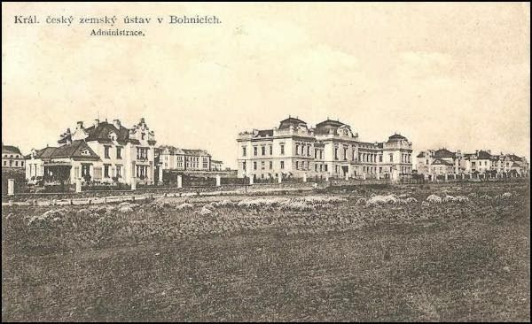
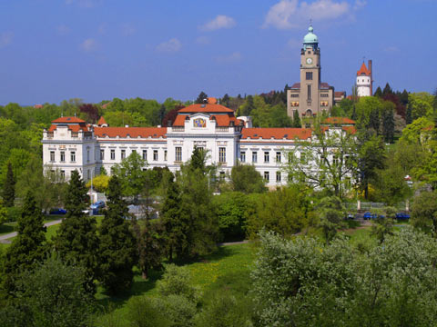
PHB

Slide 8
PHB – Project activities:
1) Project management
2) Creating a system of comprehensive rehabilitative care for the physical health of the mentally ill
3) Creating a system of training in independent living skills
4) Implementation of comprehensive rehabilitative care for the physical health of the mentally ill and practicing skills for independent living and related skills
5) Construction works and purchase of equipment
6) PEER Club

Slide 9
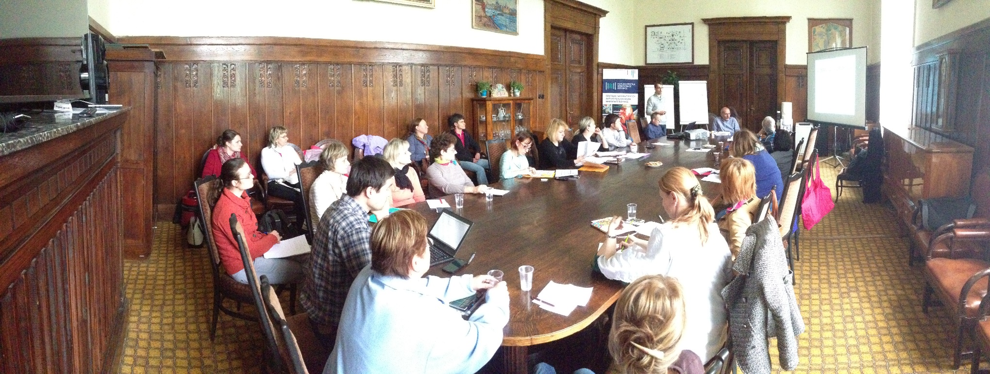
Two new standards:
methodology of complex rehabilitative care of physical health of patients with mental illness
Physiotherapy Nutrition therapy
Occupational therapy Kinesio therapy
methodology of comprehensive rehabilitative care training in independent living
HIS – developement and implementation of new standards into HIS

Slide 10
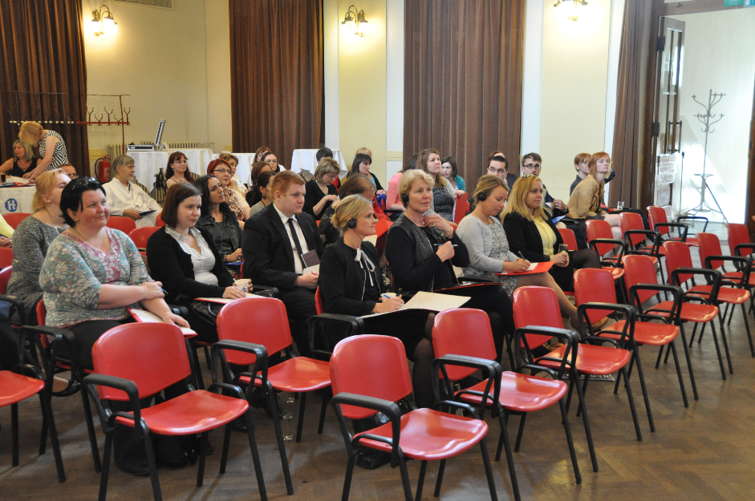
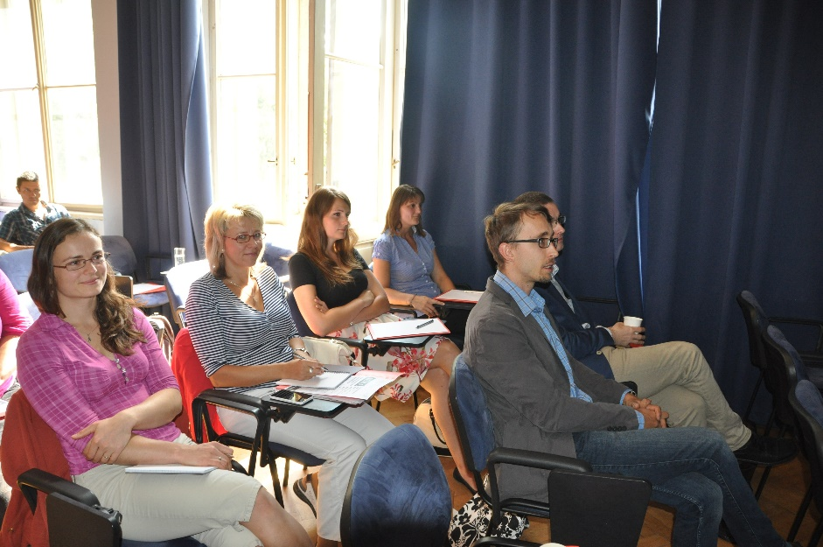
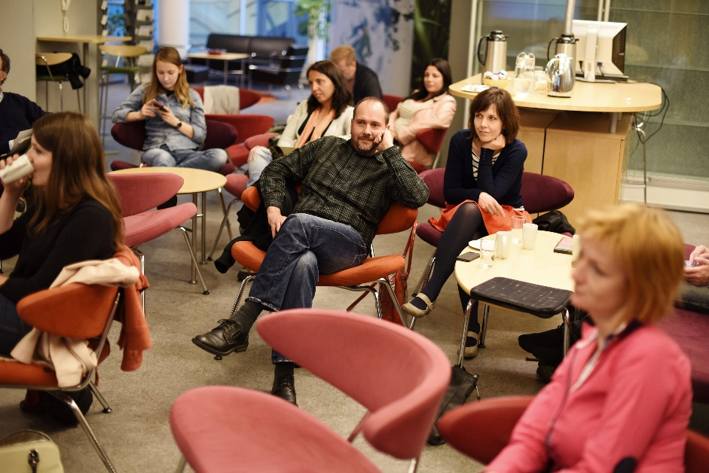
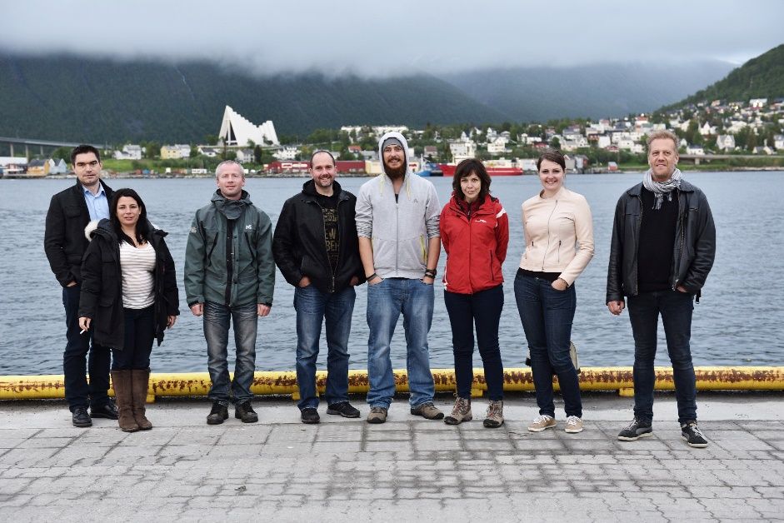

Slide 11
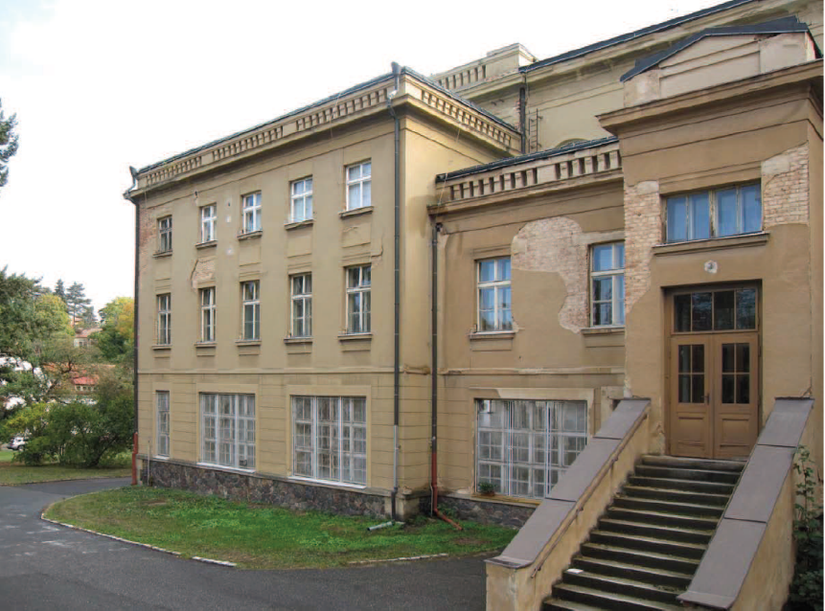
Rocenstruction works:
Fyziotherapy – Theatre building
Training flats
Pavilion 13
Pavilion 30
Peer activity

Slide 12
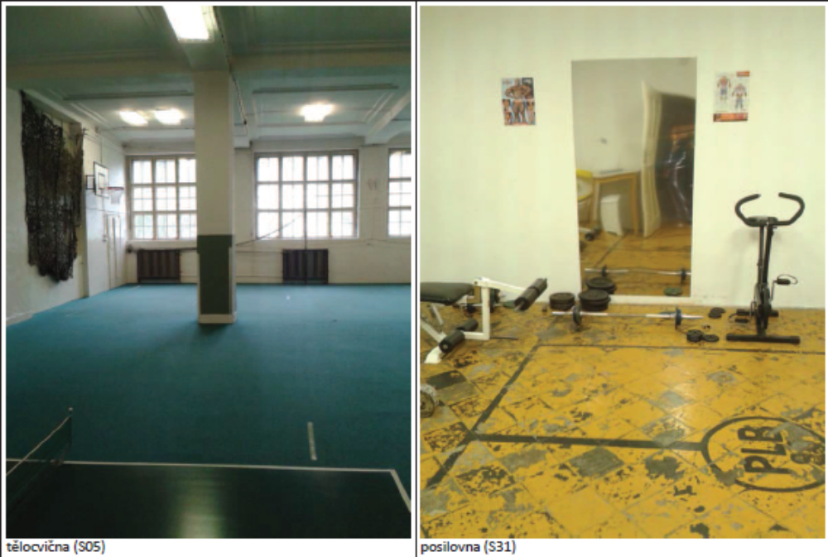

Slide 13
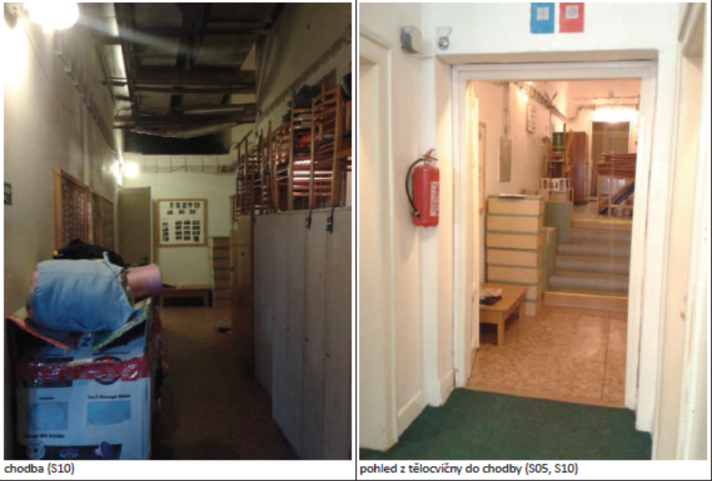

Slide 14
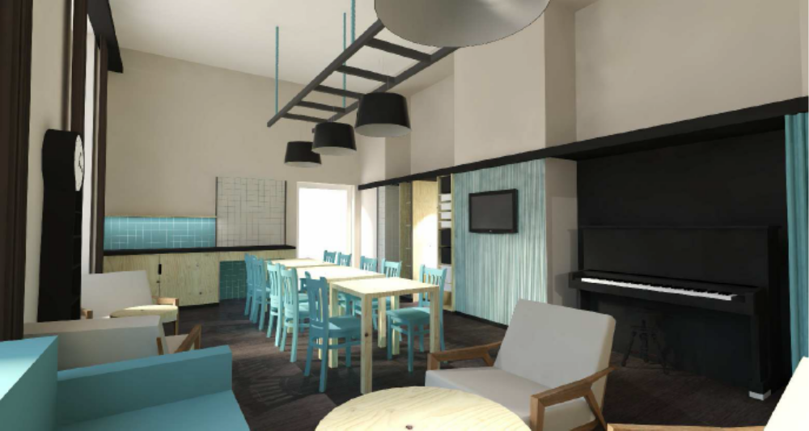

Slide 15



Slide 16
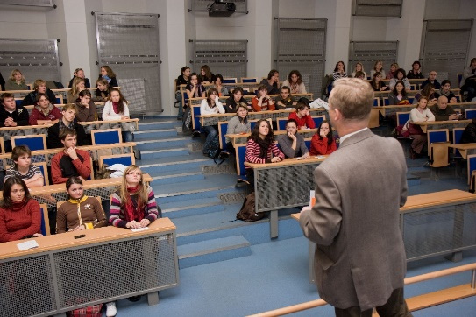
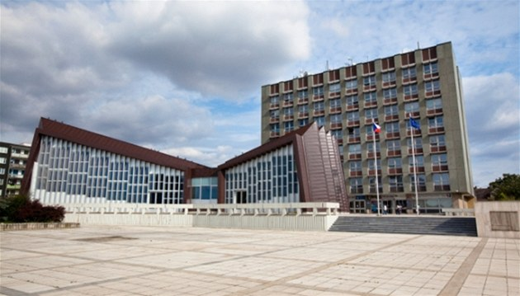
FBME

Slide 17
SOMA – pilot ministudy for physical activity
DisplayName | Days | Avg | Min | Max
AK1522 | 2 | 14759 | 7421 | 22097
BV0022 | 5 | 6912.2 | 1734 | 14673
DCH0159 | 2 | 5617 | 3770 | 7464
DK0006 | 5 | 3942.2 | 1222 | 8481
JK0065 | 2 | 221.5 | 83 | 360
JP0050 | 2 | 6160 | 4385 | 7935
LCH4782 | 5 | 7546 | 3687 | 14190
LM0270 | 4 | 6977.75 | 4337 | 10188
MK4292 | 3 | 3738.667 | 8 | 8725
MN0266 | 4 | 7699.25 | 3765 | 11090
RM0796 | 5 | 22291 | 16189 | 28230
VL0929 | 5 | 2437 | 1234 | 3212
VP3656 | 4 | 1387.25 | 22 | 2470

Slide 18
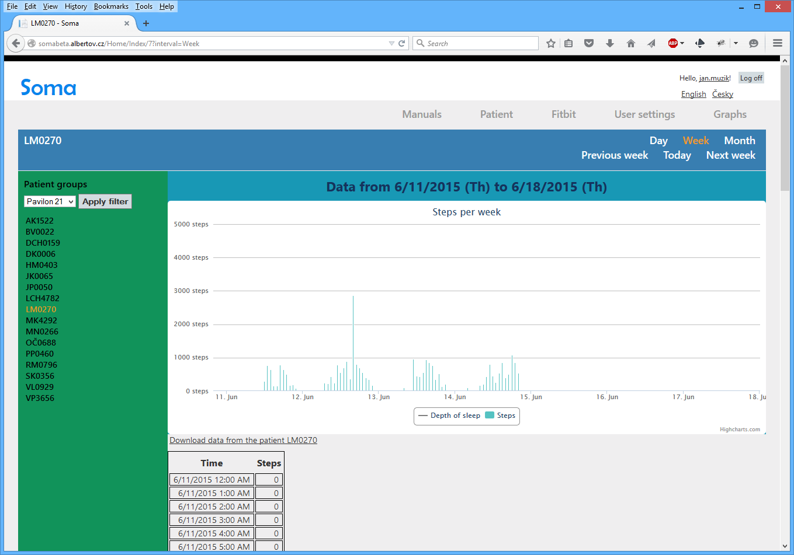
SOMA web – physical activity

Slide 19
Data collection in training housings
Remote collection of physiological data from wireless devices
Physical activity
Sleep – length, regularity, sleep phases
Location tracking
Body weight, body composition (fat percentage)
Use of home appliance

Slide 20
Integration into a HIS
Patient data from wearable electronic, telemedical system and training flats automatically incorporated into the PHR
HIS Hippo – specialized for Psychiatry hospitals
All but one psychiatry hospital in the Czech rep.
Proposed communication interface: HL7 FHIR
Current stage: preparations of the pitch requiremens

Slide 21
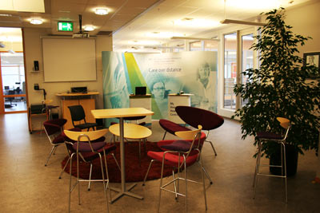
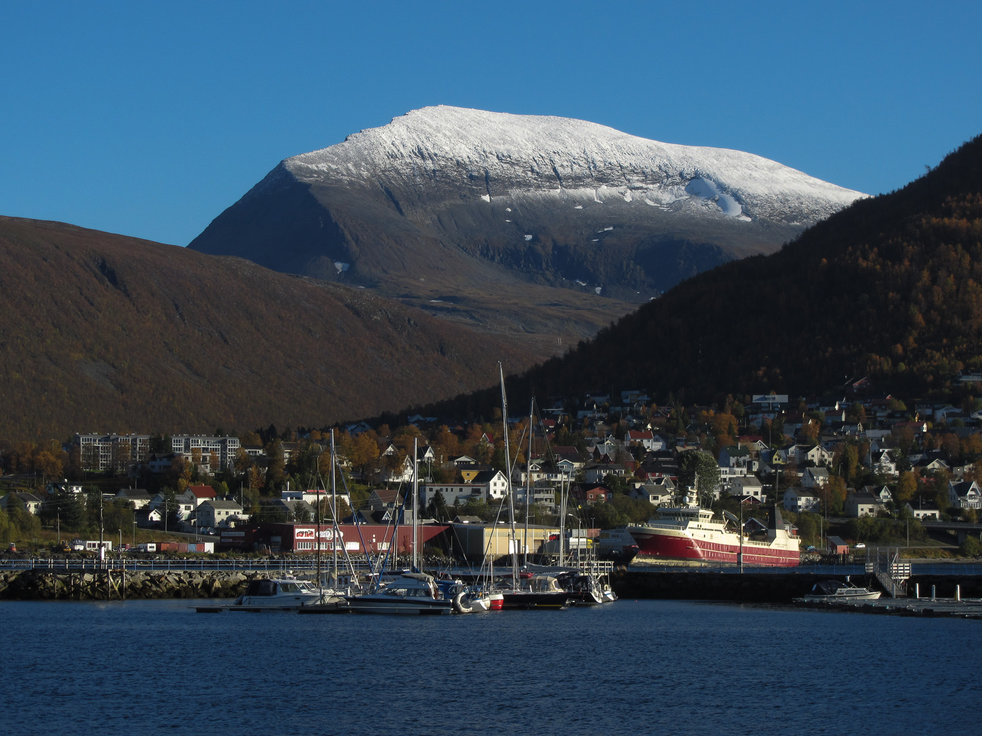
NST

Slide 22
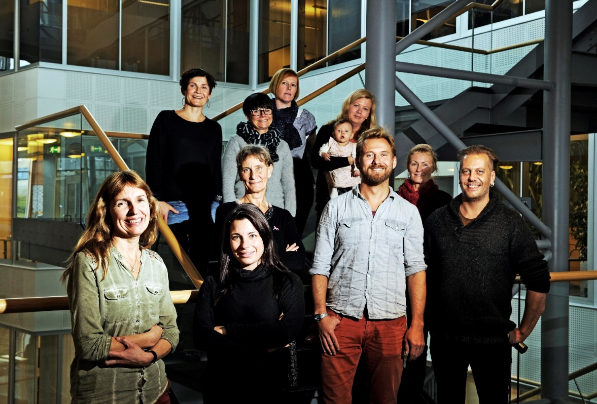
NST – Norway - Tromso
e-Hospital Research
15 Researchers
-12 PhD
- 3 PhD-students
Multidisciplinary background
Health (Medicine/ Nursing)
Technology
Sociology

Slide 23
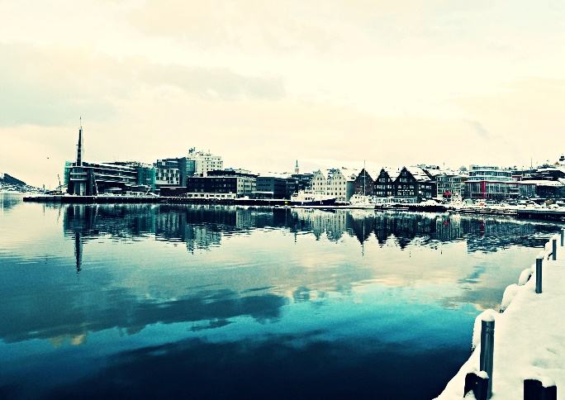
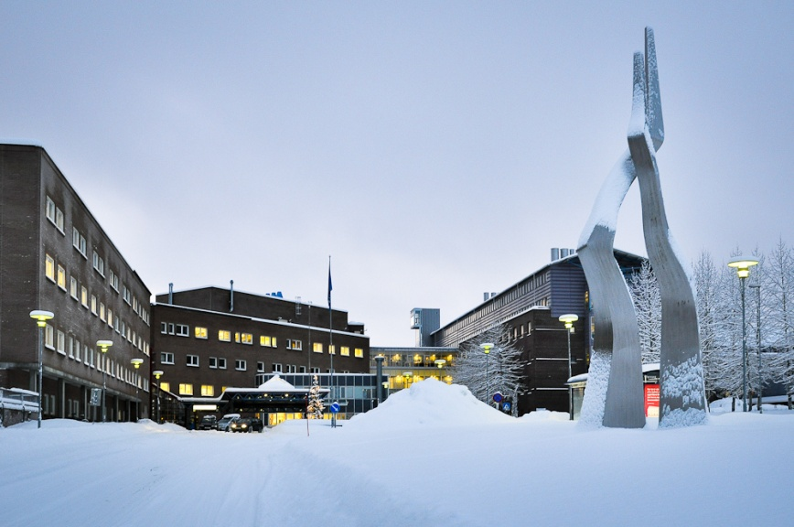
NST Tasks:
HIS consultancy
Providing meeting new partners
Medical process optimalization
ICT tools in hospital
Telemedicine tools
Publication works

Slide 24
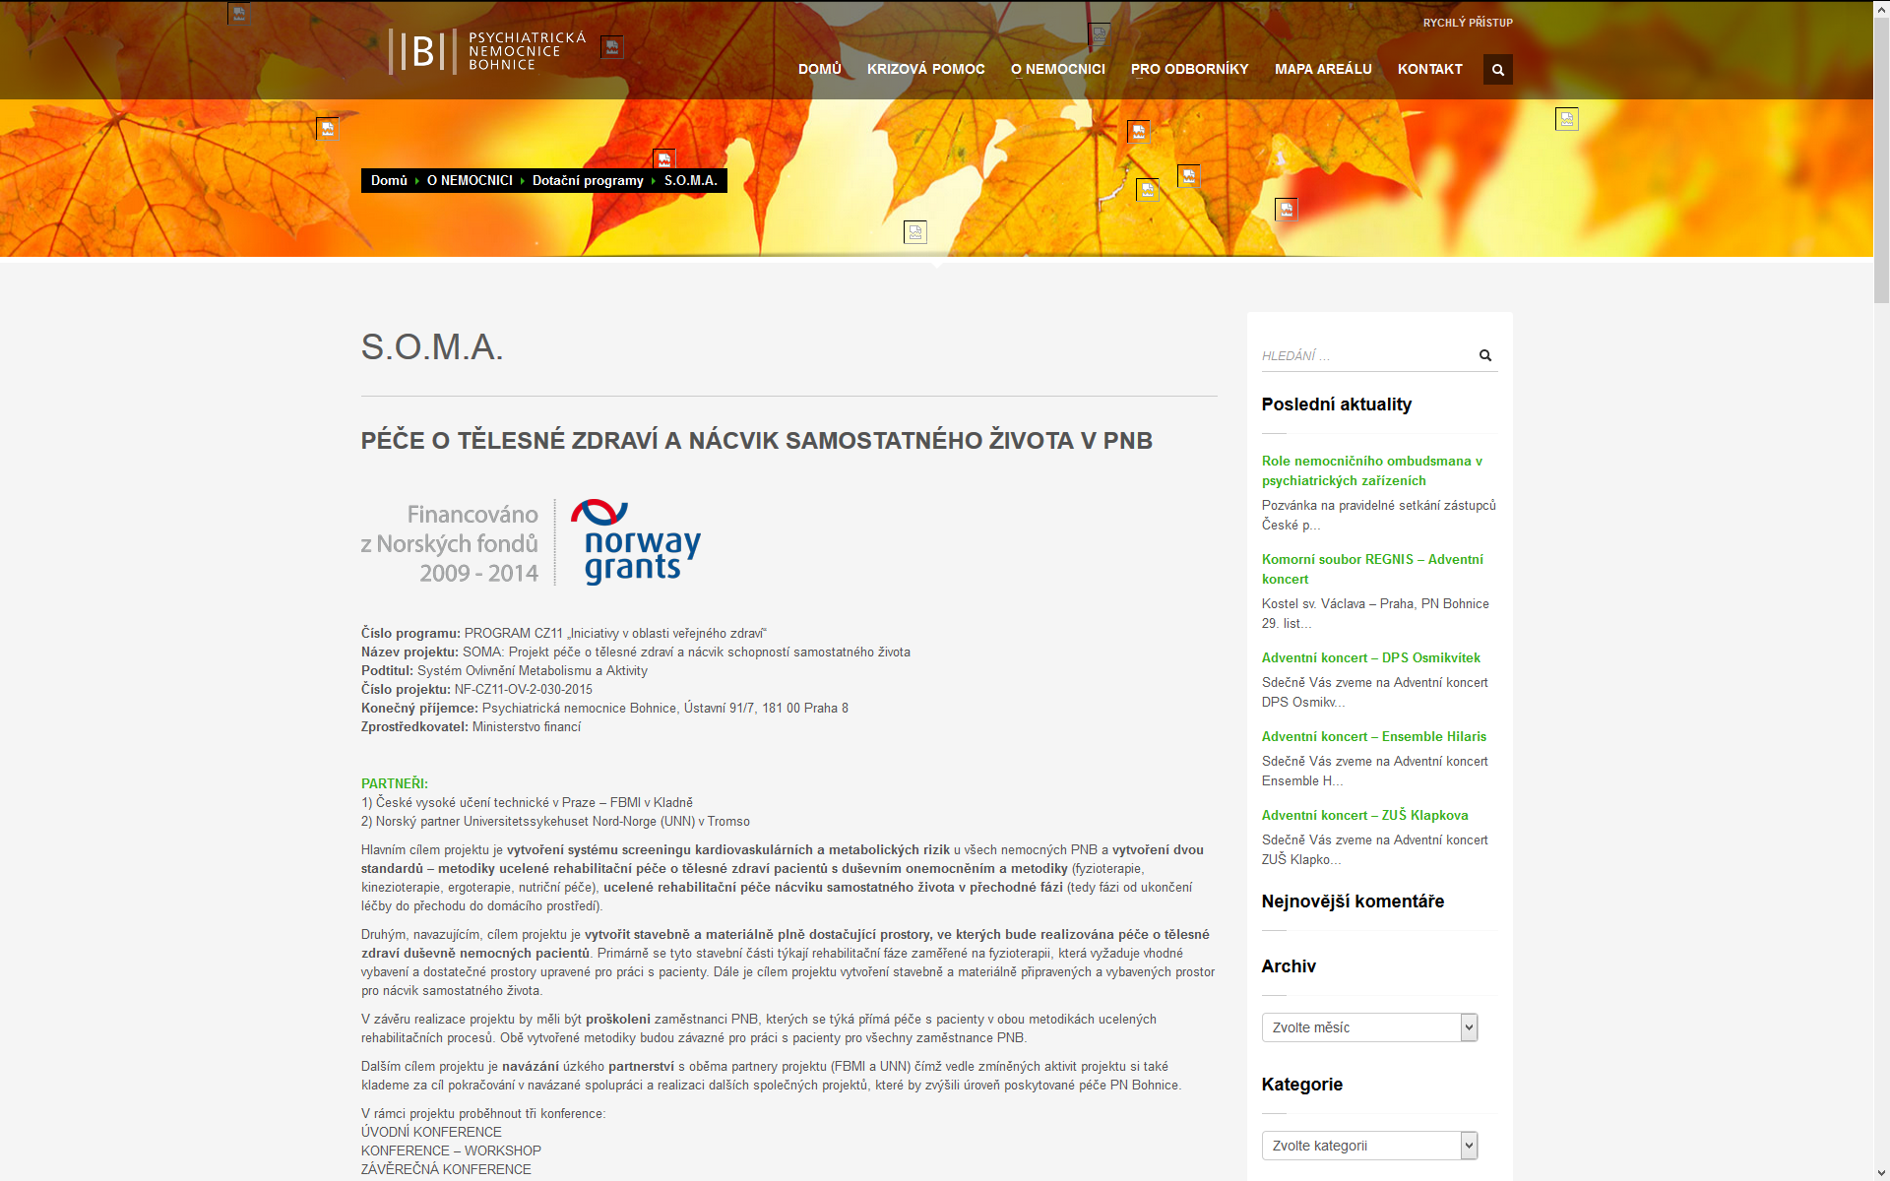


http://www.bohnice.cz/o-nemocnici/dotacni-programy/soma/

Slide 25
Thank you!
Q&A
Vojtěch Malina
vojtechmalina@seznam.cz
+420 725 005 630

Slide 26
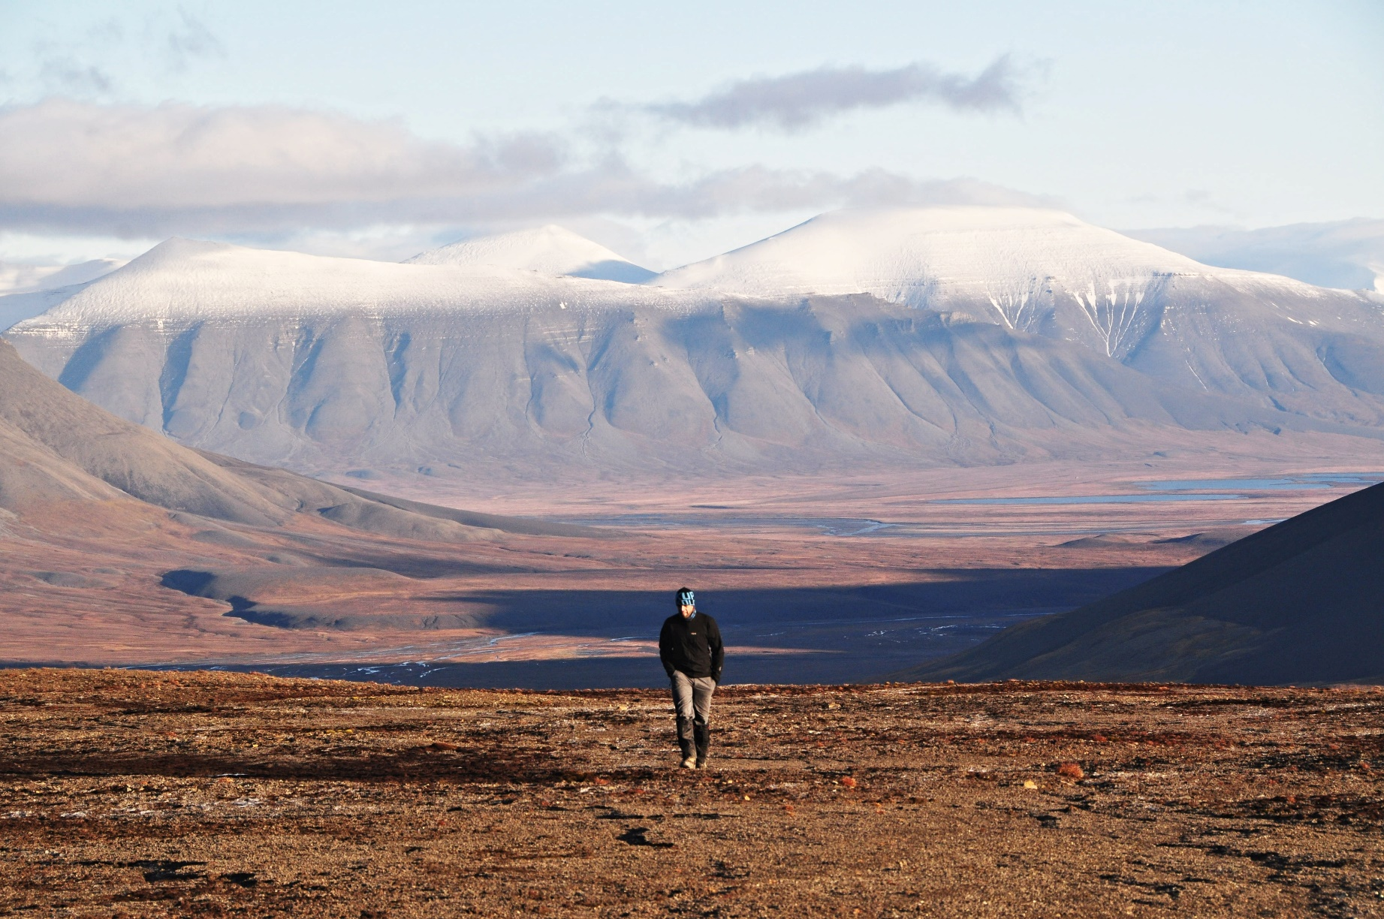
Vojtěch Malina vojtechmalina@seznam.cz +420 725 005 630

