Slide 1

Perspective of the Donor Programme Partner on bilateral cooperation
Marte Kvernland
Solfrid Johansen
Andrej Grjibovski

Slide 2
Aims of the programme
To reduce health inequalities in the Beneficiary States
To improve Public Health in the Beneficiary States
To improve bilateral relations between the Beneficiary States and the Donor States

Slide 3
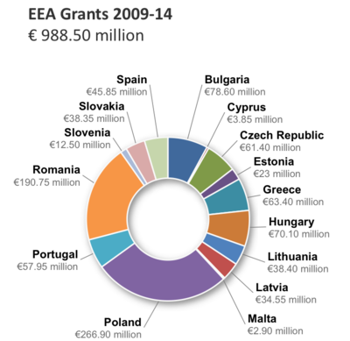
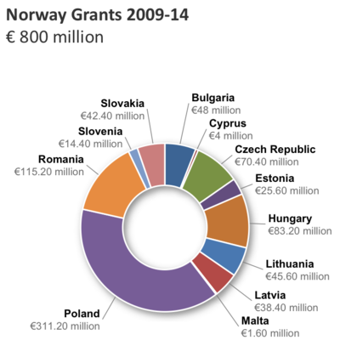

Slide 4
Donor Programme Partners
No DPP
  Bulgaria
  Cyprus
  Lithuania
  Romania
The Norwegian Directorate of Health
  Poland
The Norwegian Institute of Public Health
  Czech Republic
  Estonia
  Hungary
  Portugal
  Slovenia

Slide 5
We as a DPP invested a considerable amount of time in establishment of bilateral contacts
Contacts not just for reporting, but for development of meaningful cooperation
We are interested in development of cooperation beyond the EEA Grants / Norway Grants

Slide 6
Any achievements?

Slide 7
Do incentives pay off?

Slide 8
Use of opportunities for promotion of bilateral activities
Expert meetings
Launch conferences
Study trips
Conferences in the beneficiary states or in Norway

Slide 9
Involvement of the DPP
Many inquiries (often poorly specified)
Example: psychiatric care
Many inquiries from countries we are not a DPP for
Arrangement of study trips

Slide 10
Prerequisites for successful bilateral cooperation
Mutual understanding of the topic
Motivation and enthusiasm
Both parties see opportunities (what’s in it for me?)
Clear procedures (reimbursement etc)
Opportunities beyond the EEA Grants

Slide 11
Examples
A large-scale epidemiological study in the field of mental health in Estonia
Development of cooperation with the National Institute of Public Health in Portugal beyond the Grants incl. application to Horizon 2020
Input on how Norway can improve its health registries

Slide 12
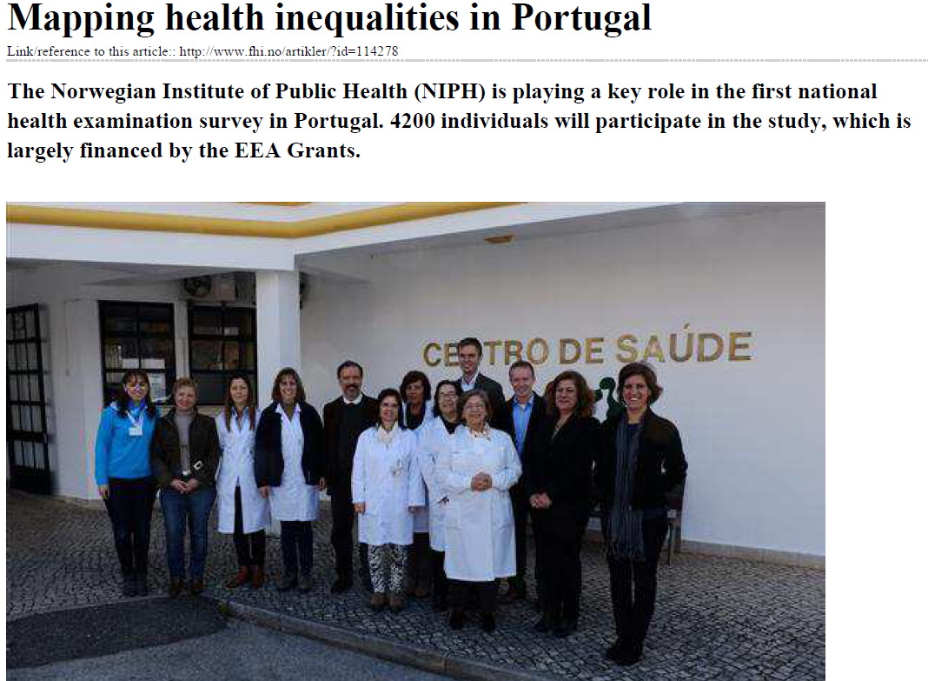

Slide 13
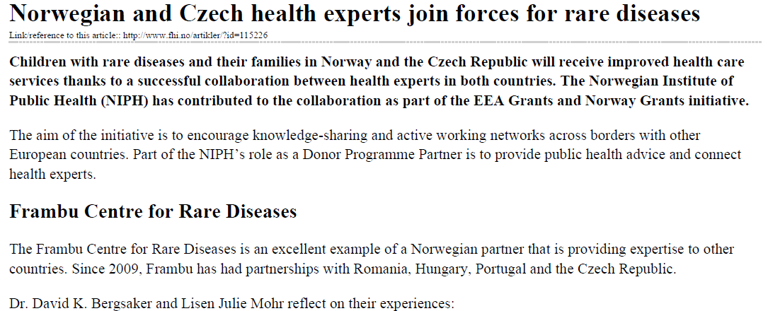
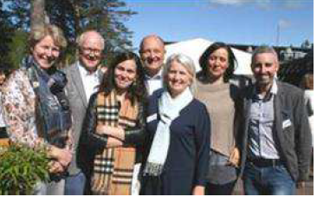
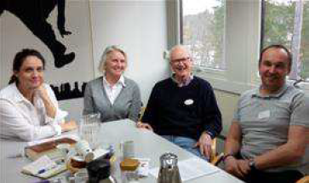

Slide 14
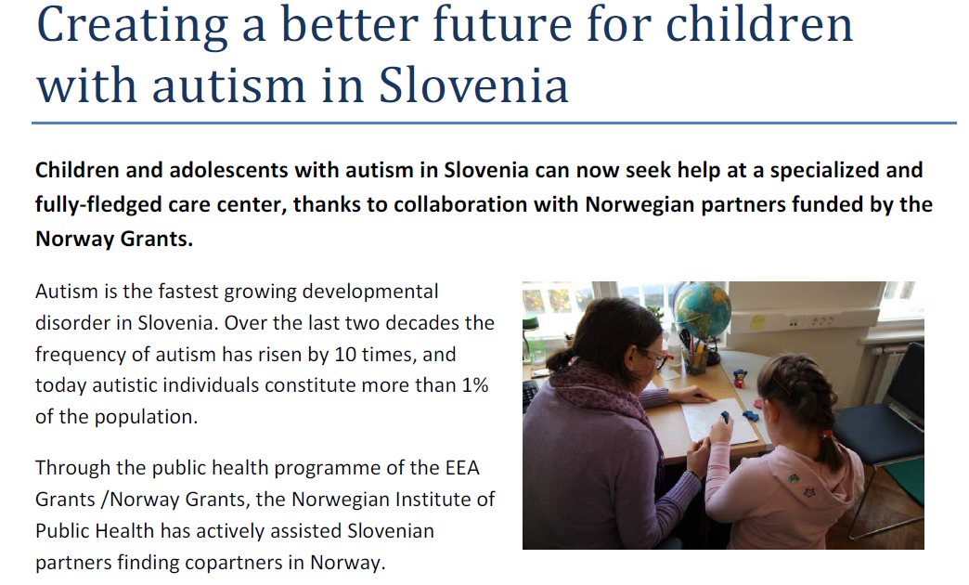

Slide 15
EEA Conference in Oslo
Target audience – Norwegian partners
Main focus – exchange of experiences
Good examples from the beneficiary states are welcome

Slide 16

Thank you

