Slide 1
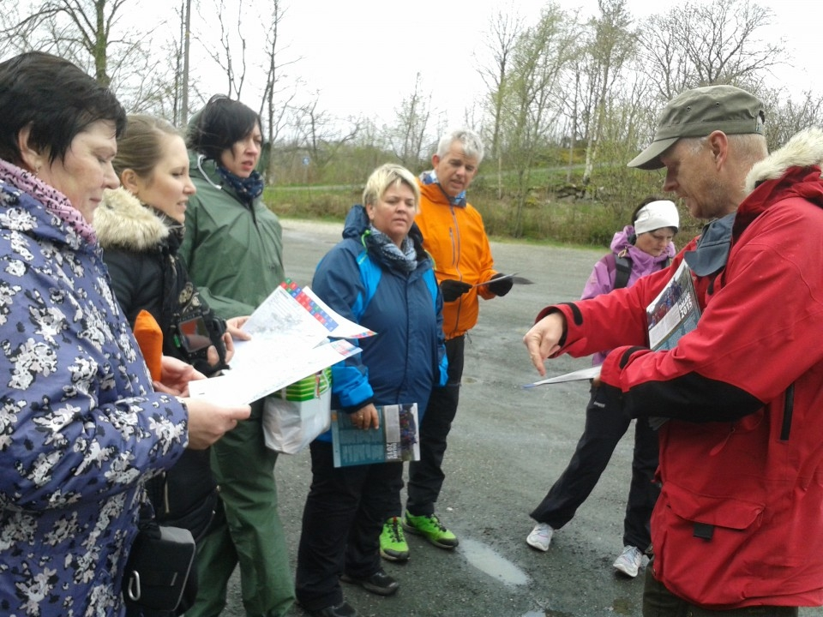
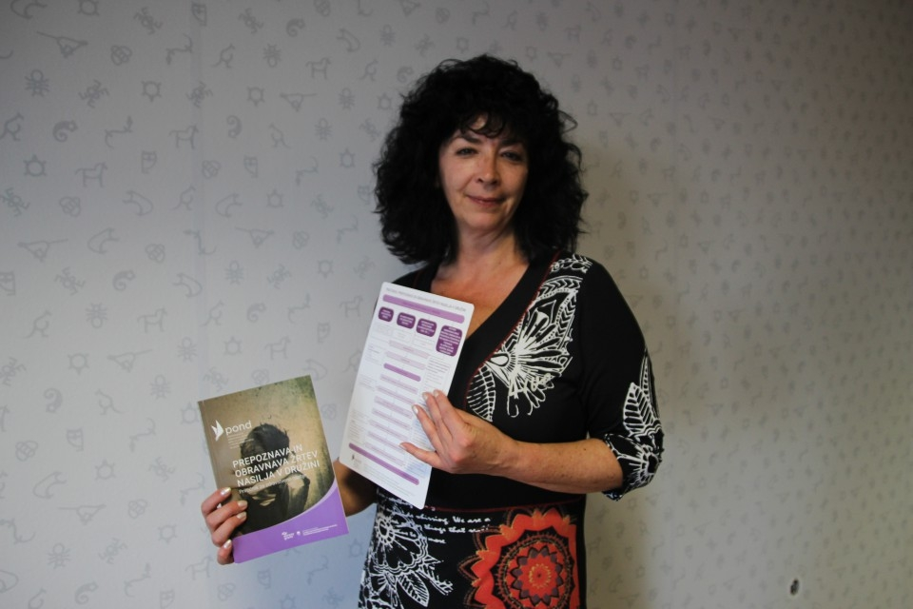
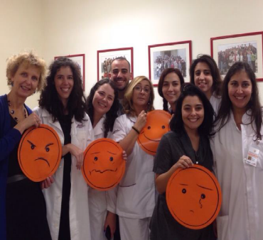
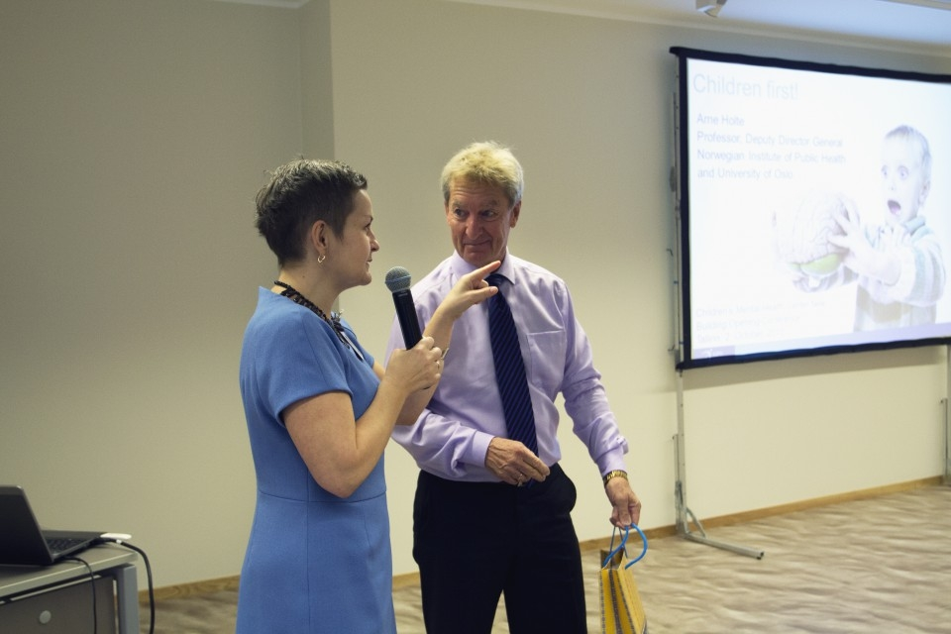
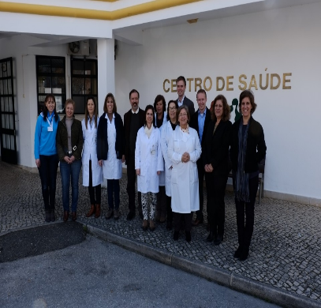
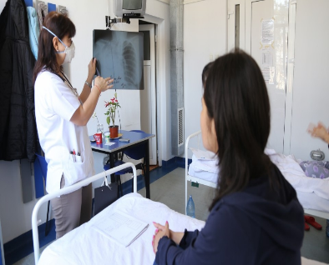
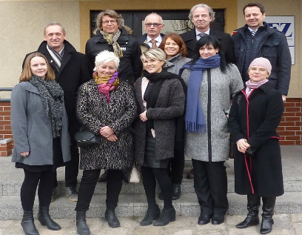
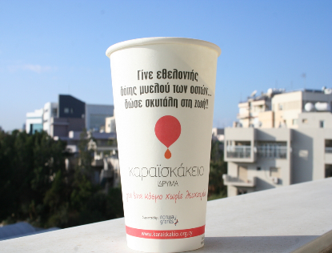
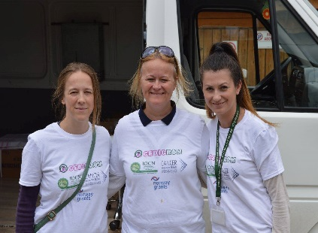
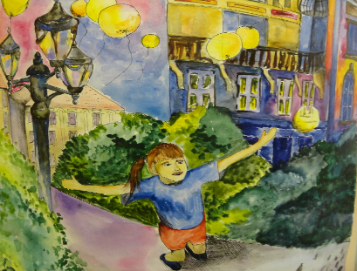
Public health initiatives programmes - achievements and challenges
Prague December 2015

Slide 2
Achievements public health initiatives programmes
All projects selected
All projects under implementation
Significant progress towards targets
Projects stories developing

Slide 3
State of play
June
2015
15 calls
4 SGS
25 PDPS
160 projects in DoRIS
December 2015
15 calls
4 SGS
26 PDPs
280 projects in DoRIS

Slide 4
11 programmes
€184.1 million net allocation
6 programmes with DPPs
HDIR and NIPH
Bilateral funds at programme level
€3 million
66 projects with Donor partners

Slide 5
How to communicate results*
Ways of communicating results - infographics
Ad hoc collection of data between annual Reports show significant progress towards targets
Expected results
*Non-official data – only preliminary indicative results

Slide 6
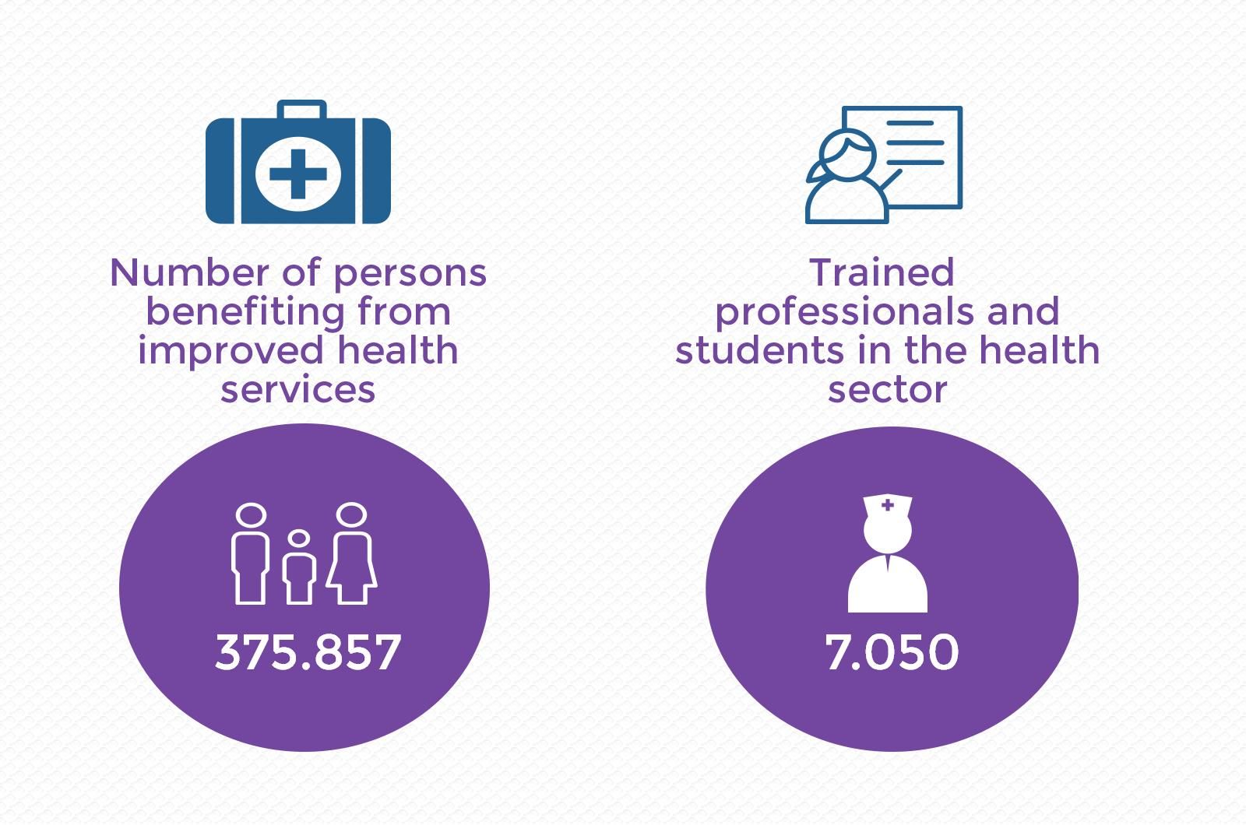

Slide 7
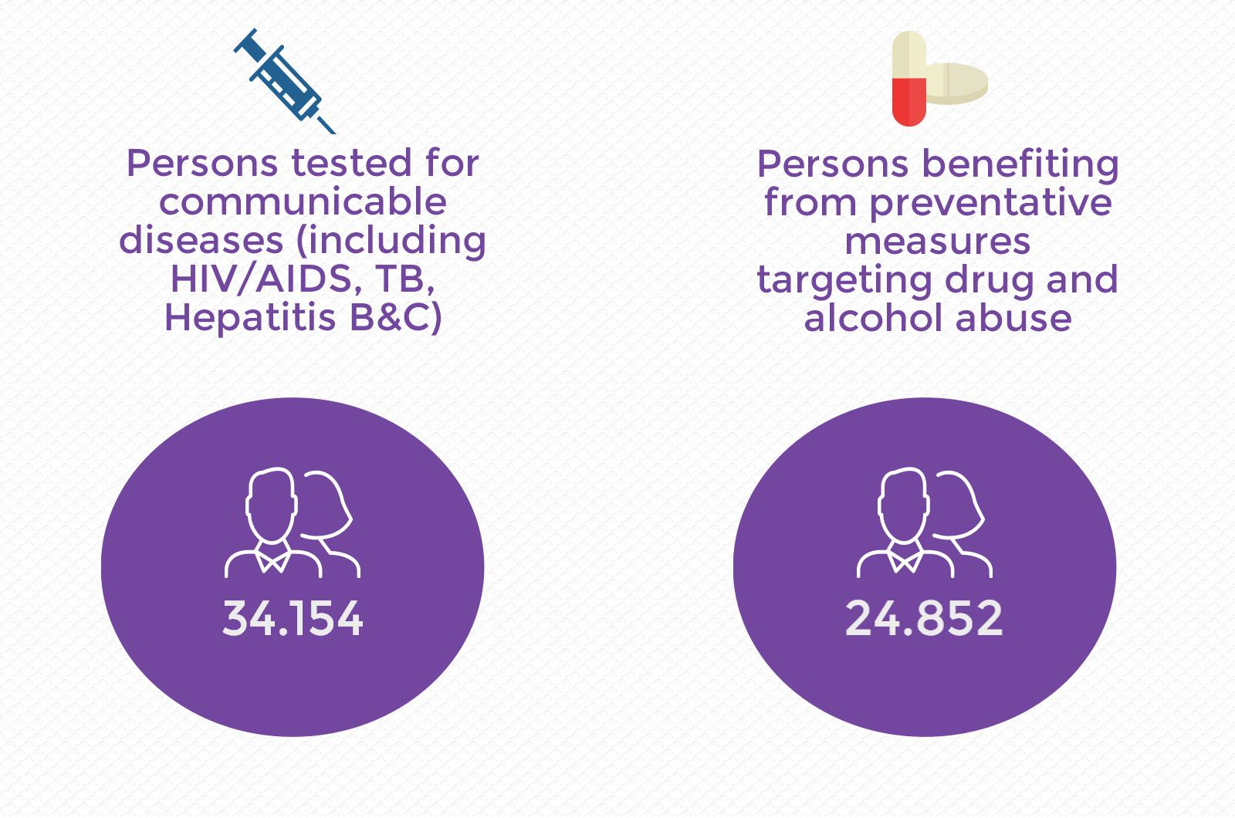

Slide 8
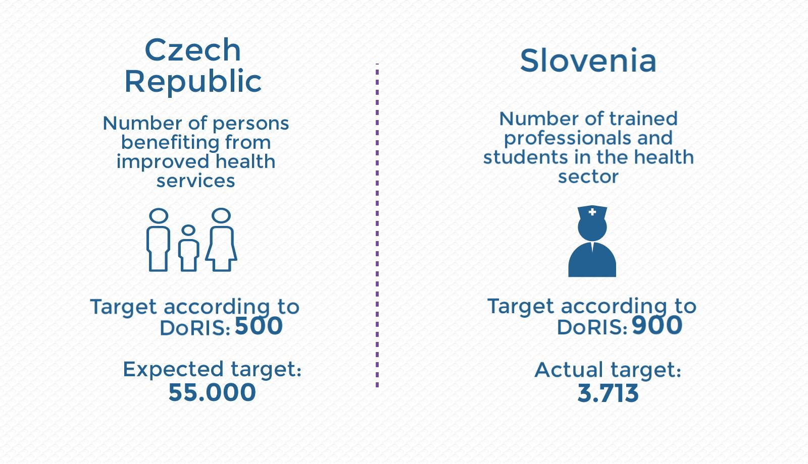

Slide 9
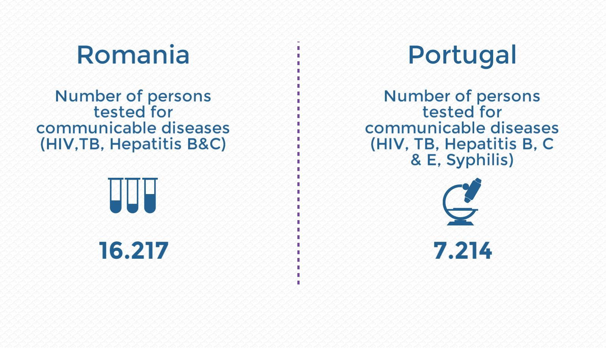

Slide 10
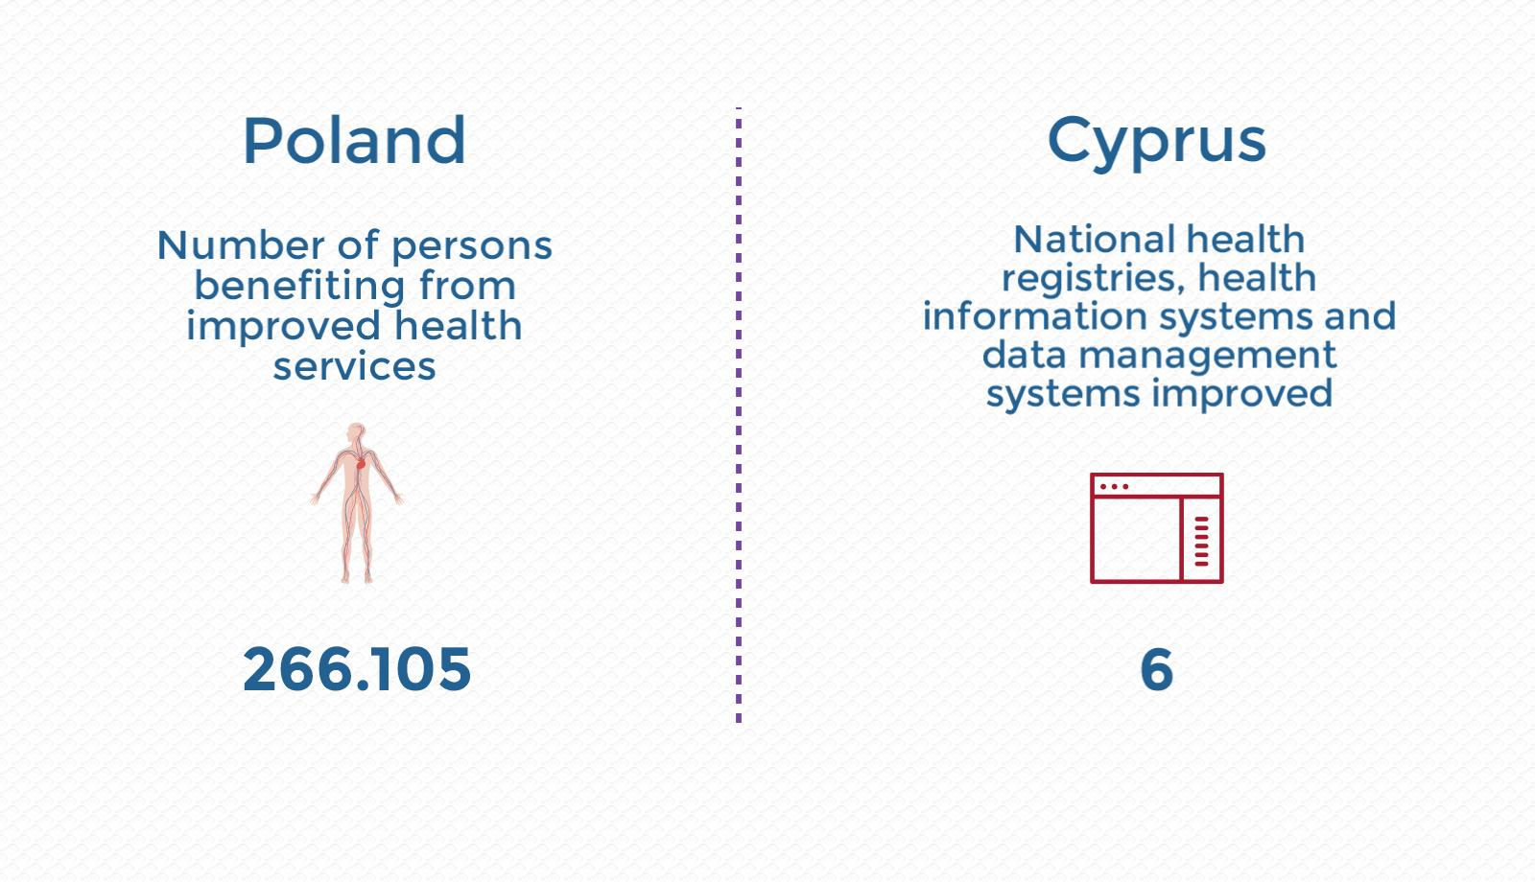

Slide 11
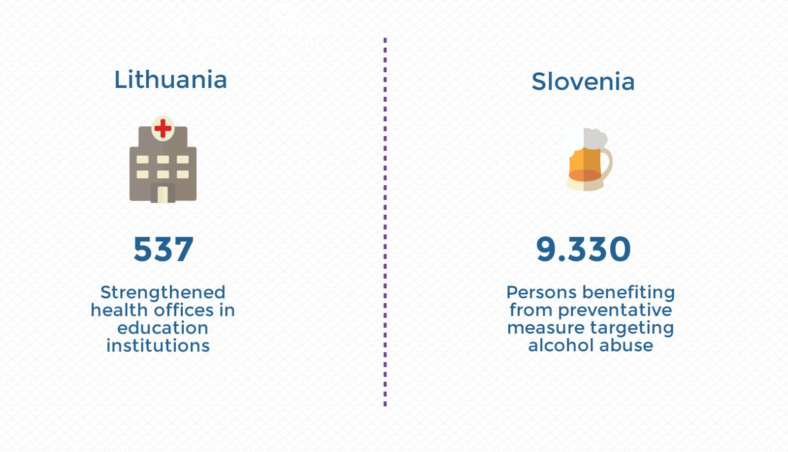

Slide 12
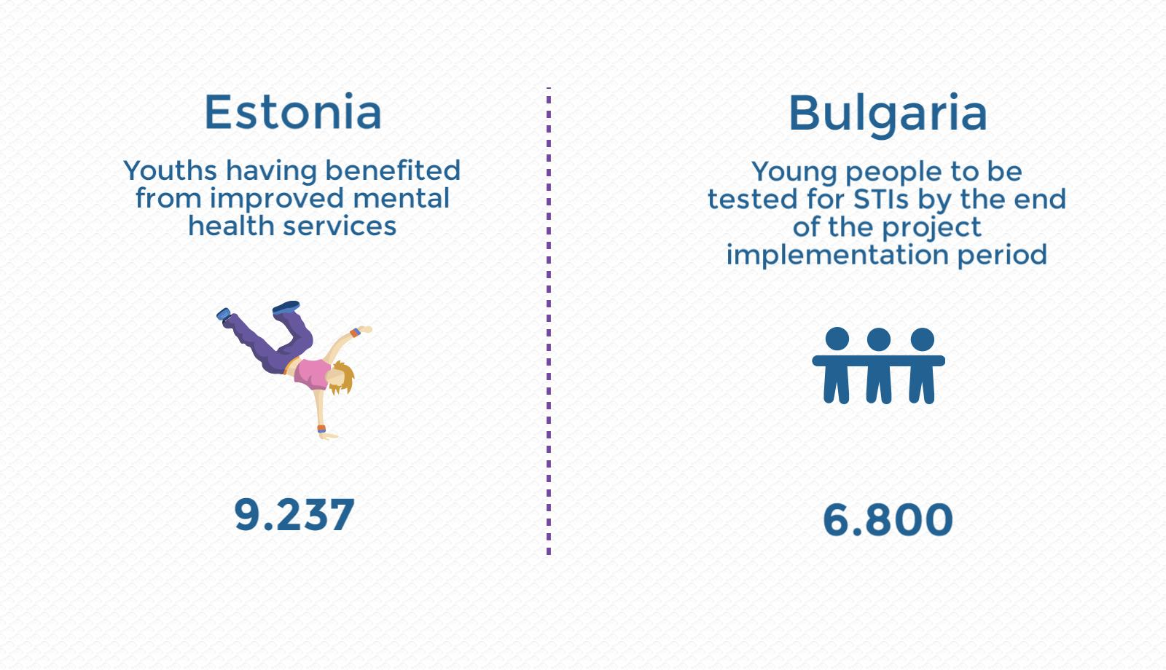

Slide 13
Challenges
Disbursement rates bilateral funds
Time
Communicating results and telling the stories
Evaluating results and lessons learned

Slide 14
Disbursement Rate
Bilateral Fund Health
December 2015

Slide 15
Number of projects with partners in Donor States

Slide 16
Comparison of number of projects by sector code

Slide 17

Telling the stories!
We need your input!

Slide 18
Next period
Regulation and programme-menu – public consultation
MoUs with each country-negotiations with the beneficiary countries
Proposals- from the beneficiary countries –Donors approval
Calls and selection by beneficiary countries
Negotiations with the EU

Slide 19
www.eeagrants.org
www.facebook.com/EEANorwayGrants
www.twitter.com/EEANorwayGrants
www.youtube.com/EEANorwayGrants

