Slide 1
PL 07 Development and better adaptation of health care to demographic and epidemiological trends
POLAND
Małgorzata Zadorożna, Deputy Director, Ministry of Health
Overview of the programmes in PA13 & PA27, EEA & Norway Grants 2009-2014

Slide 2
Supported activities
  Amelioration of perinatal care – preventive services, diagnostics and treatment with a view to increase the number of births
  Better adaptation of health care system in order to meet the needs of fast-growing population of chronically-ill and dependant elderly persons
  Cancer prevention aimed at reducing cancer morbidity and mortality indicator in Poland

Slide 3
Supported activities
number of projects according the scope of intervention
  amelioration of perinatal care - 9
  better adaptation of health care system - 23
  cancer prevention - 5

Slide 4
Specific selection criteria
(in the area of public health
initiatives)
Two stage assesment employed during calls - formal review and content-related appraisal
Formal review was carried out by the Formal Review Team (internal).
Content-related appraisal of each application was carried out by the Content-Related Appraisal Team (external experts).
Two separate sets of selection criteria.

Slide 5
Selection procedure
One call hase been announced – lasted between 15.03.2013 – 28.06.2013
Astonished by response – 585 applications submitted
The ranked list of applications was submitted to the Selection Committee.
The Committee reviewed the ranked list and presented a list of recommended projects to the Programme Operator
Project agreements have been signed

Slide 6
Results
  The implementation of 37 projects, which is carried out throughout the country including rural areas, has already started. Most projects are pursued in the Malopolska Province and Wielkopolska Province (7 in each)
  Projects with partners – 4
  Project entitled: „Enlargement and reconstruction of building No.10 designed for elderly and chronically ill patients” is being implemented in partnership with a Norwegian entity (hospital owned by a non-profit organisation)

Slide 7
Story
Parents in Lodz region gained tangible support in the most difficult of times
First in central Poland, second nationwide Perinatal Palliative Care Center has been established with the use of Norwegian grants.
Parents of children with lethal disorders may expect
a multidisciplinary assistance including psychological care, at the privacy of their homes or at the stationary hospice.
What is more, funding provided contributes to enhancement of professionalism of healthcare by offering Perinatal Palliative Care trainings and workshops to the medical staff.

Slide 8
PL 13 Reducing social inequalities in health
POLAND
Overview of the programmes in PA27, Norway Grants 2009-2014

Slide 9
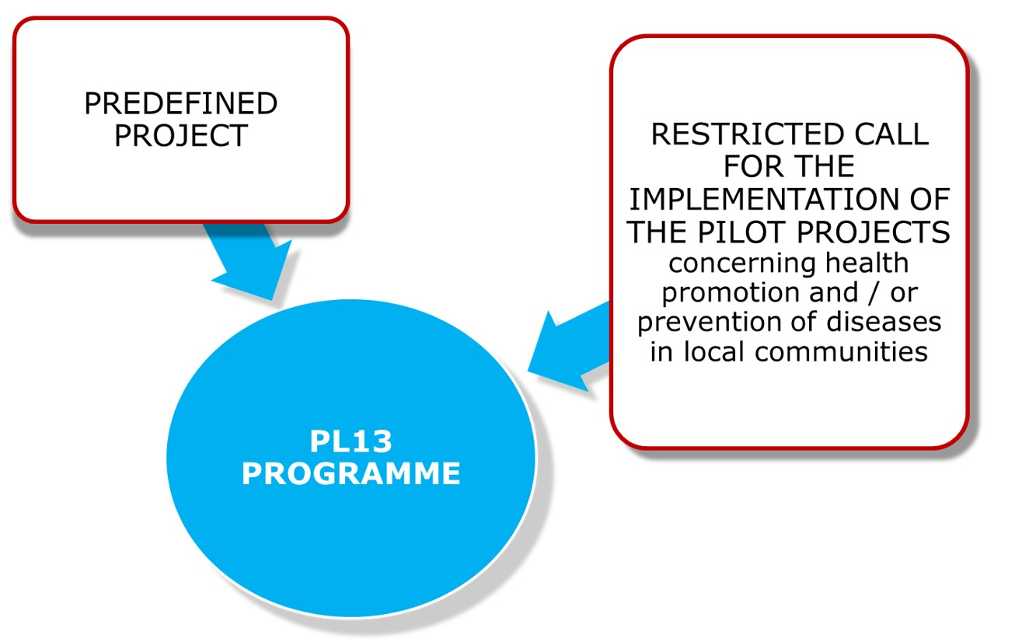
Supported activities

Slide 10
Supported activities
TITLE: Reducing social inequalities in health
AIM: Improvement of health and health-related quality of life of the population and reduction of inequalities in health.
Outcomes:
    -Cross-sectoral strategy for reducing social inequalities in health
    -Public health trainings
-Models and reports
-Pilot projects

Slide 11
Supported activities
The Predefined Project will contribute to:
  future improvement of population health status,
  reduction of health inequalities triggered by social factors,
  improvement of governance in health.

Slide 12
Supported activities
PILOT PROJECTS:
In the restricted call for pilot-projects proposals there was a possibility to apply for financing the implementation of community-based health promotion and/or disease prevention pilot-projects consisting of:
  - preventive programmes and/or,
  - educational actions on health topics.

Slide 13
Supported activities
ELIGIBLE APPLICANTS:
Local goverment units – poviats, with the highest standardized mortality rates (SMRs) in a three-year period 2009-2011, identified in the following categories:
  all causes of death;
  malignant neoplasm;
  cardiovascular disease;
  respiratory system disease;
  digestive system disease;
  external causes of death.

Slide 14
Specific selection criteria
(in the area of public health
initiatives)
Two stage assesment employed during calls - formal review and content-related appraisal
Formal review was carried out by the Formal Review Team (internal).
Content-related appraisal of each application was carried out by the Content-Related Appraisal Team (external experts).
Two separate sets of selection criteria.

Slide 15
Selection procedure
  The restricted call for proposals in Programme PL13 lasted from 31 March 2014 till 02 June 2014.
  Grant amount for projects in the PL13:
  15 423 206 EUR
  Total number of submitted applications: 98
  1 application has been withdrawn by the Project Promoter before the start of formal appraisal
  Average project value: 2 603 054 PLN,
  i.e. 618 185 EUR

Slide 16
Results
The implementation of 26 Projects which is carried out throughout the country has already started. The biggest number of Projects (4) is implemented in the Mazovia Province.
Contracts between Beneficiaries and the Programme Operator were signed (one entity from the reserve list was chosen);
Programme Operator is veryfying 1st/2nd project payment claims

Slide 17
Results
  The number of projects according
  to the scope of main SMR to be tackled:
  malignant neoplasm - 7;
  cardiovascular disease - 12;
  respiratory system disease - 3;
  digestive system disease – 2;
  external causes of death – 2.

Slide 18
Story
10 teams of pre-school children with their parents have competed during the integration and activity day at a farm.
Many smiles have been seen during numerous games and open air activities at a mini zoo, on an educational ecological path, at a shooting range or during treasure hunting.
This event - an element of a Norway Grants project implemented in Pultusk poviat contributed to promotion of mental health of children and youngsters in the region.

Slide 19
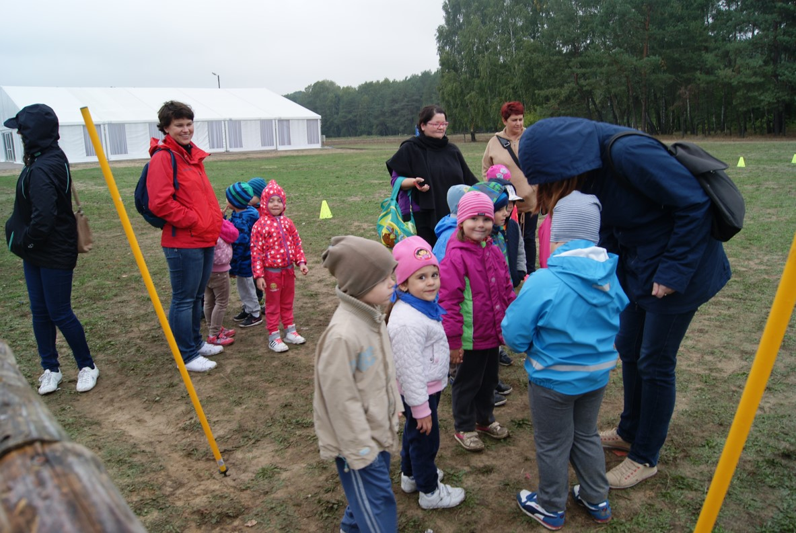
Story

Slide 20
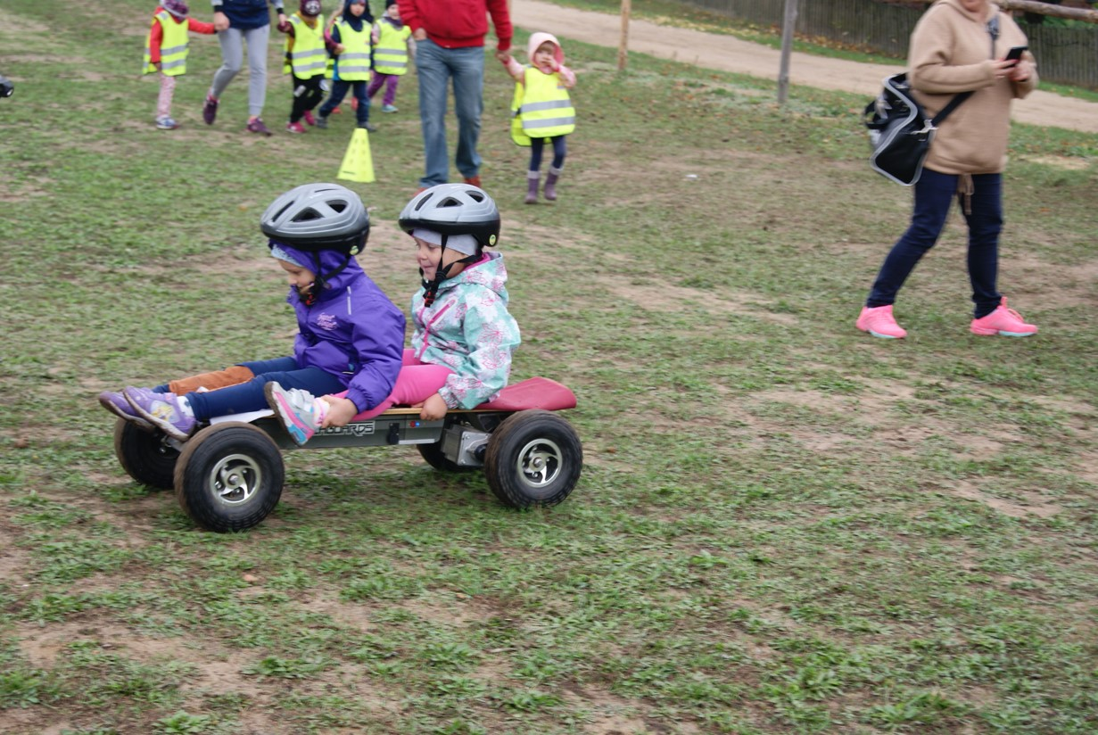
Story

Slide 21
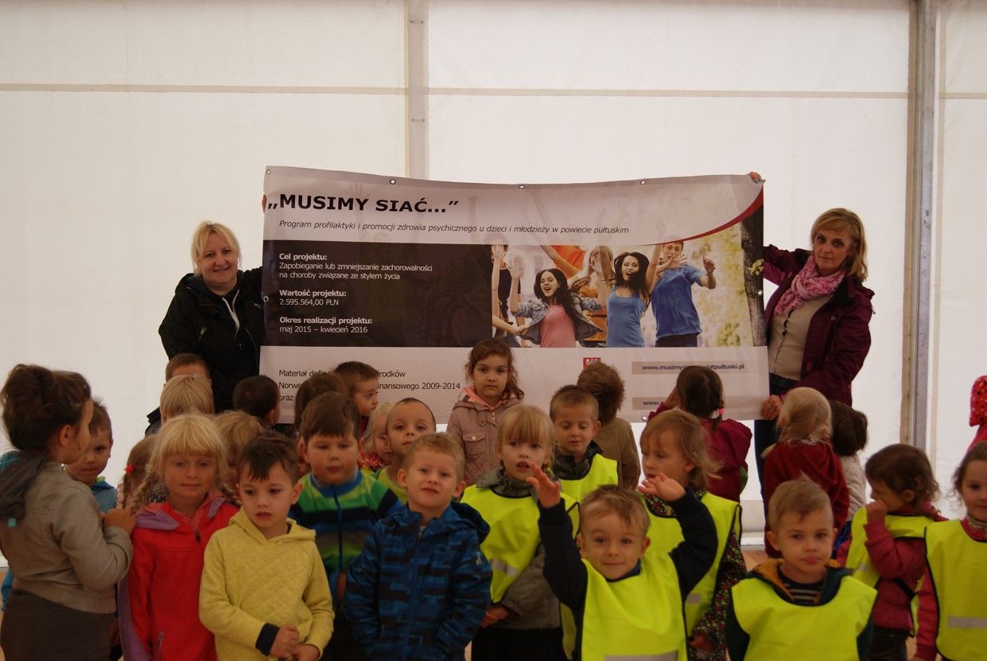
Story

Slide 22
More information
General webpage of EEA Grants, Norway Grants in Public Health Initiatives area:
http://zdrowie.gov.pl/strona-219-English_version_EEA_and_Norway_Grants_.html
Webpage devoted to the PL13 pre-defined project:
www.inequalities.mz.gov.pl
Webpage devoted to PL07 & PL13 Fund for Bilateral Relations:
http://fbr.zdrowie.gov.pl/fbr_zdrowie/index.php?page=start-en

