Slide 1
CY04-Norway Grants
Public Health Projects Cyprus
Petros Attas, Directorate General for European Programmes, Coordination and Development
Overview of the programmes in PA27, Norway Grants 2009-2014

Slide 2
Supported activities
Outcome: Reduced inequalities between user groups
The Cyprus Bone Marrow Registry
  Upgrading Infrastructure (IT and Laboratory Equipment)
  Facilitate Tissue Typing Process (↓ cost ,↑ analyses speed and volume => ↑ public health benefits)
  Update Bone Marrow Donor Registry (renew aging samples)
Translational Facility at the Cyprus Institute of Neurology and Genetics
  Purchase and Installation of Proteomics and Genomics Facilities (Introduction of new technology => ↓ cost, ↑ analyses speed and volume => ↑ public health benefits)
  Research (i. evaluation of new biomarkers for early detection and diagnosis, ii. protein analysis [products of genes] to discover molecules important in the development of complex diseases like cancer, iii. identify genetic causes)
  Evaluation of new diagnostic criteria (identifying the exact genetic causes of disorders)

Slide 3
Specific selection criteria
(in the area of public health
Initiatives)
Improve Public Health
Reduce inequalities in health through increased access
Bi-communal inclusion (increased access for patients and scientists from all communities)
Bi-lateral cooperation (knowledge transfer)

Slide 4
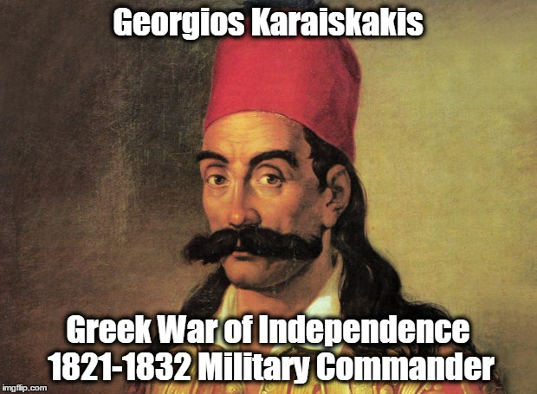
Story: The Evolution of the Cyprus Bone Marrow Registry: “Karaiskakio Foundation”
Where does the name come from? What does it mean?
Is it from this man? A famous military commander and hero rebel of the Greek War of Independence?

Slide 5
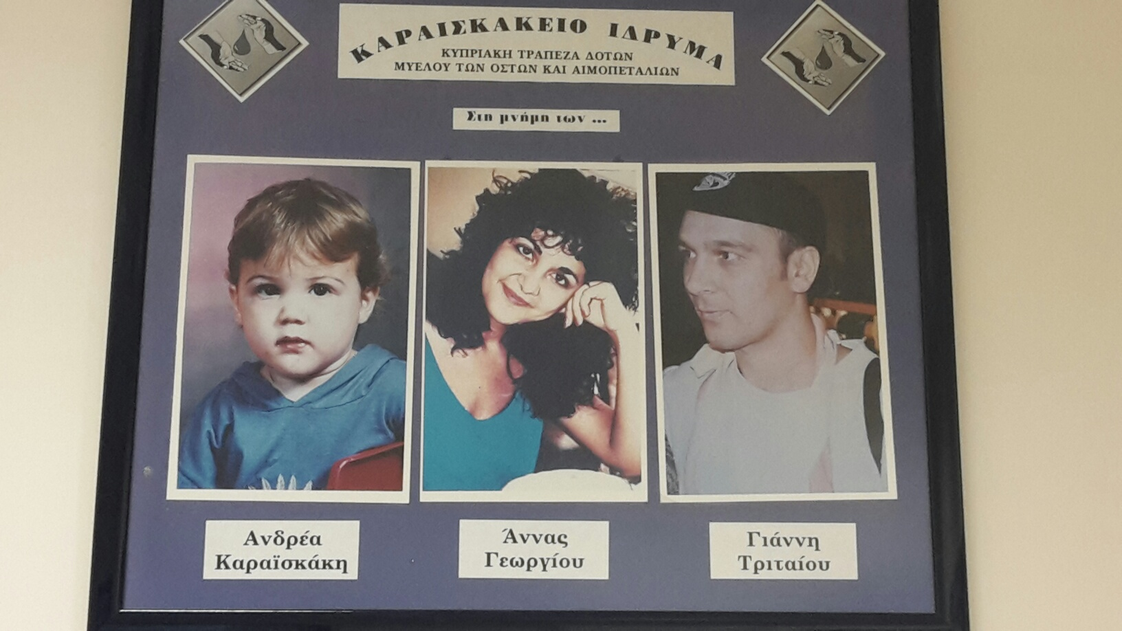
No more lives lost due to leukemia…need to take action
How did the Cyprus Bone Marrow Registry evolve?
1993 – Momentum for addressing the need for a Cyprus Bone Marrow Registry by the cases of three leukemia patients:
Yiannis Triteos
(UK expatriate)
Anna Georgiou
(UK expatriate)
Andreas Karaiskakis
(5-year old son of Michalis and Katerina Karaiskaki)

Slide 6
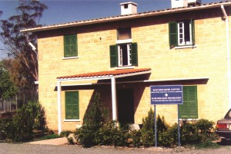
From this small House…
Family of Andreas Karaiskakis, donates the money gathered for their son’s bone marrow transplant (£60.000), towards the cause of organizing a bone marrow donor registry in Cyprus. The Foundation which undertook to implement this was thus named "Karaiskakio Foundation" in memory of Andreas Karaiskakis.
1995: Foundation accommodated in an old house used by the British forces back in the 1950s, with three people employed initially, who, accompanied by doctors of the hematological department of the General Hospital, were travelling through towns and villages in an effort to create public awareness and to register volunteer bone marrow donors.

Slide 7

With the courage of this family…
Michalis Karaiskakis: The Referee who “favored” humanity

Slide 8
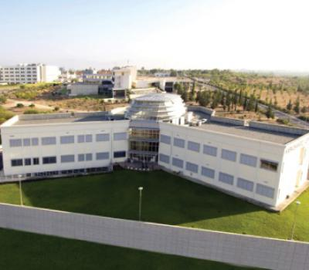
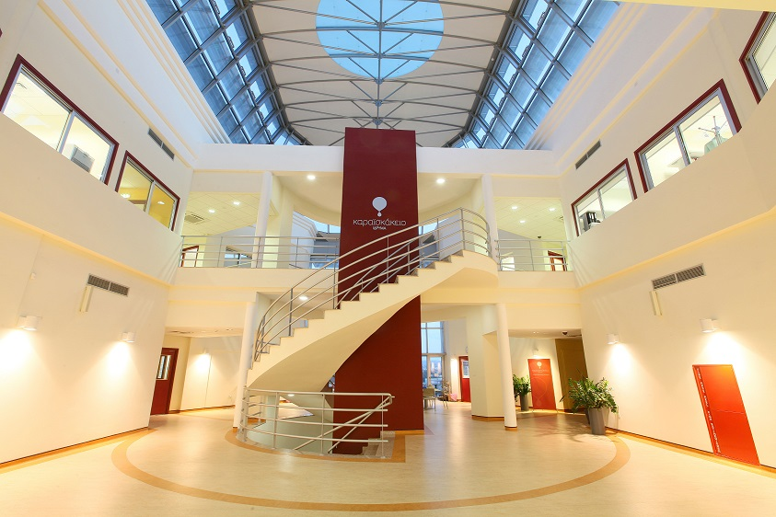
To The New Premises ……
2011: New Premises

Slide 9
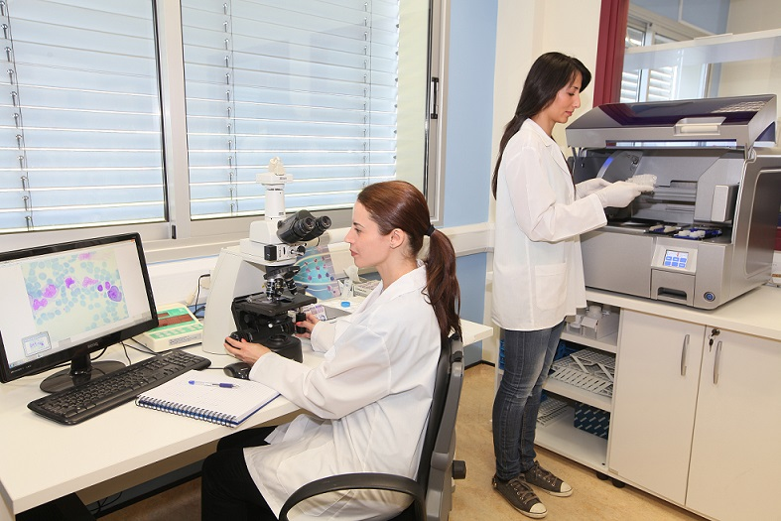
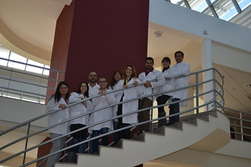
To The New Premises ……
2011: New Premises

Slide 10
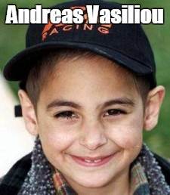
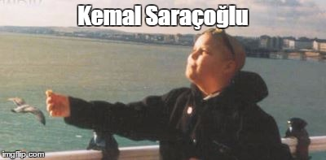
A series of inspiring stories… humanity overcomes politics
2000: Cases of 12-year old Kemal Saracoglou and 6-year old Andreas Vasiliou, two children suffering from leukemia, a Turkish Cypriot and Greek Cypriot prompted more than 50,000 people, from both communities, to provide blood samples and register as volunteer donors. The two boys became symbols of peace and cooperation.

Slide 11
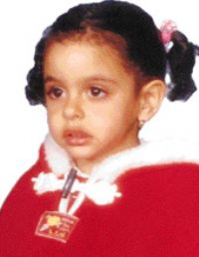
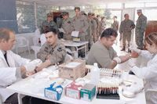
A series of inspiring stories… humanity overcomes politics
2002: case of 5-year old leukemia patient Jale Sakaoğlu sparks another blood sample campaign, with more than 15.000 samples gathered from both communities.
Republic of Cyprus National Guard members providing blood samples for Jale Sakaoğlu
Jale Sakaoğlu

Slide 12
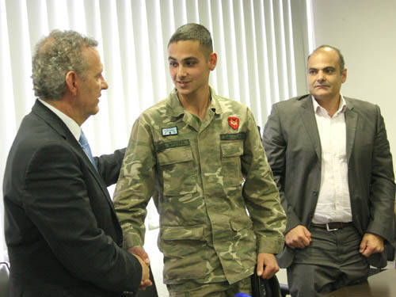
A series of inspiring stories… humanity overcomes politics
2013: case of 5-year old leukemia patient Giorgos Phileppides gathers more than 20.000 samples. “The Cyprus Bone Marrow Registry” Project supported by Norway Grants initiated beginning of year. One of the goals was to attract 2000 potential donors. Goal achieved.
Appeal for donors made by Andreas Vasiliou (one of the two boys from 2000 campaign) and his family while serving in the National Guard

Slide 13
Some interesting facts…
Facts and figures
Today 128.520 Greek and Turkish Cypriot volunteers (1 out of 3 Cypriots within the age of 35-45) are registered, making the Cyprus Bone Marrow Registry the largest bone marrow registry globally, by percentage of population!
Turkish Cypriot database has been updated and all necessary information, forms etc have been translated in Turkish and English through the funds provided by Norway Grants
A total of 317 donors have provided grafts to 26 different countries. In 2015 alone, the CYBMR has provided 29 grafts to patients from 12 different countries.
Finding a compatible donor is often challenging; only people in good health between the ages of 18 to 45 eligible. Chances of compatibility reduced when patients cannot find a donor among close family members. The island’s genetically heterogeneous population adds to the challenge of matching patients with donors. Because tissue types are inherited, having donors from diverse backgrounds increases the likelihood that the patient will find a life-saving match.

Slide 14
More information
Featured article on eeagrants.org
http://eeagrants.org/News/2014/Saving-Cypriot-lives-over-a-cup-of-coffee
Karaiskakio Foundation website
http://karaiskakio.org.cy
Cyprus Institute of Neurology and Genetics website
http://www.cing.ac.cy

